Slide 1
MRS Slidepack
Norsk Nyreregister

Slide 2
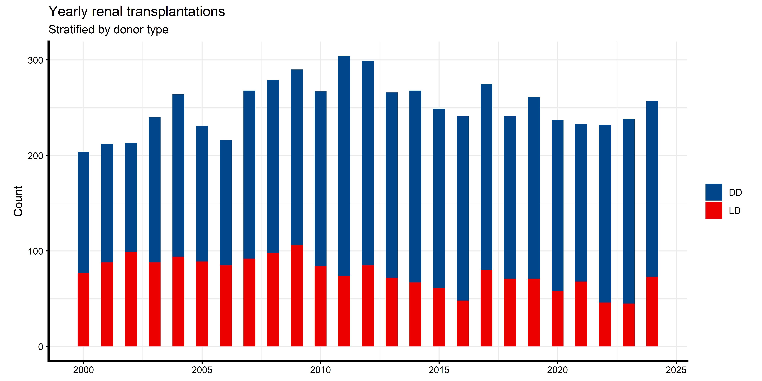
Yearly renal transplantations (including SPK)

Slide 3
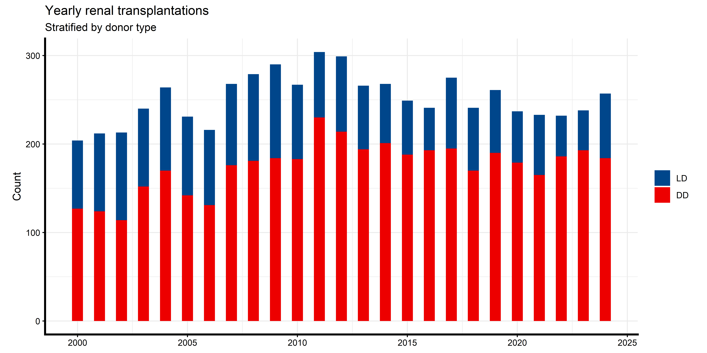

Slide 4
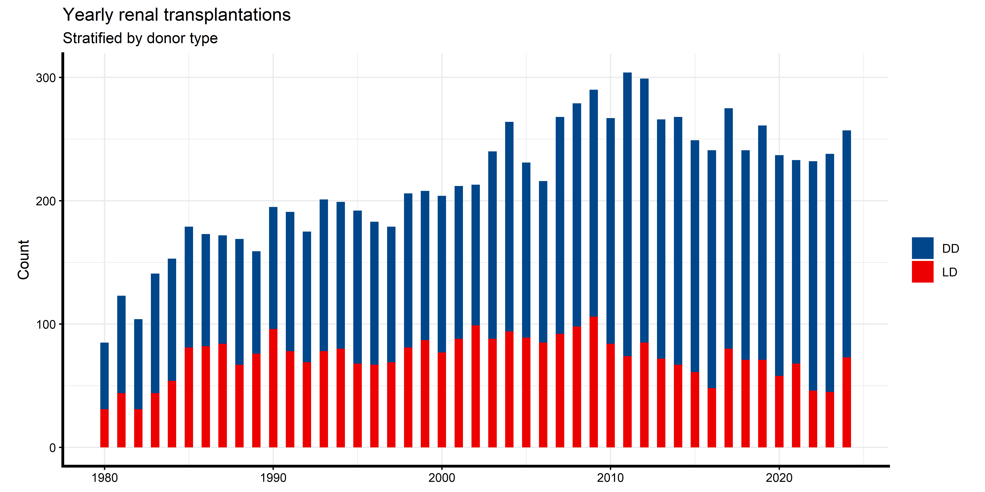

Slide 5
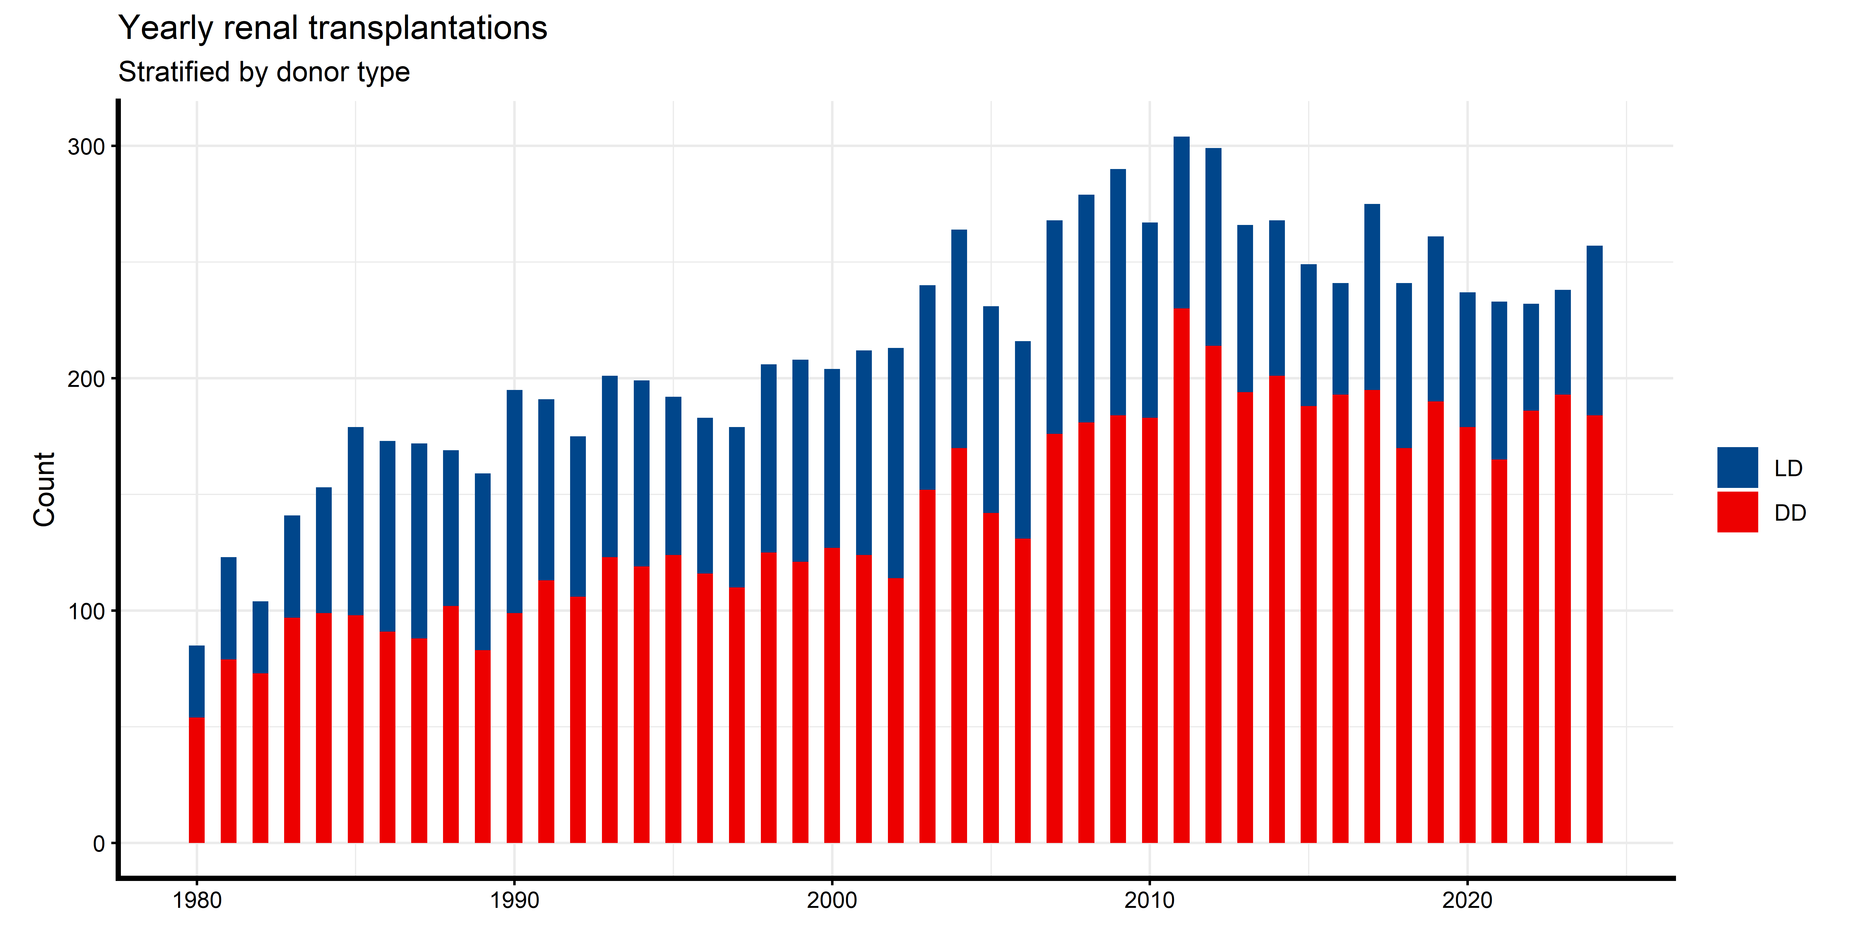

Slide 6
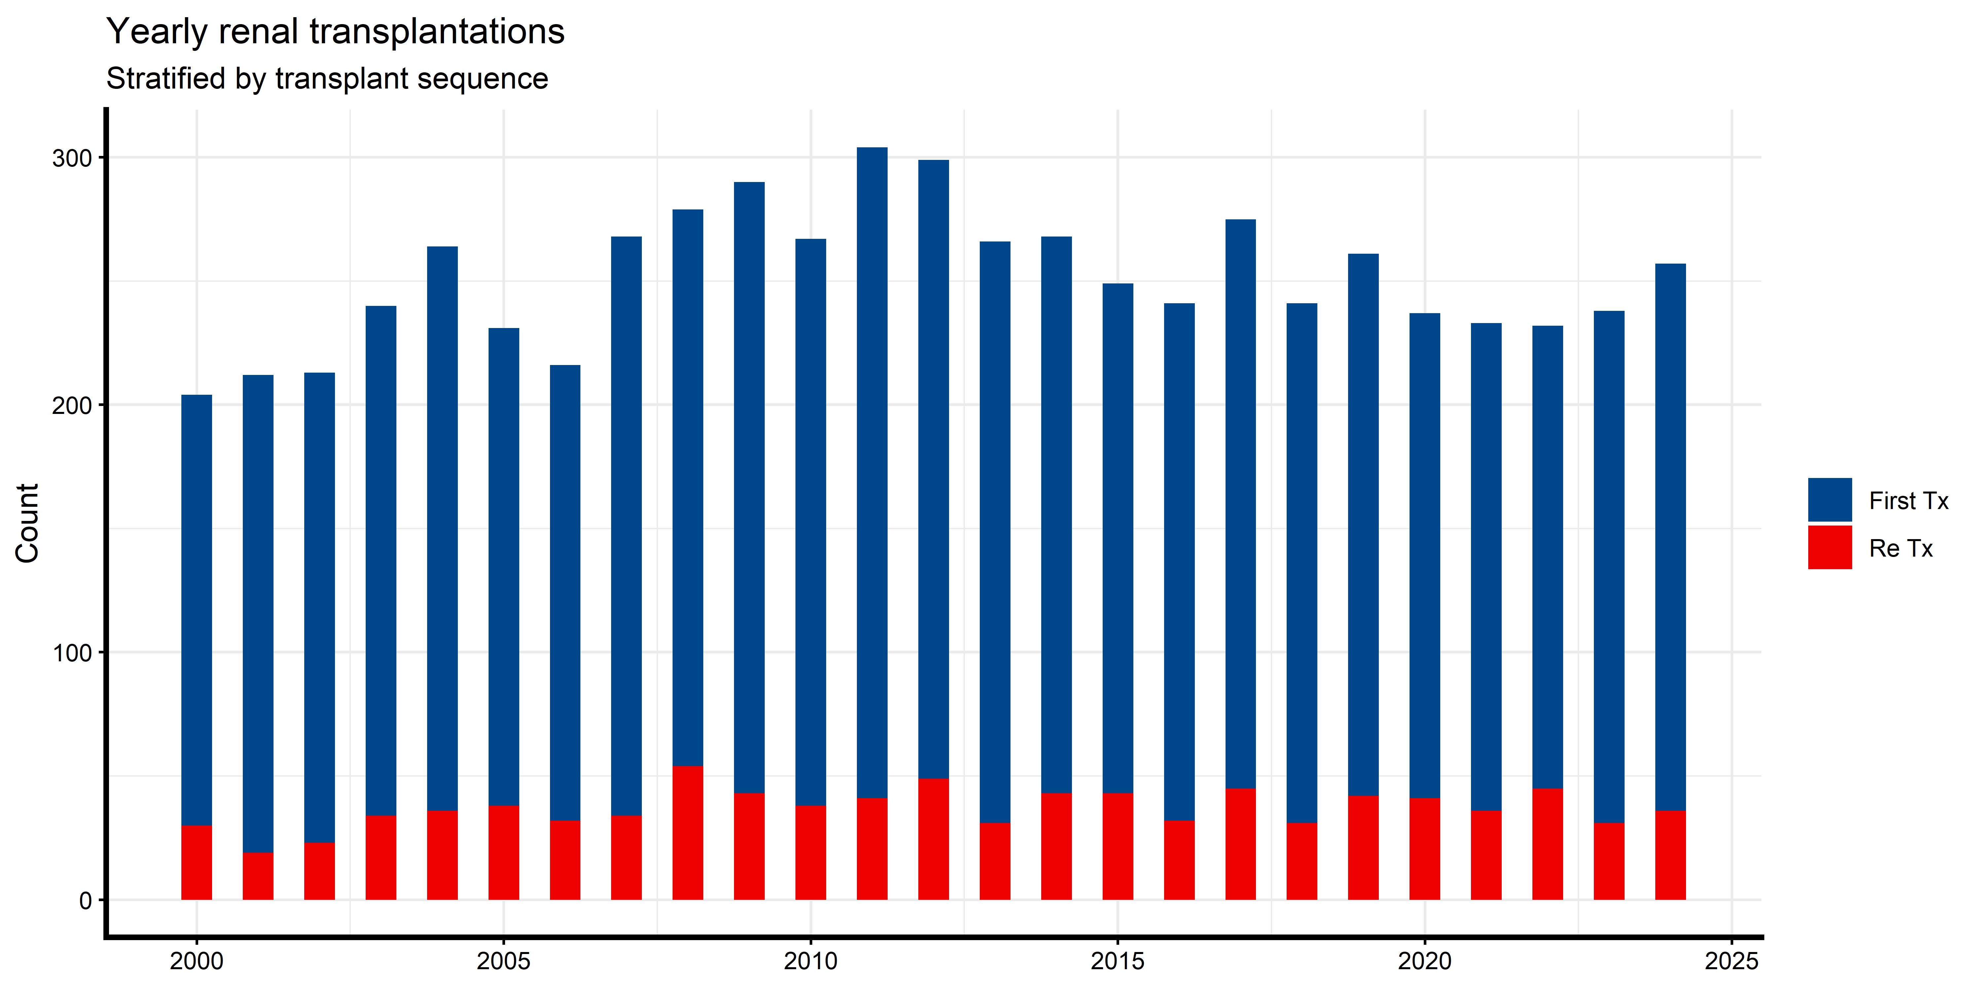
Yearly renal transplantations (first vs reTx)

Slide 7
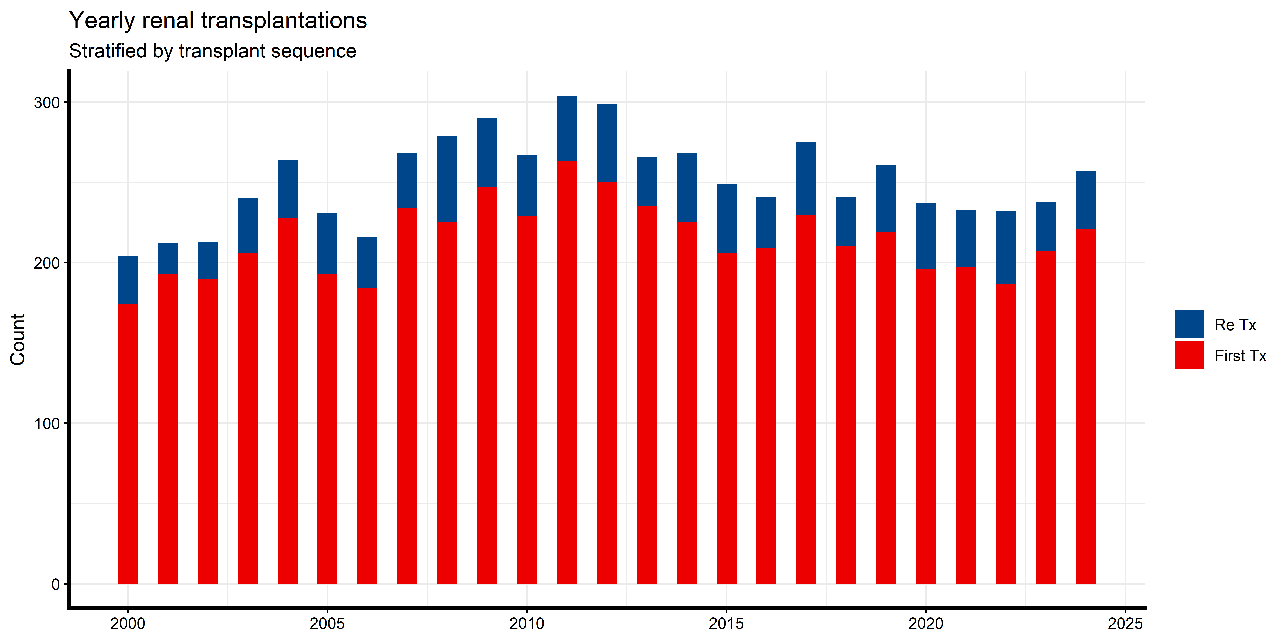

Slide 8
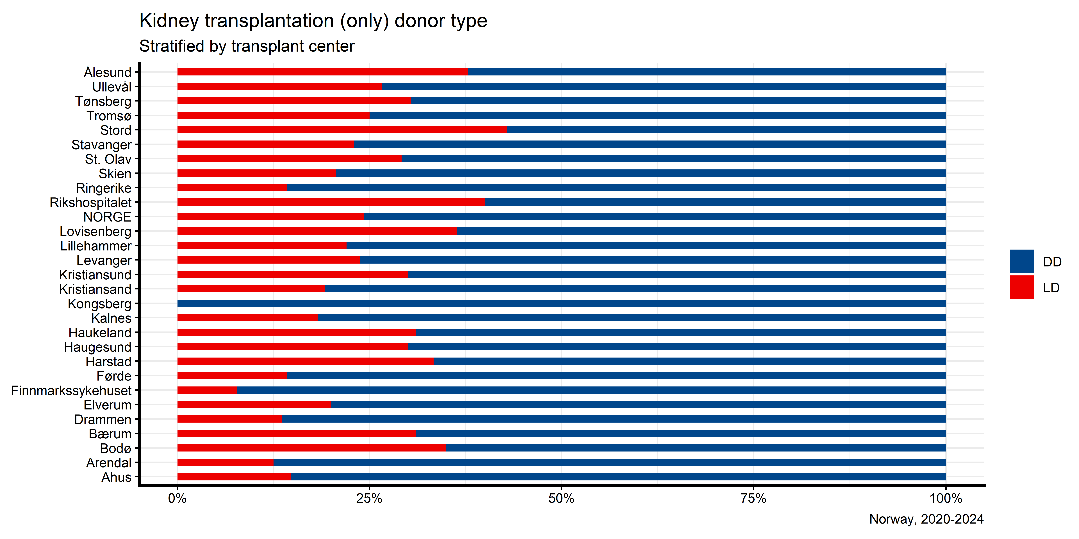
Fraction LD/DD by center (last 5 years)

Slide 9
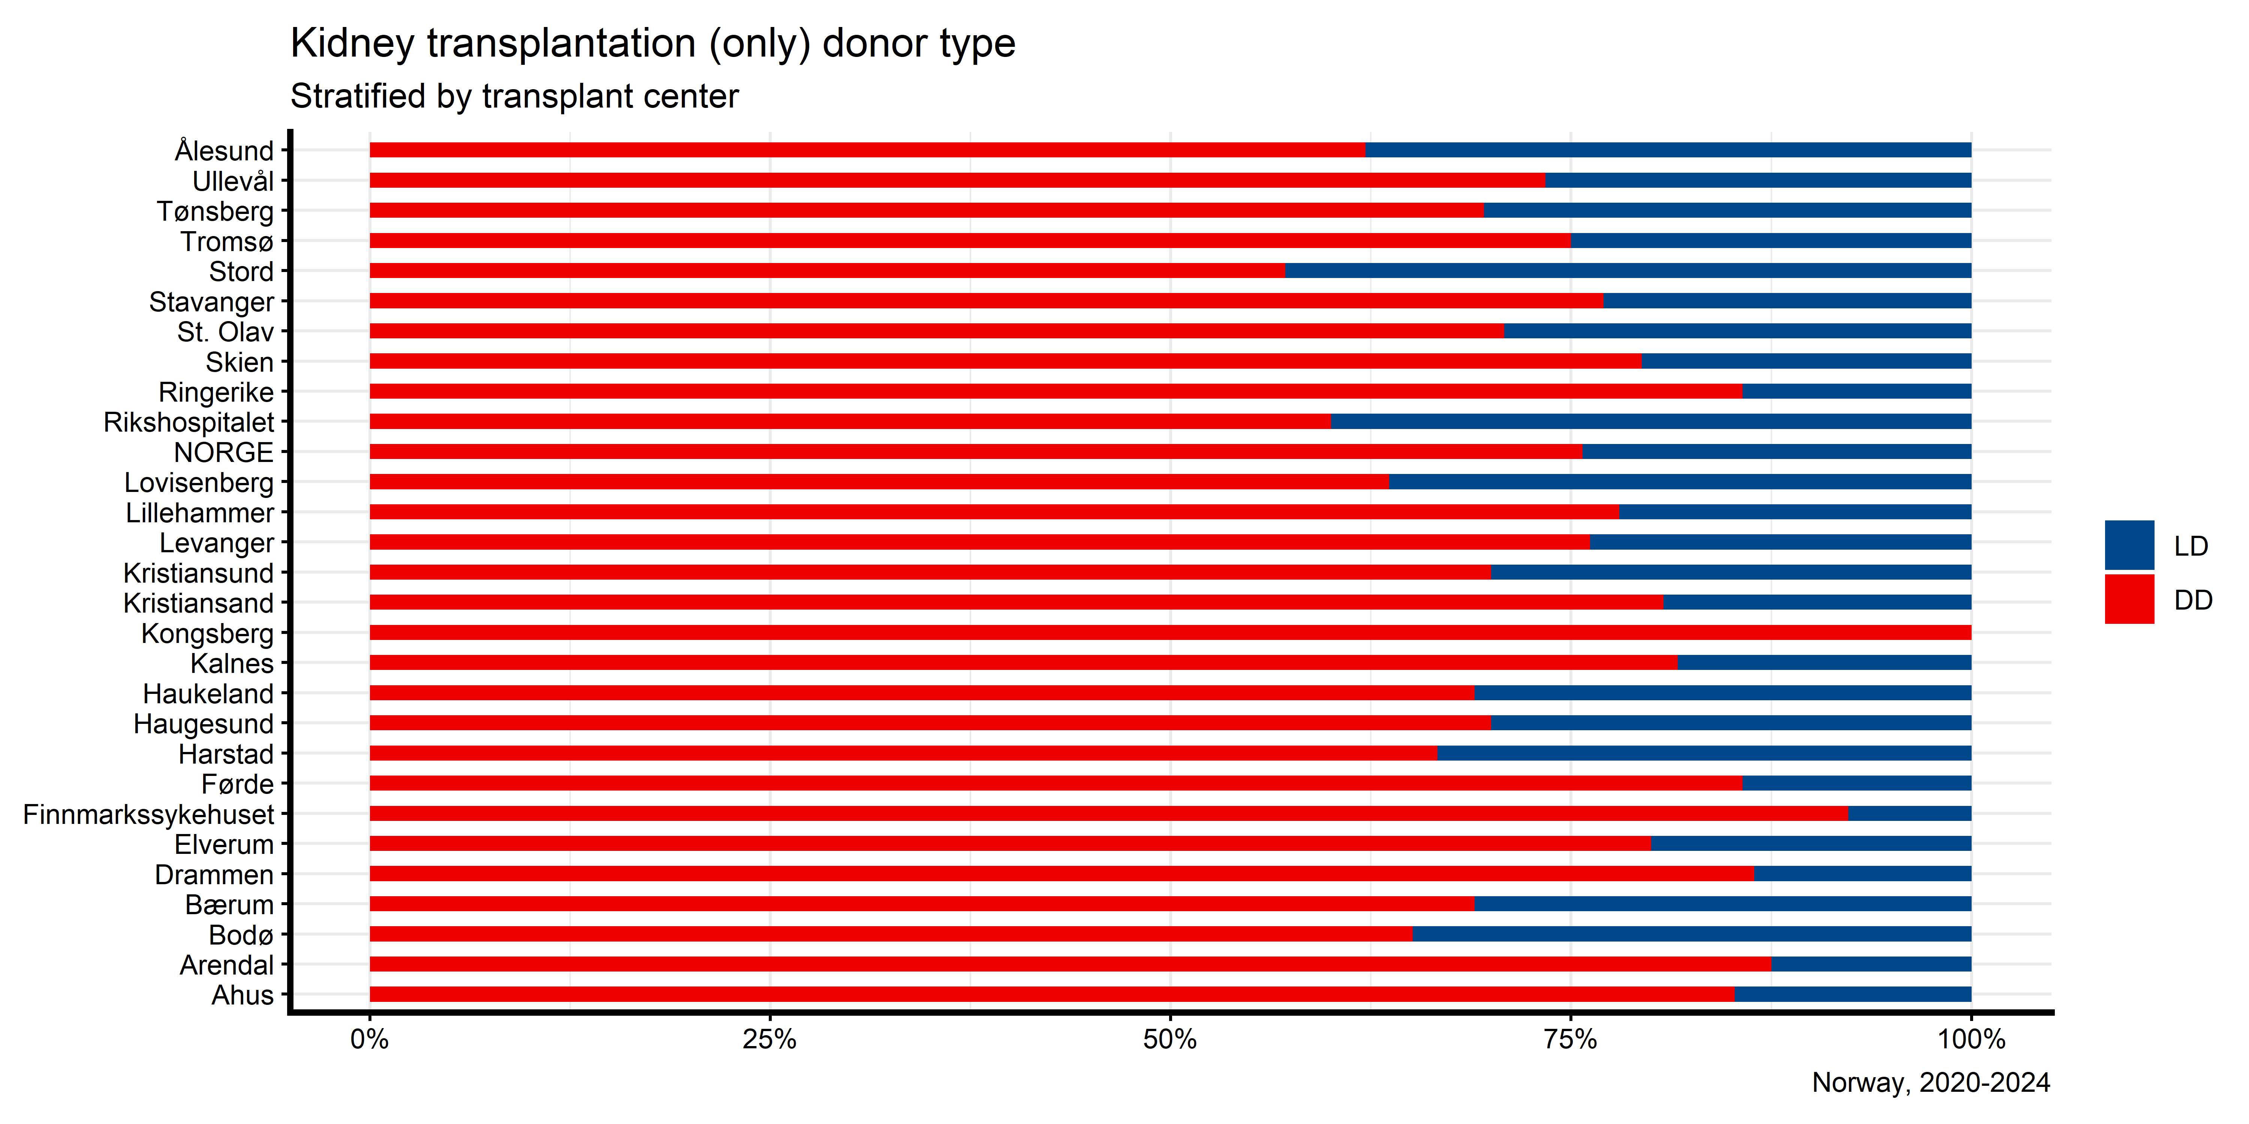

Slide 10
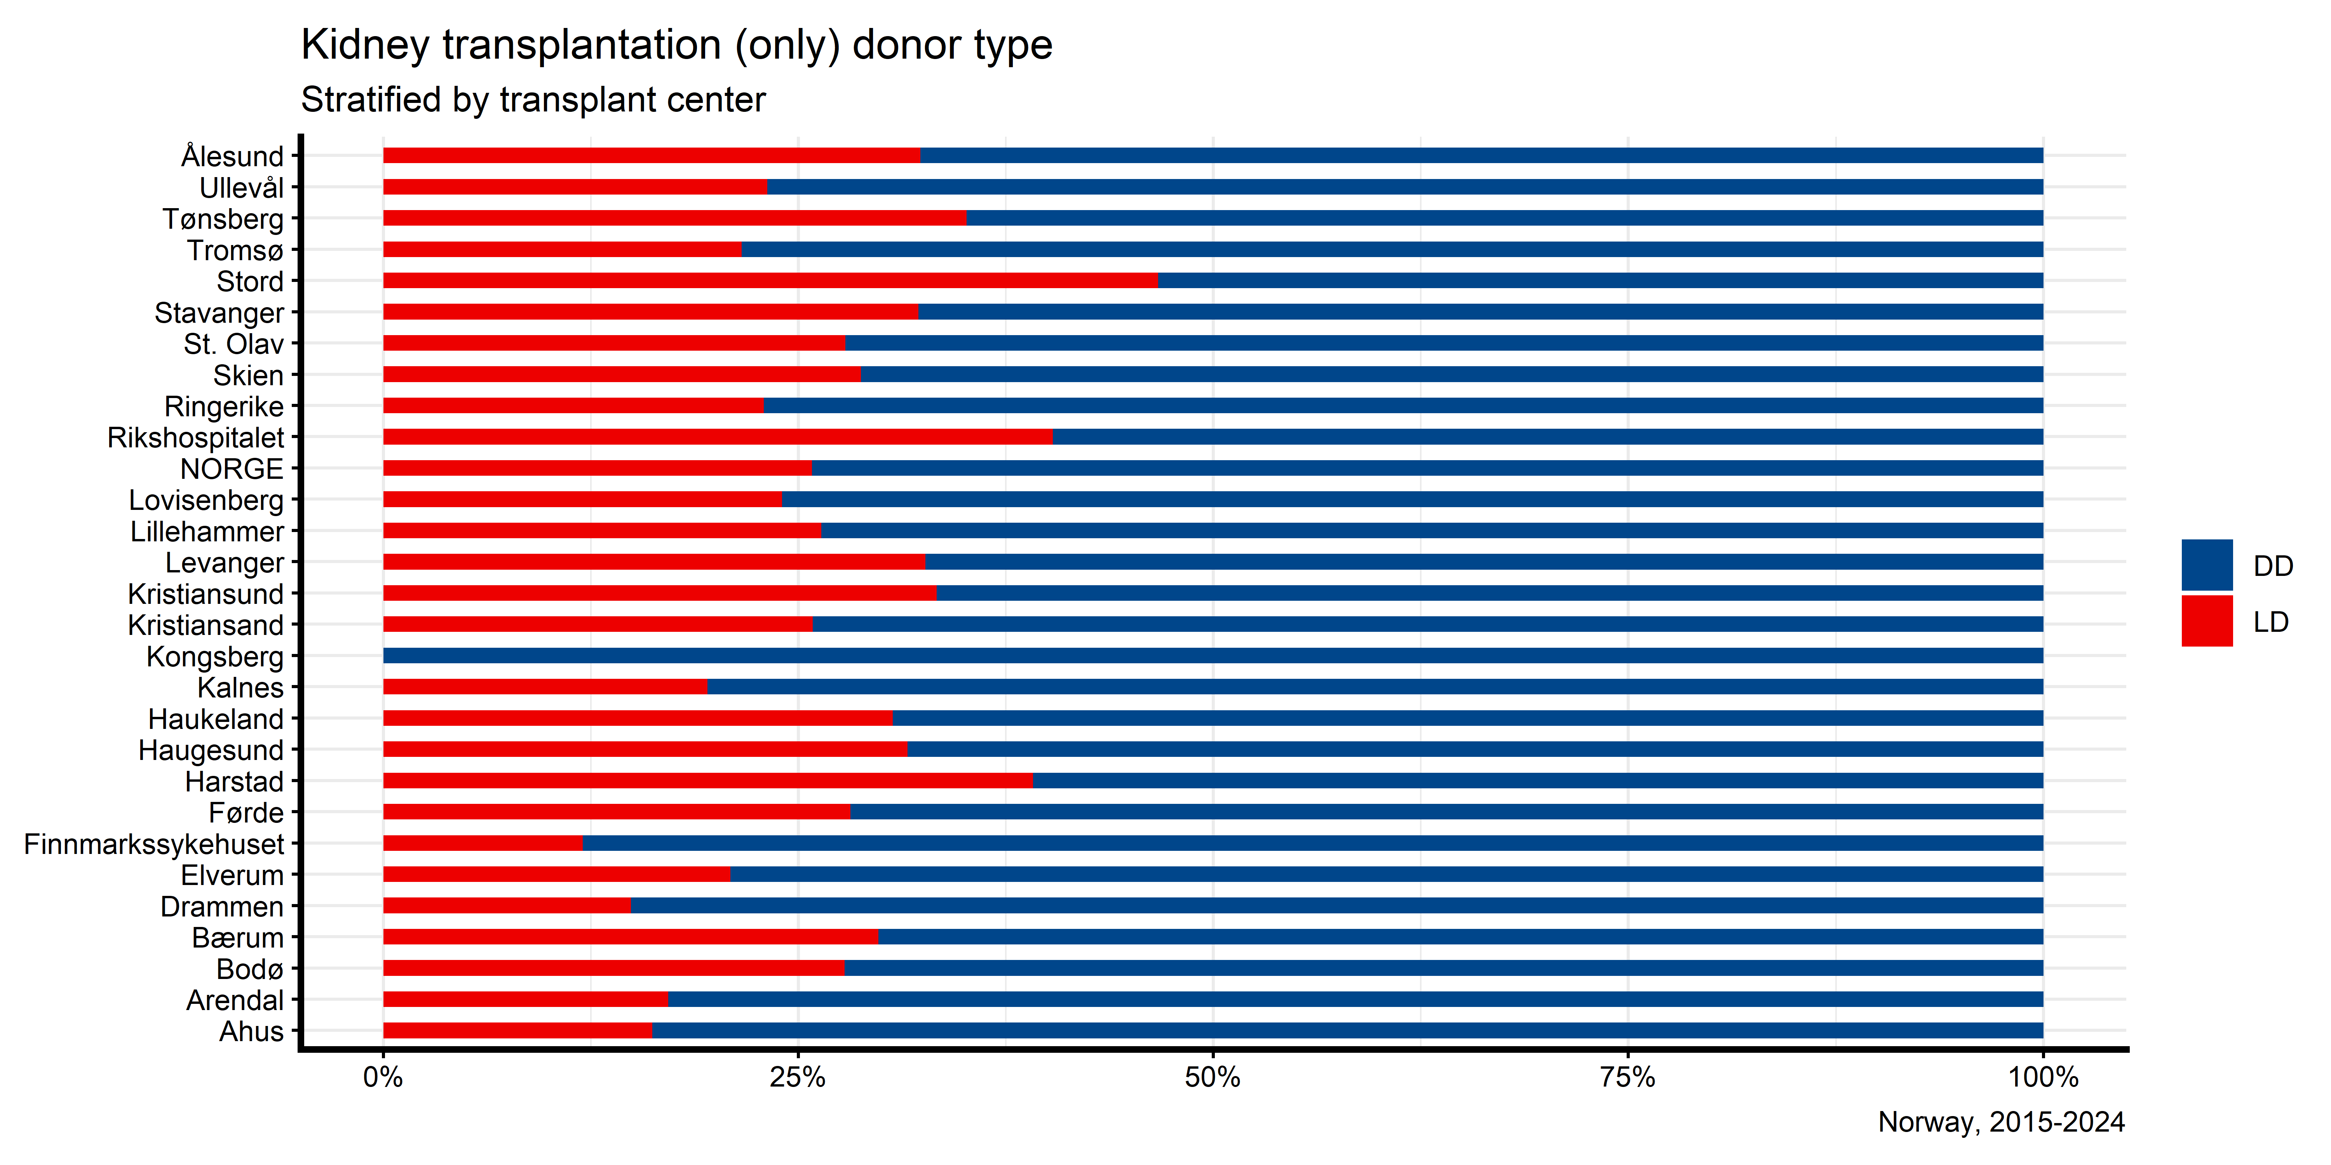
Fraction LD/DD by center (last 10 years)

Slide 11
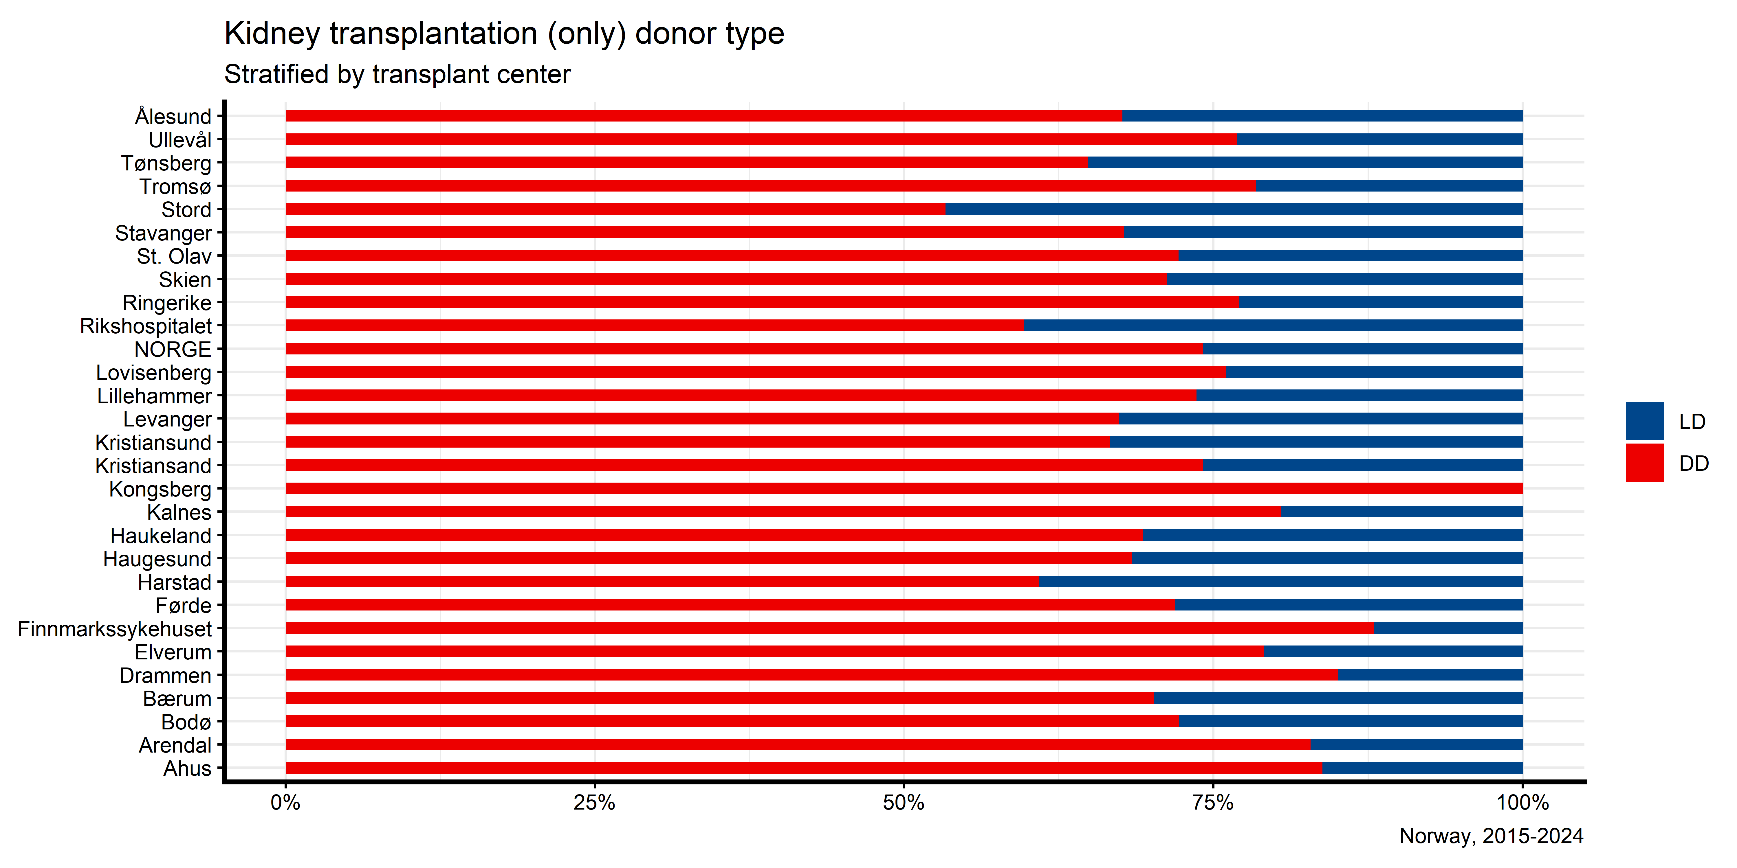

Slide 12
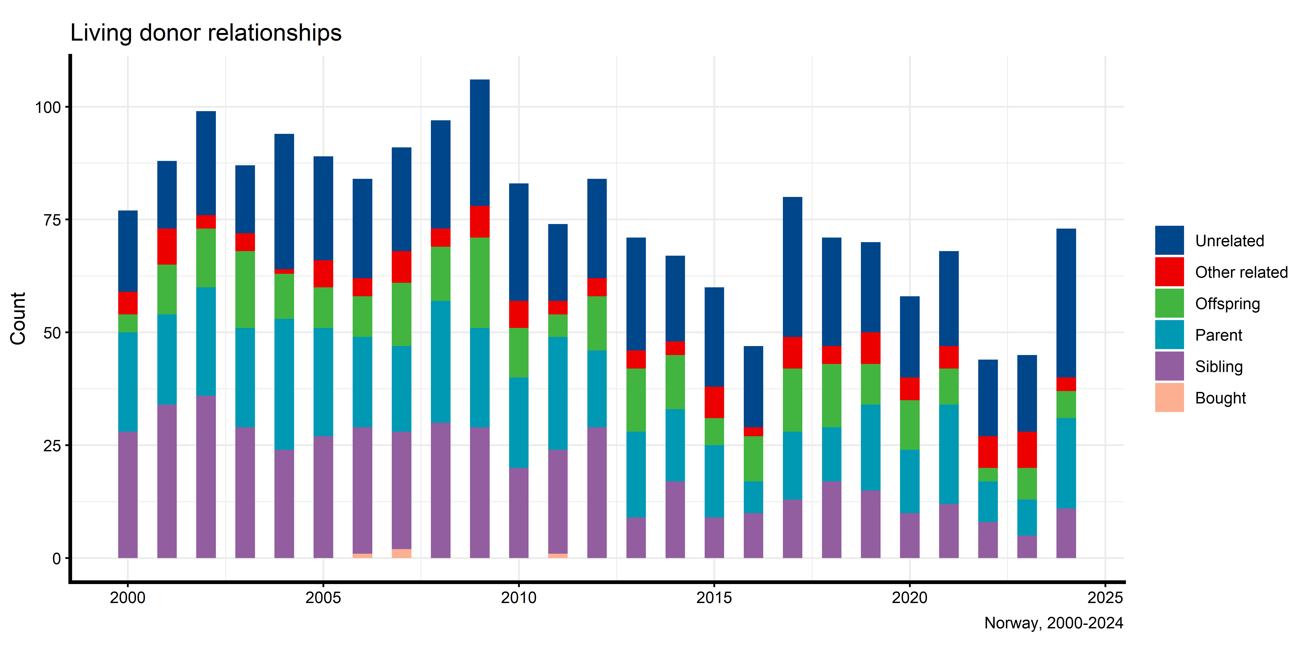
Living donor relationships

Slide 13
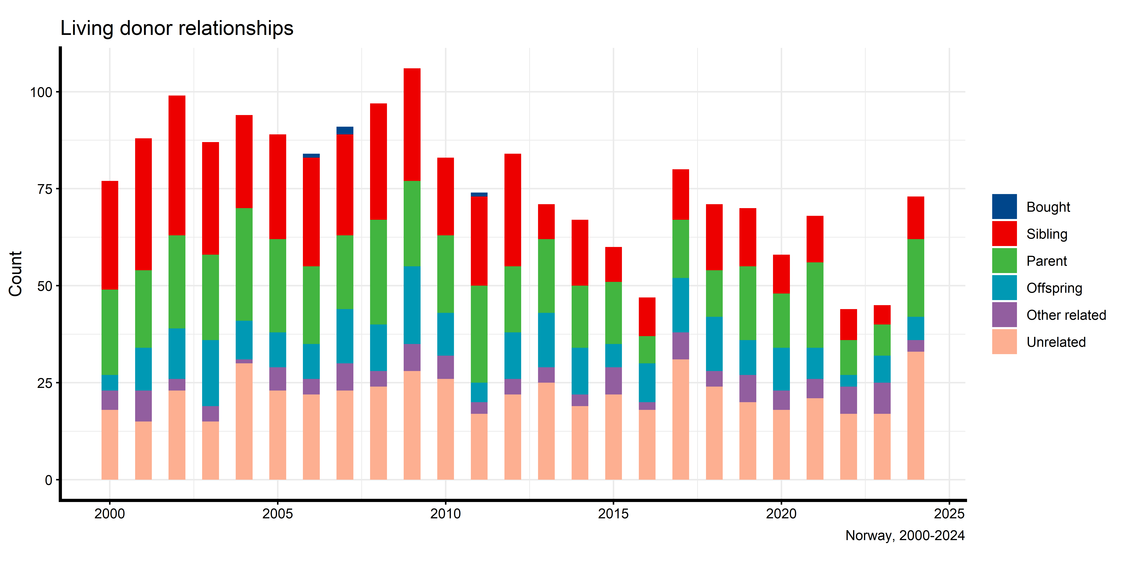

Slide 14
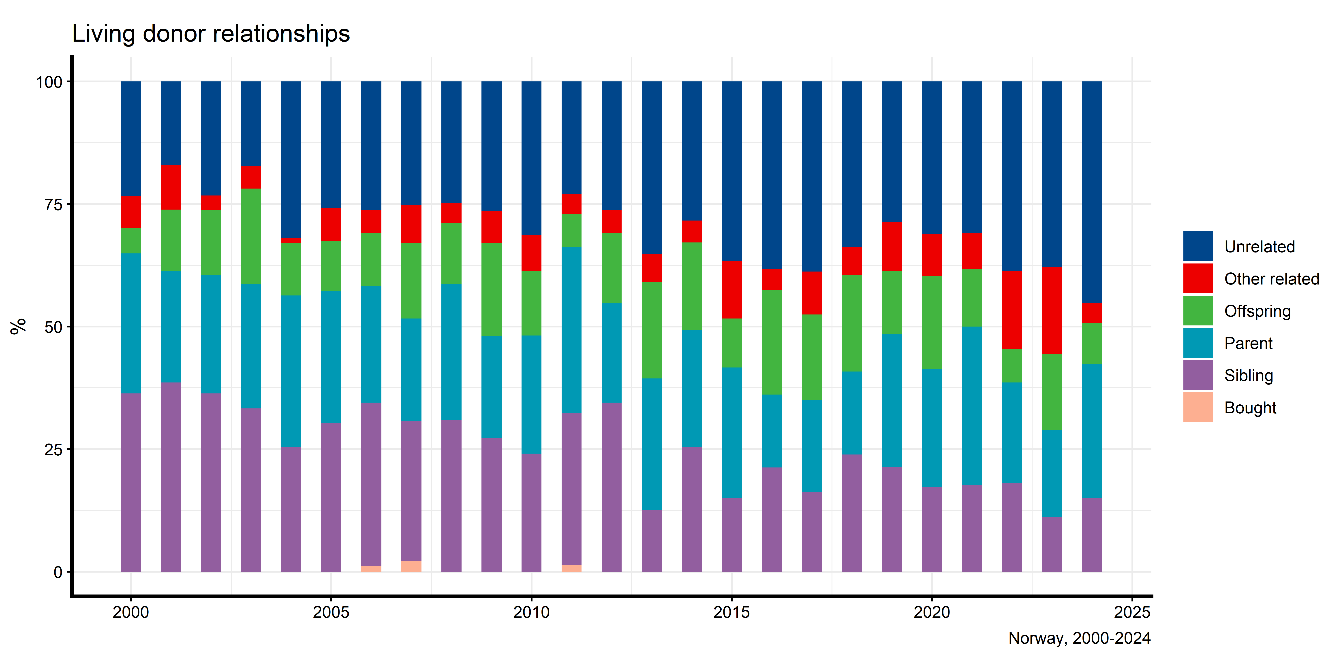
Living donor relationships (proportion)

Slide 15
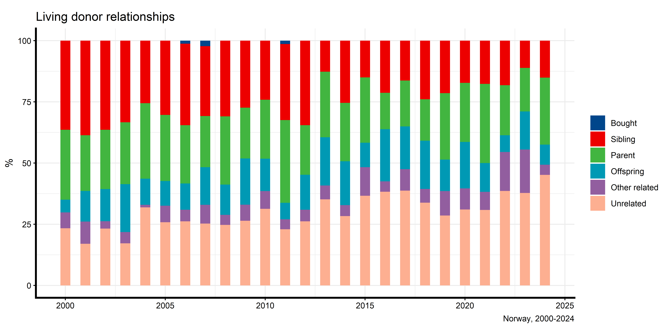

Slide 16
# RRT prevalence

Slide 17
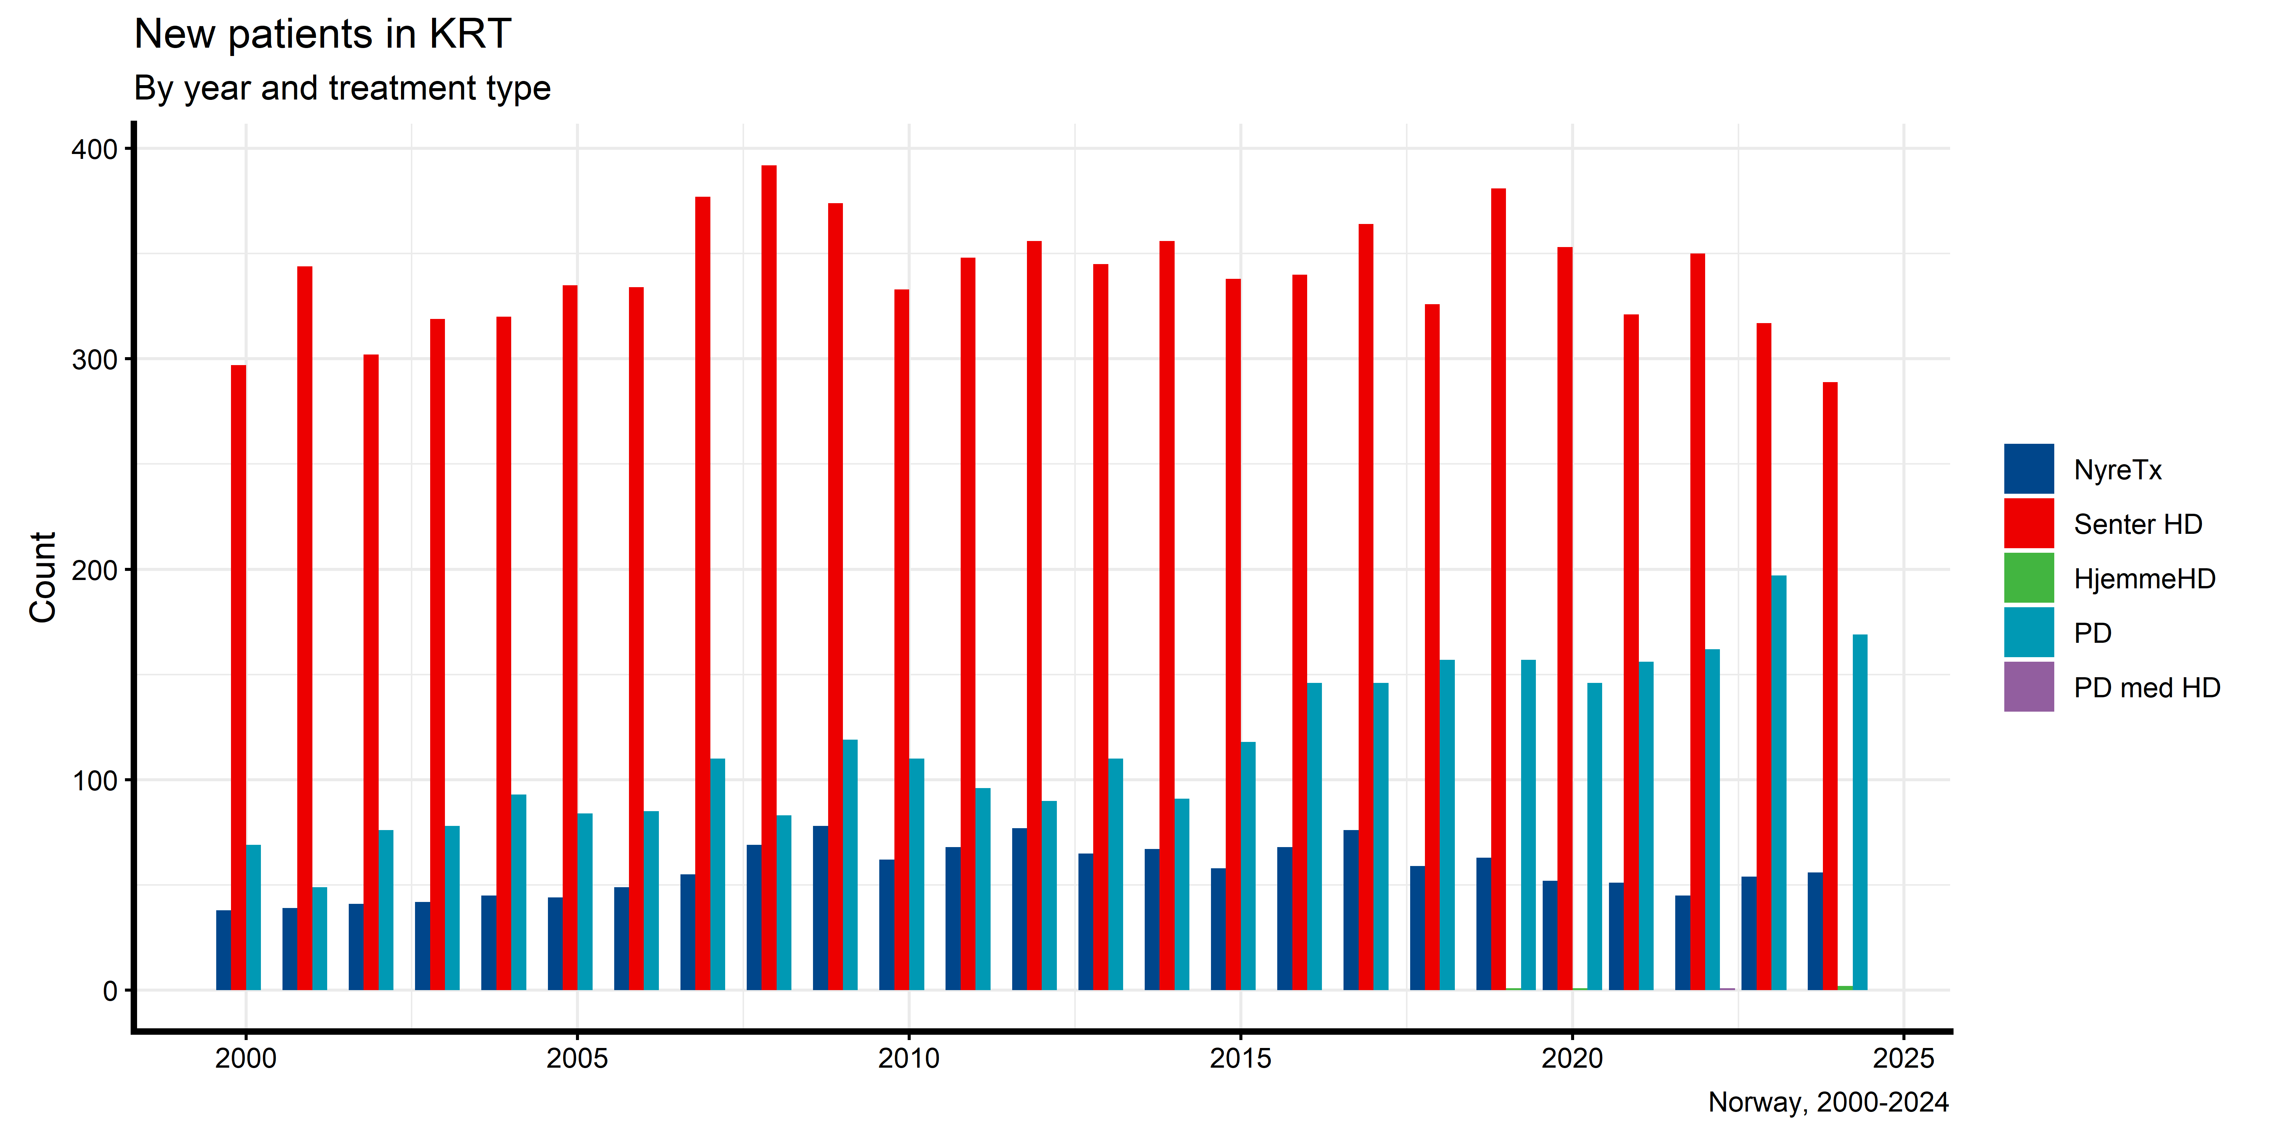
New patients in KRT

Slide 18
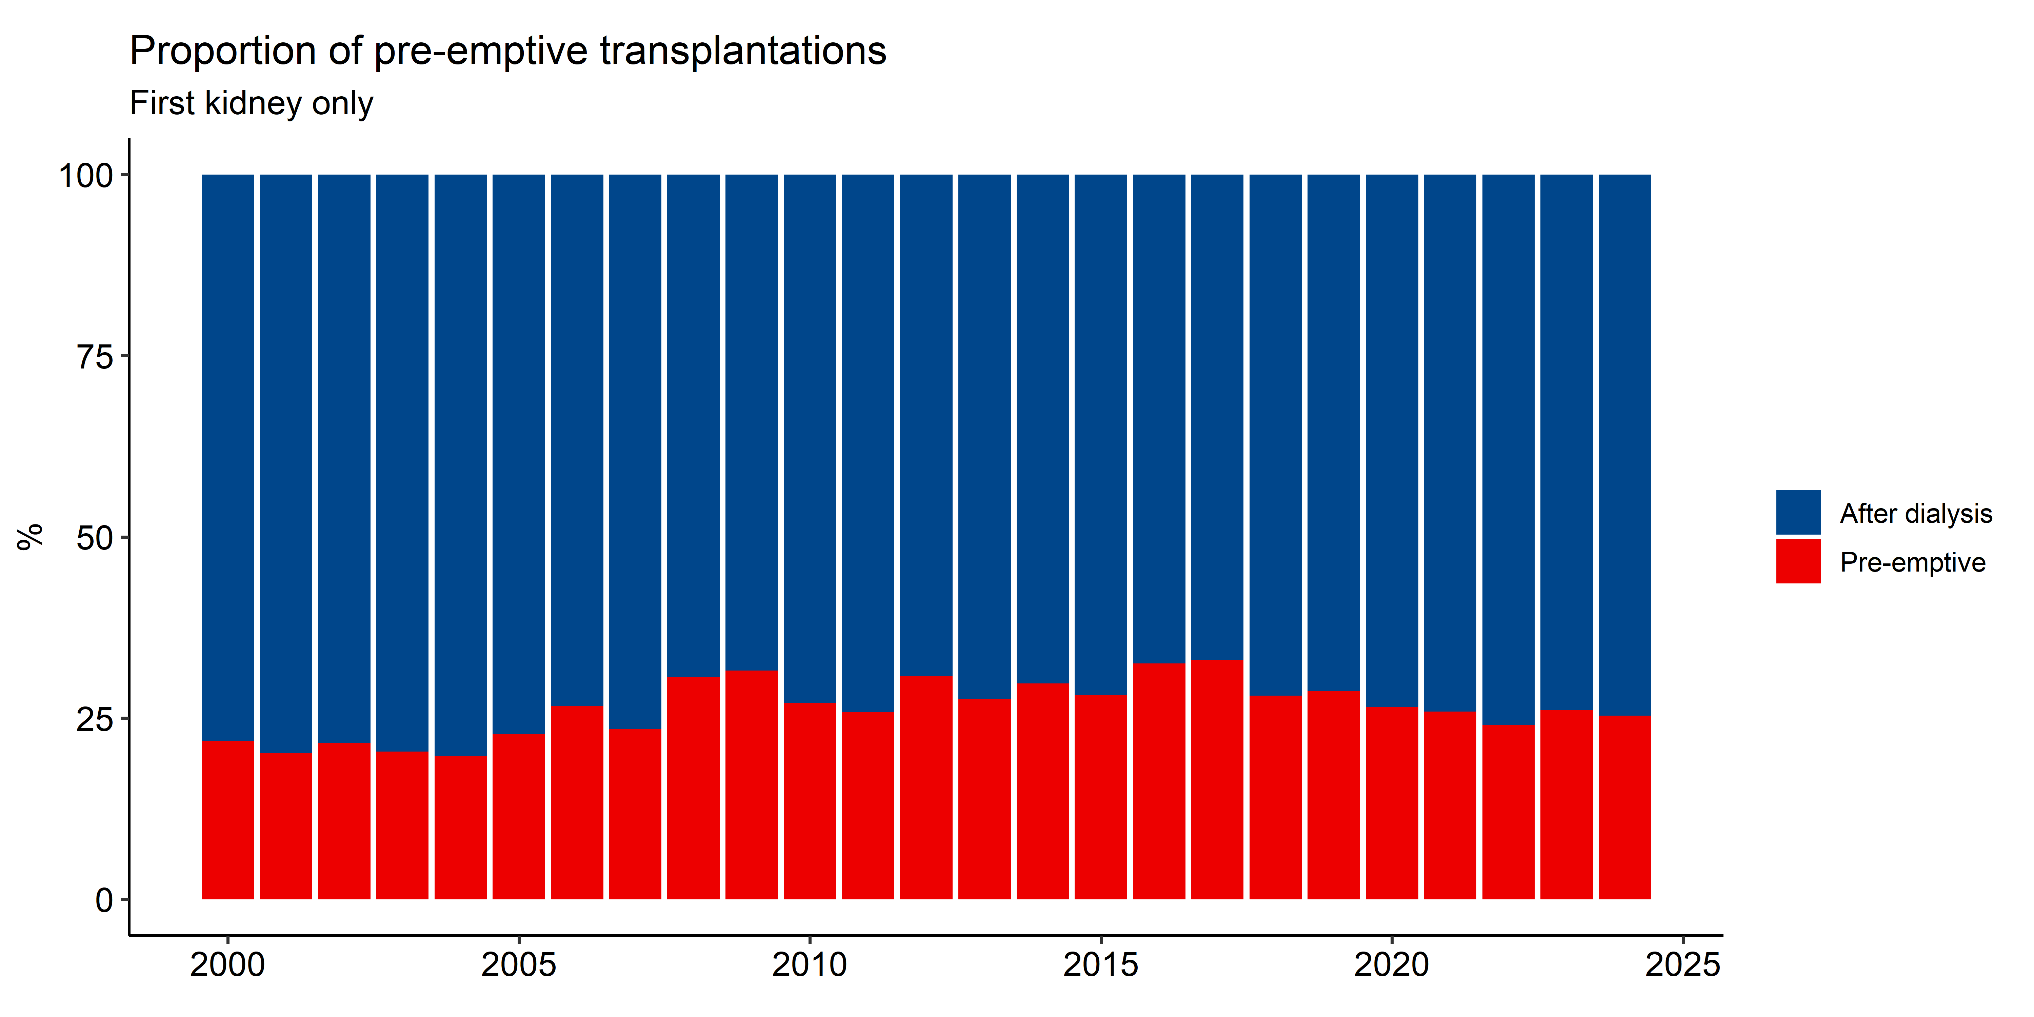
Pre-emptive transplantations by year

Slide 19
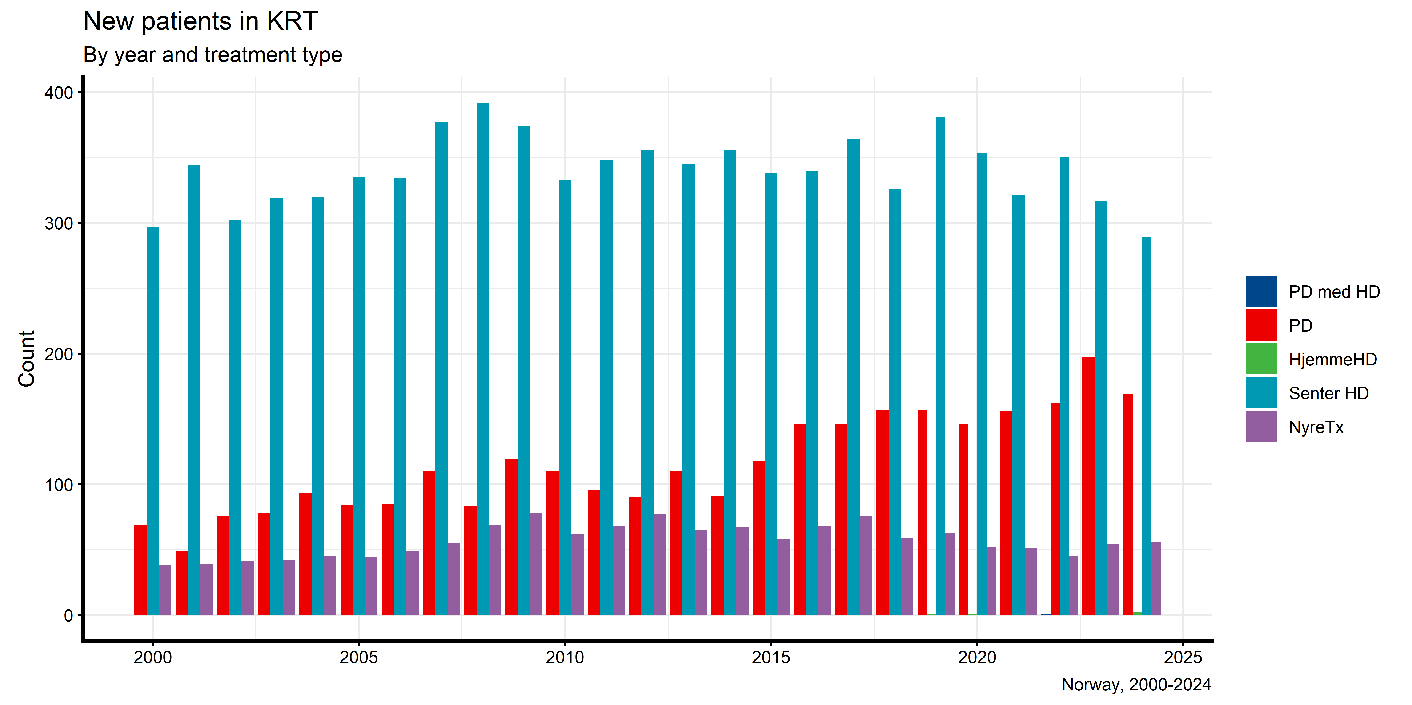

Slide 20
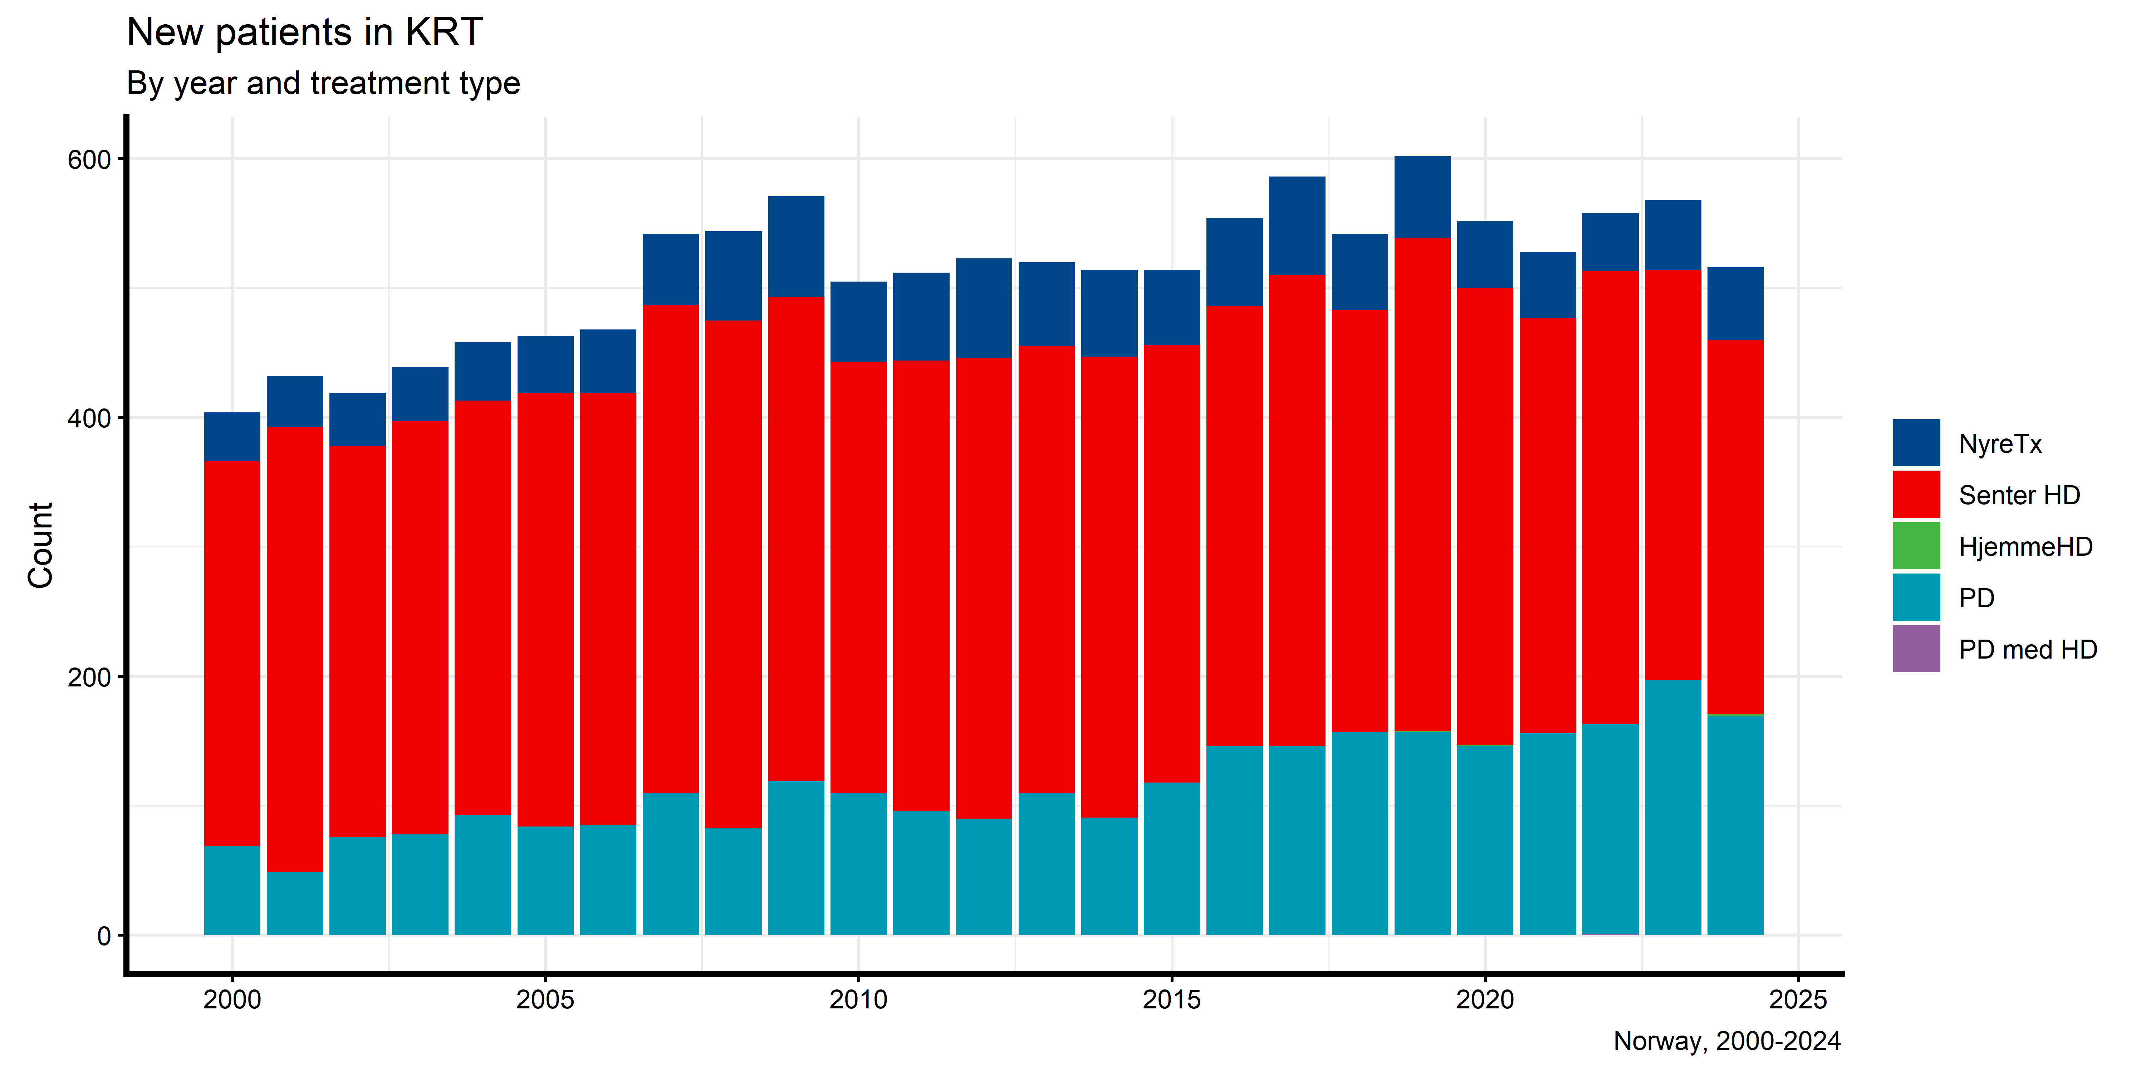
New patients in KRT (stacked)

Slide 21
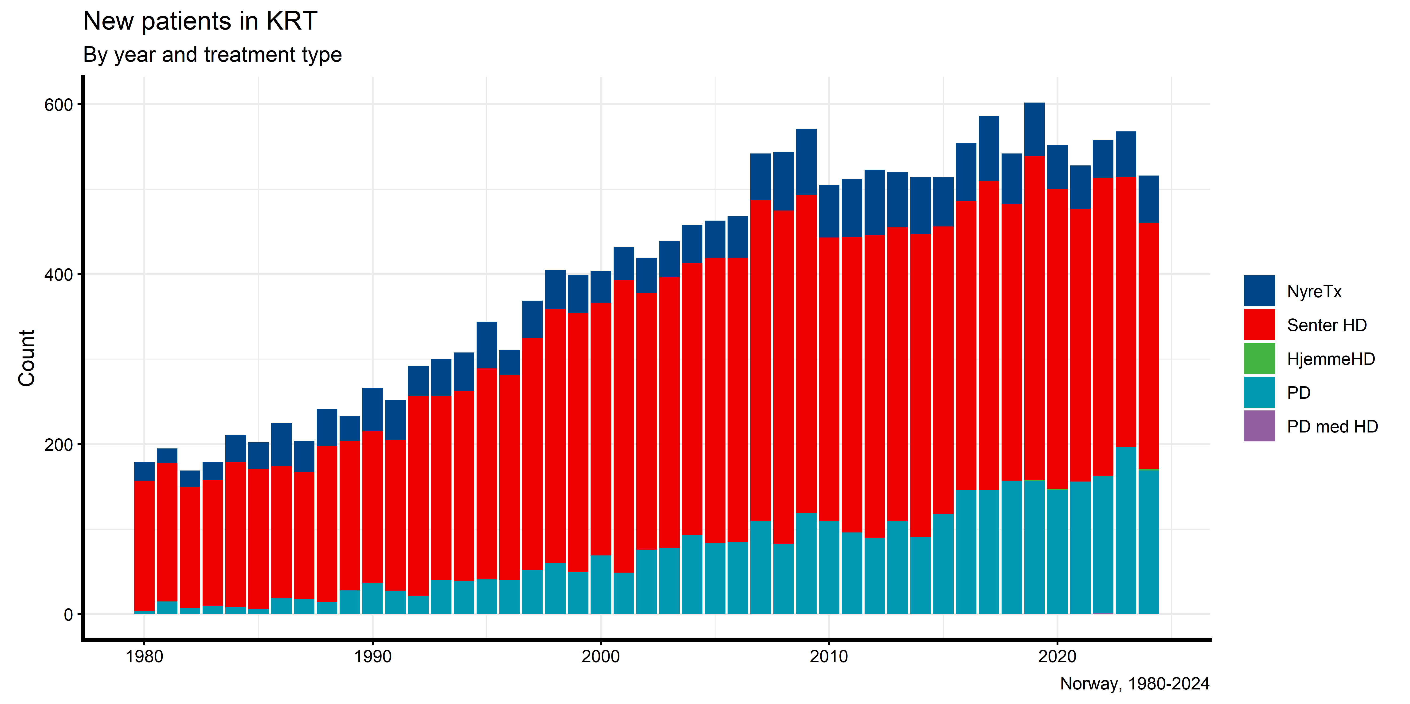
New patients in KRT (stacked, from 1980)

Slide 22
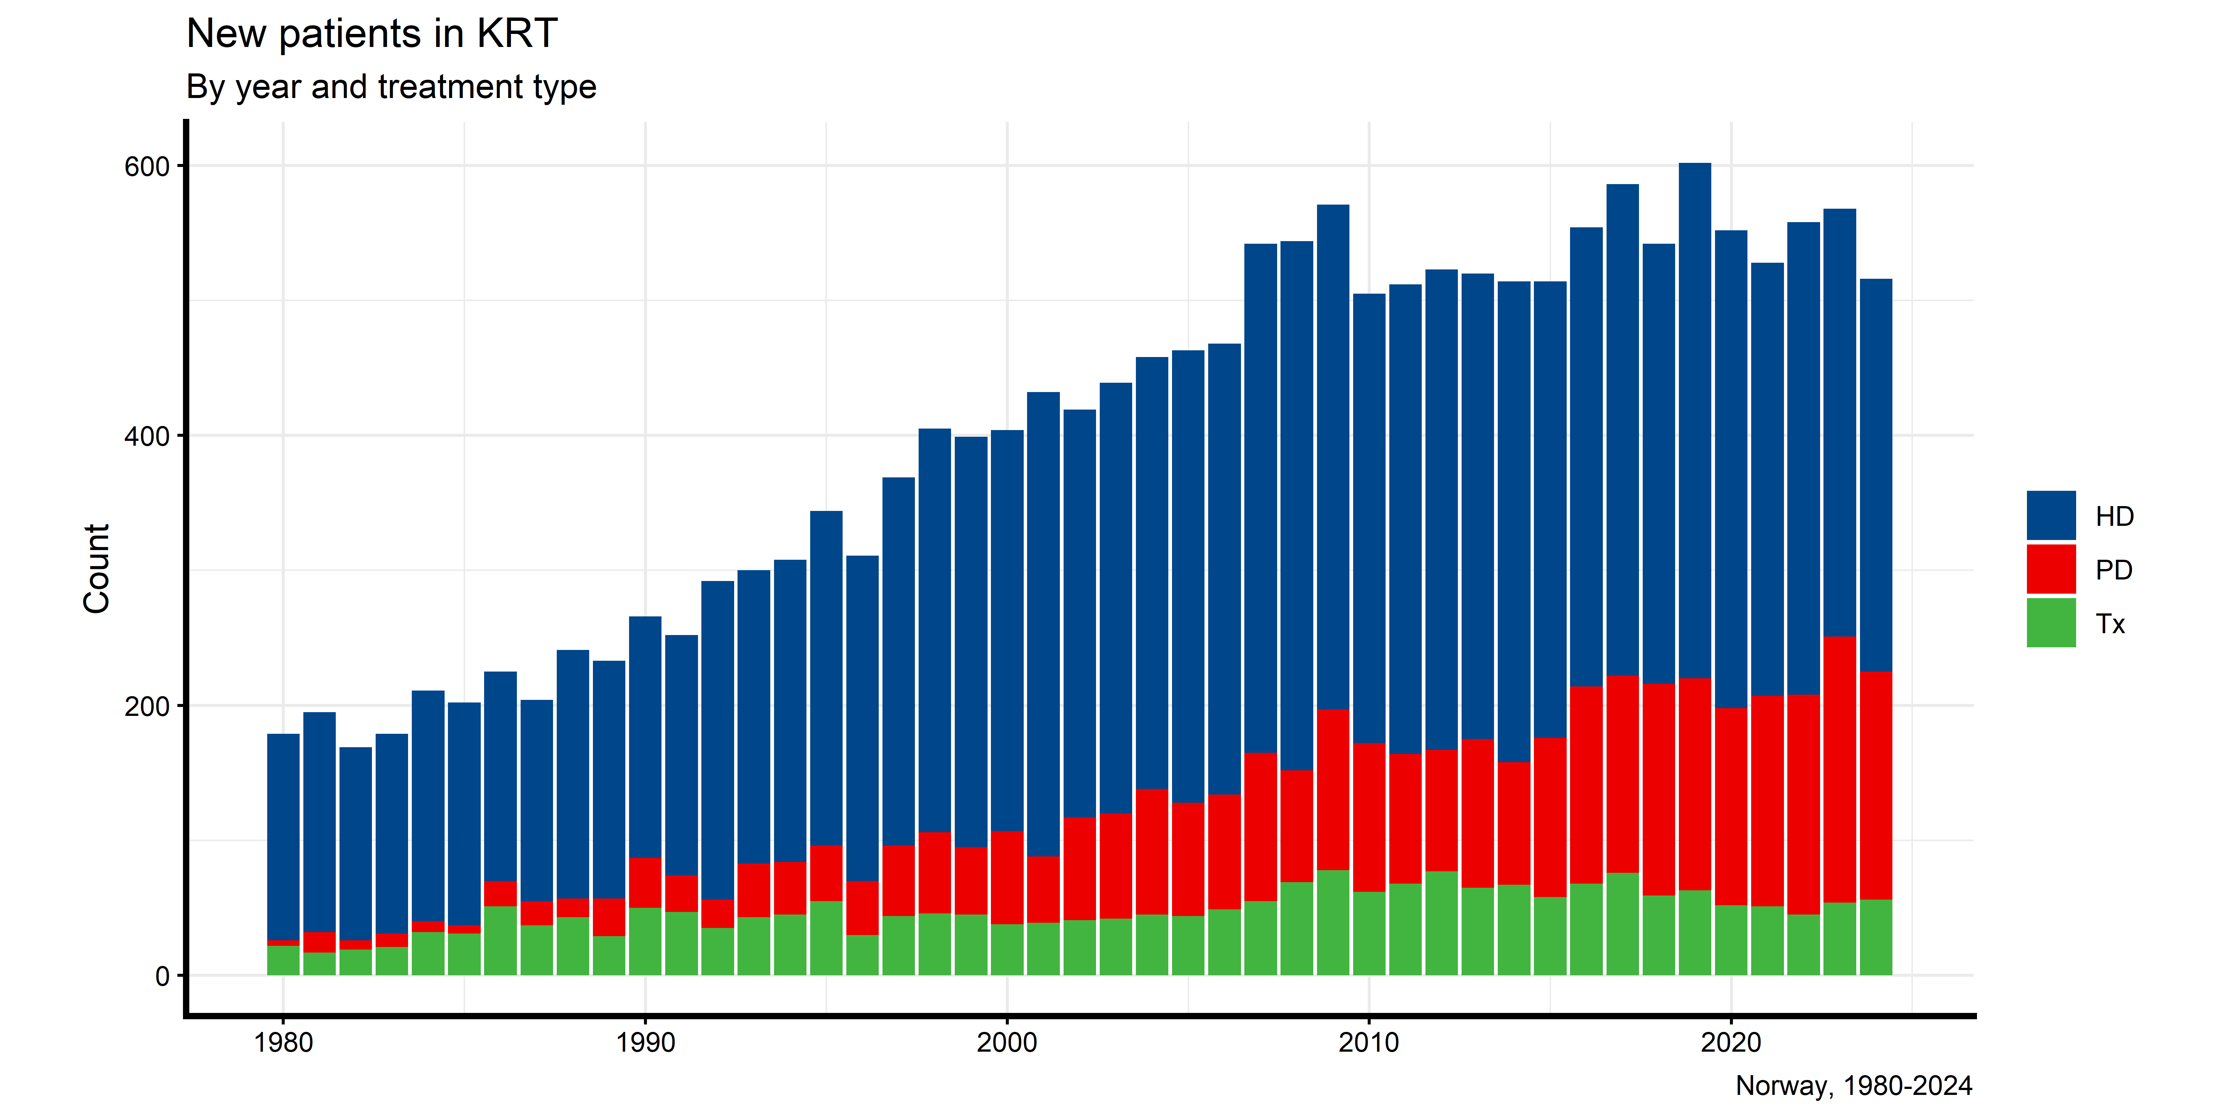
New patients in KRT (stacked, from 1980)

Slide 23
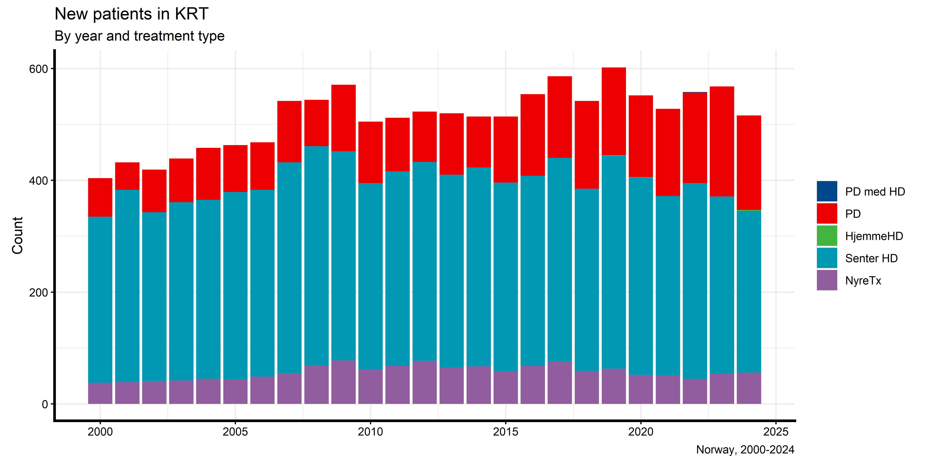

Slide 24
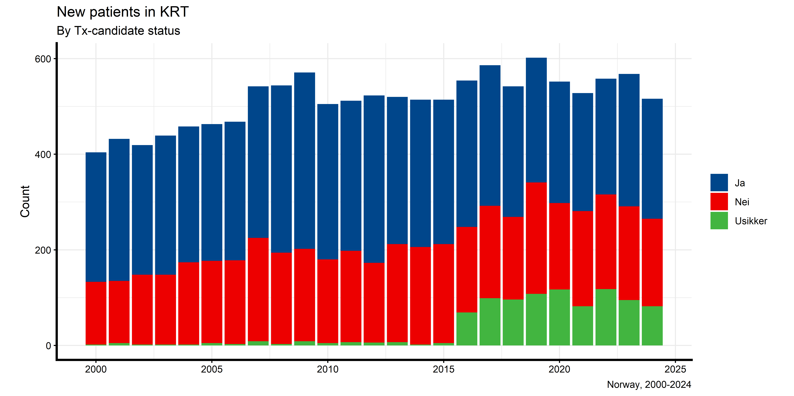
New patients in KRT by Tx-candidacy

Slide 25
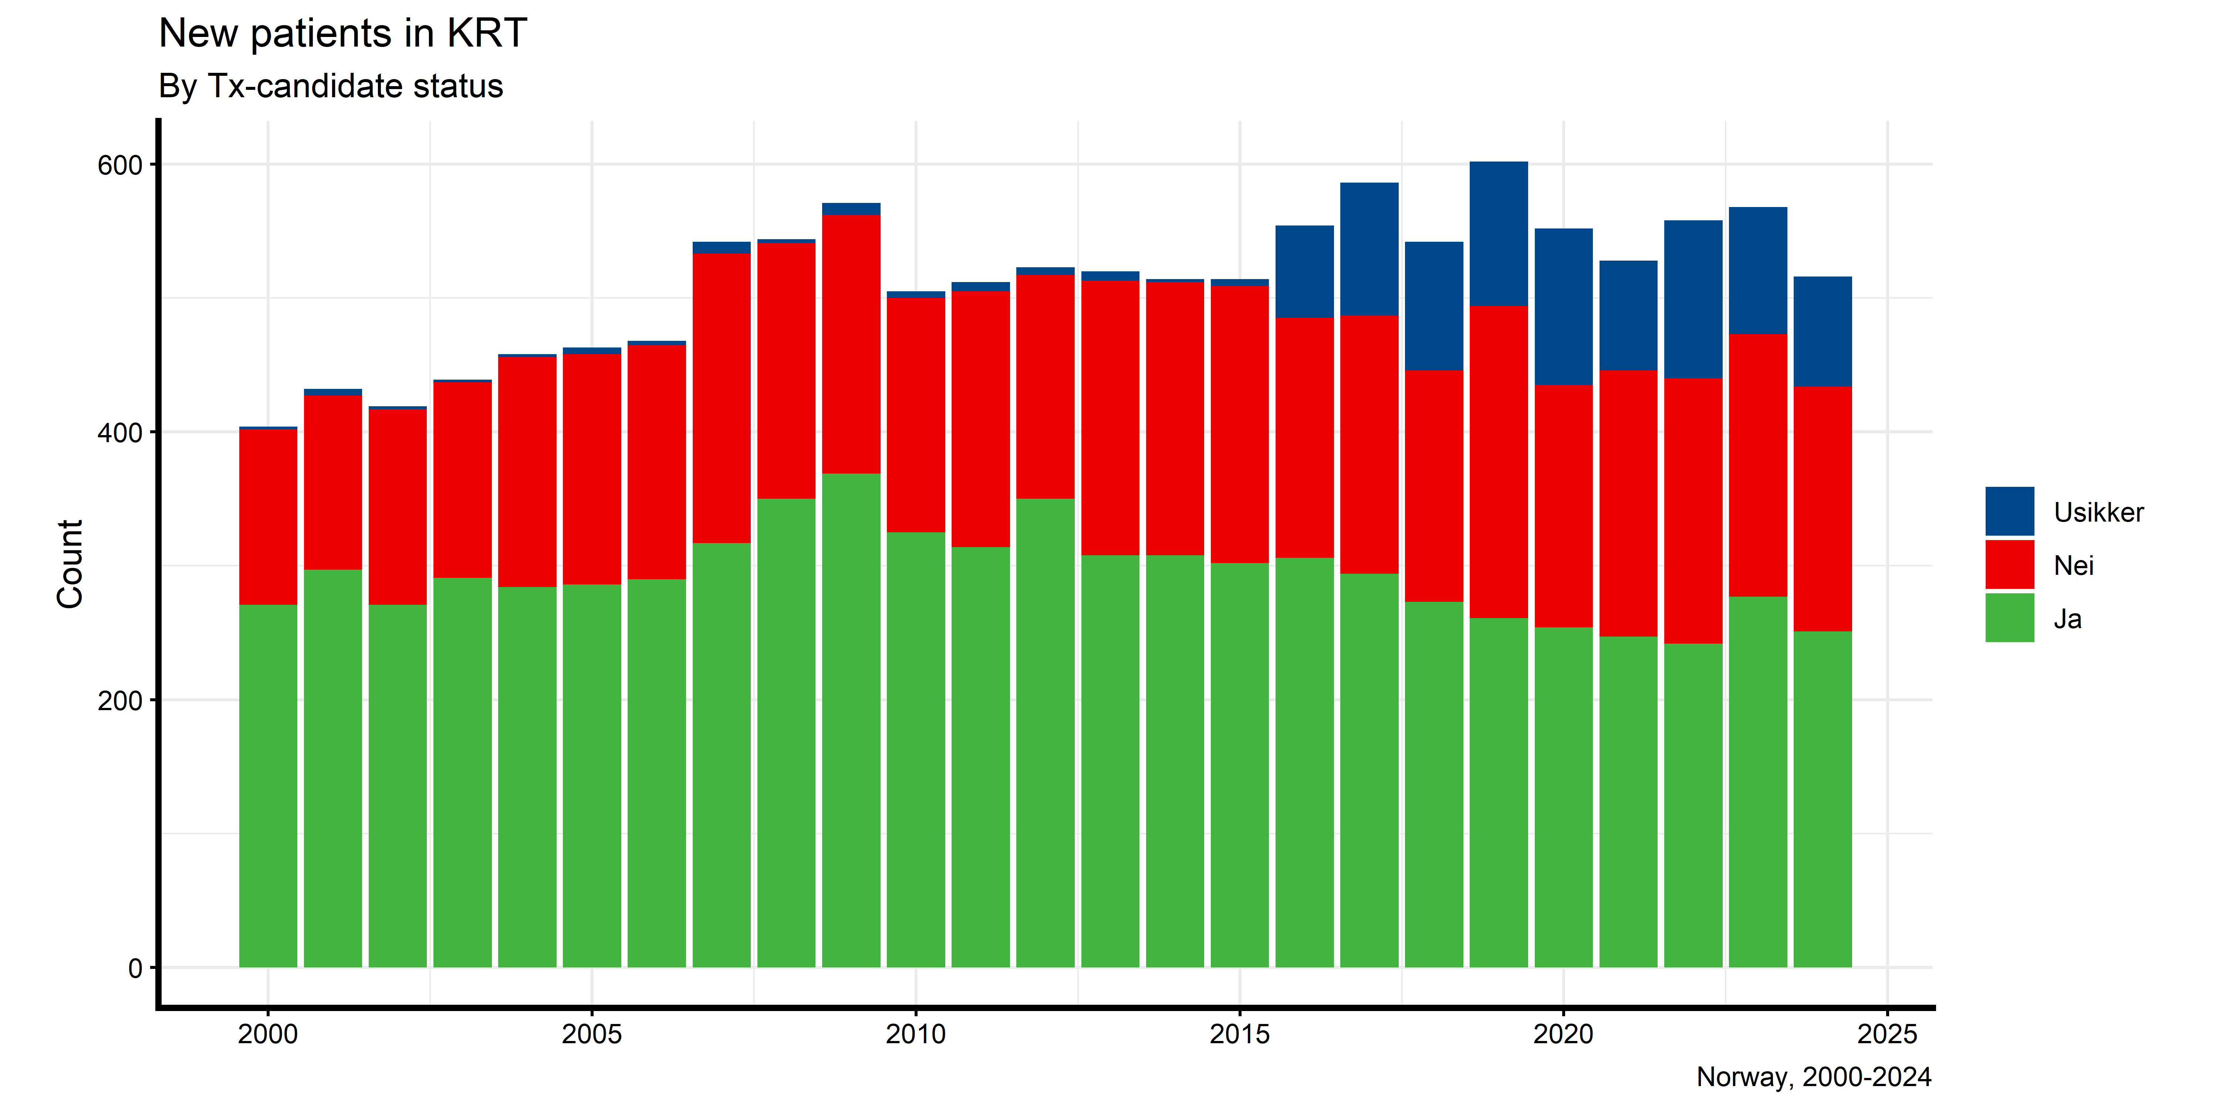

Slide 26
New patients in KRT by Tx-candidacy (relative)

Slide 28
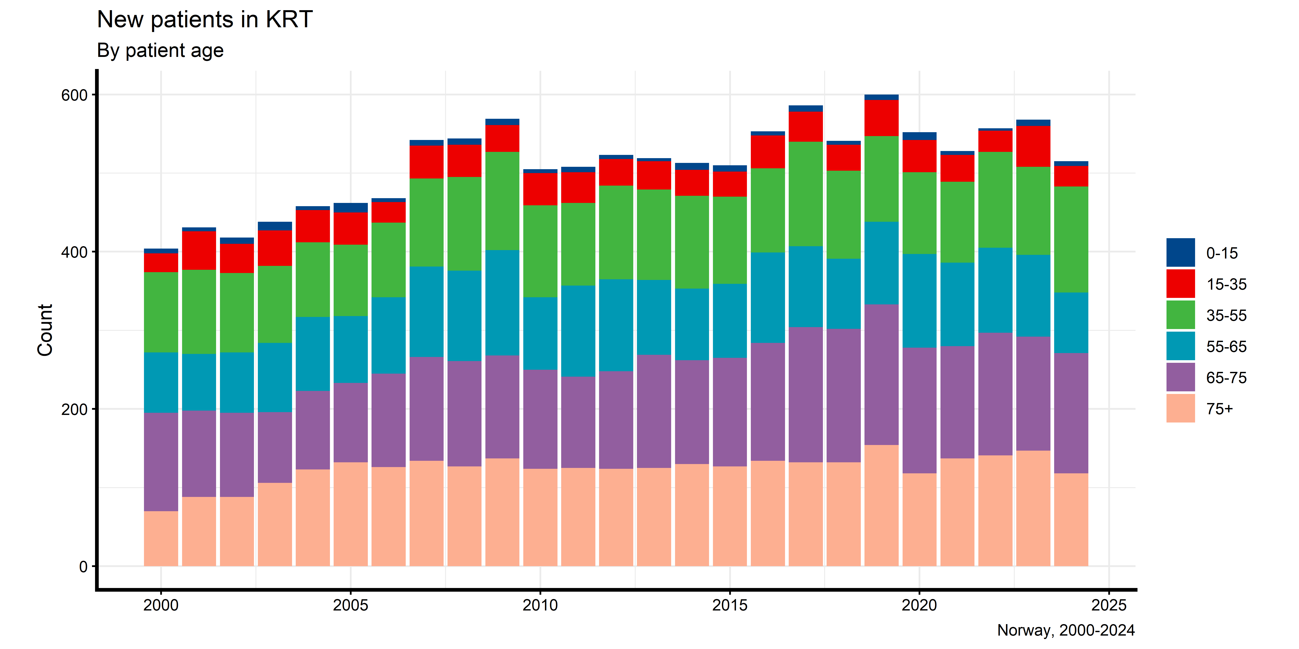
New patients in KRT by age

Slide 29
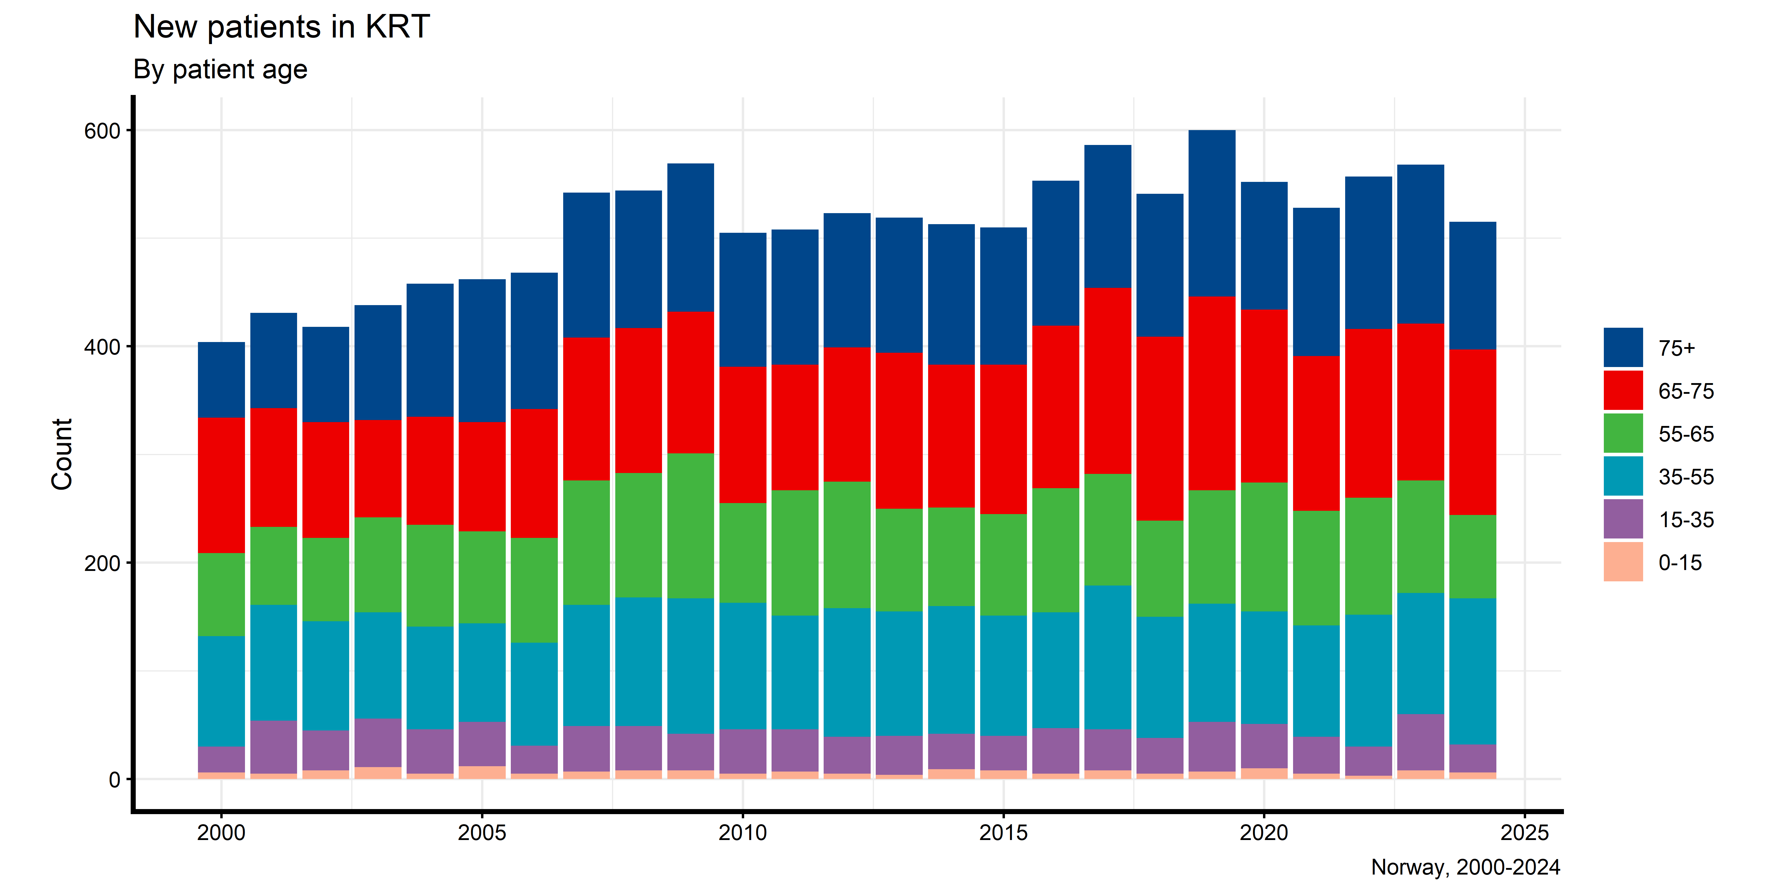

Slide 30
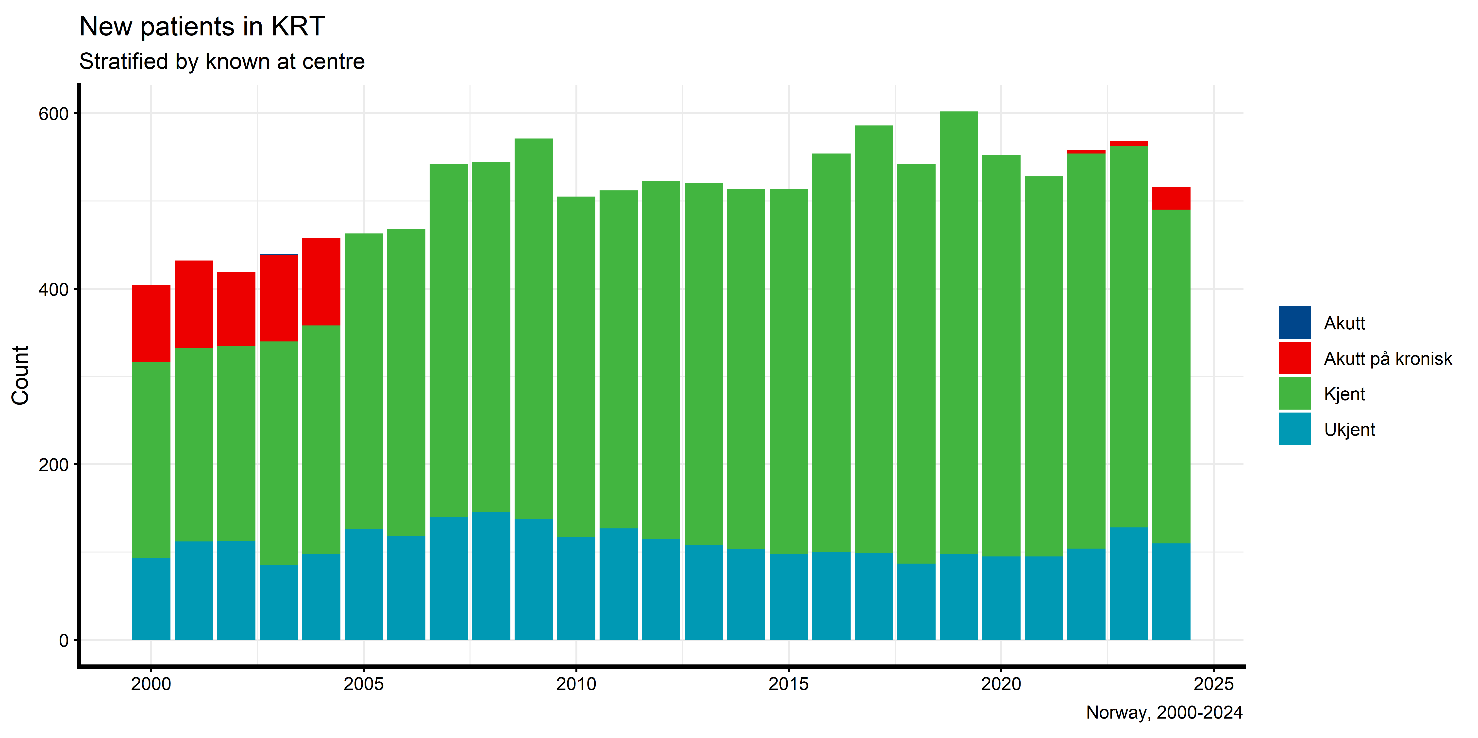
New patients in KRT by known

Slide 32
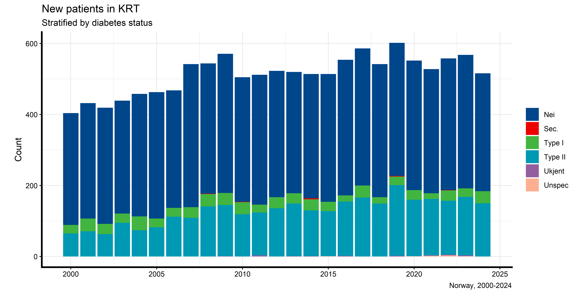
New patients in KRT by year and diabetes status at first RRT

Slide 33
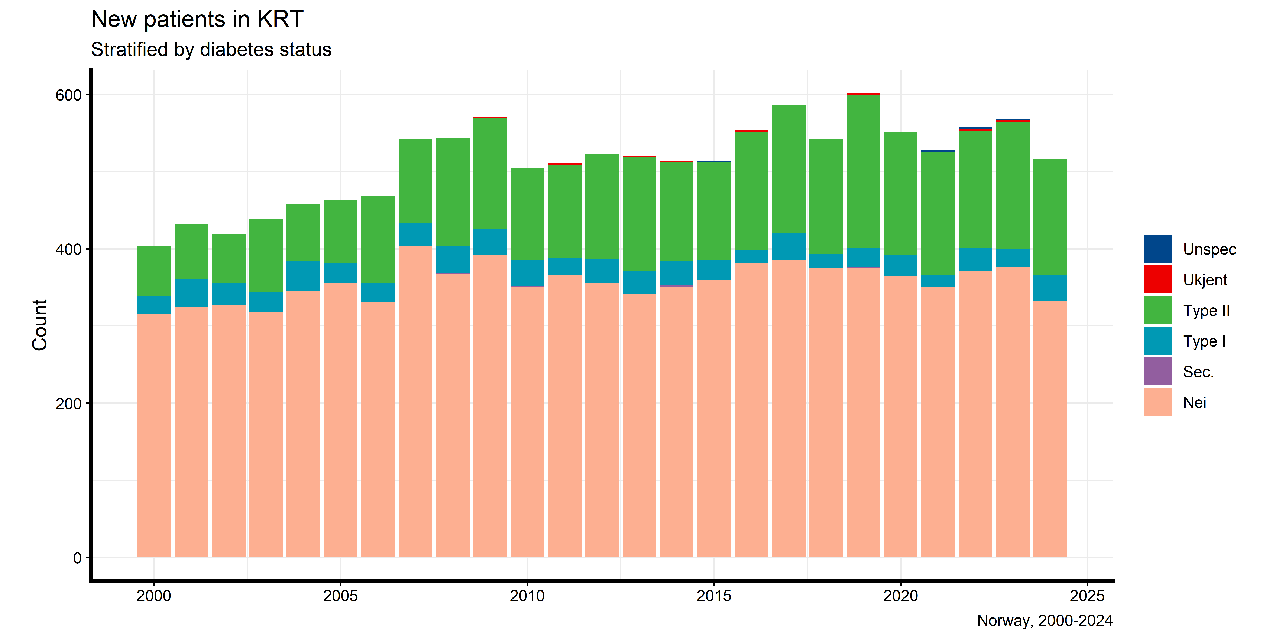

Slide 34
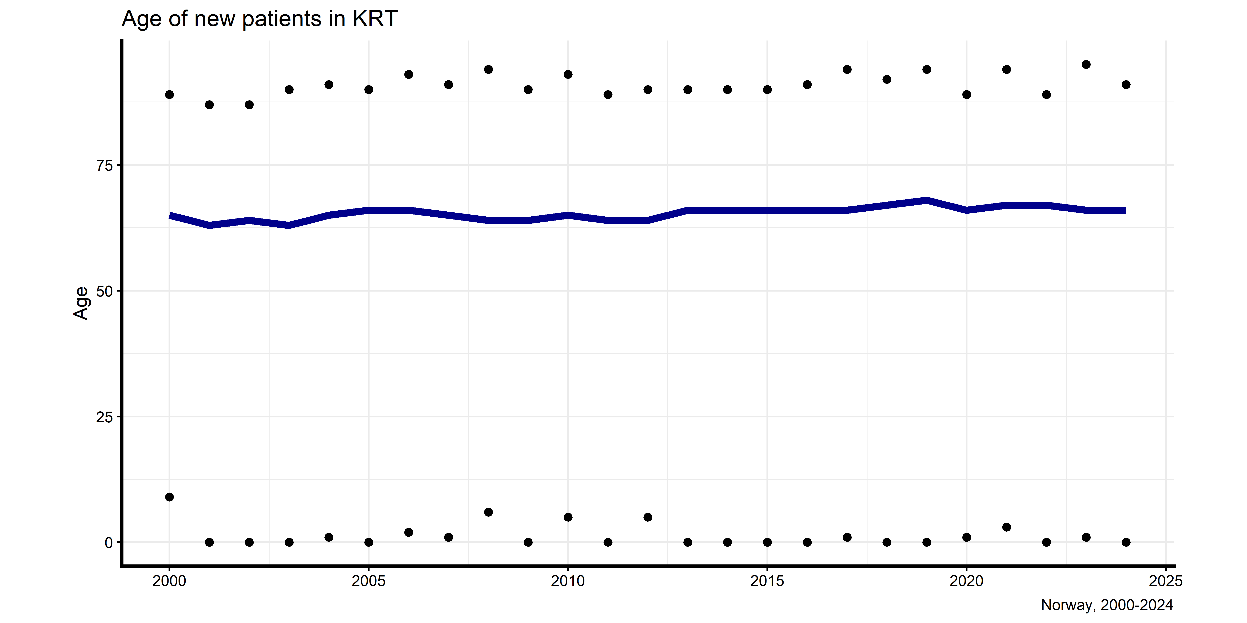
Age of New patients in KRT

Slide 35
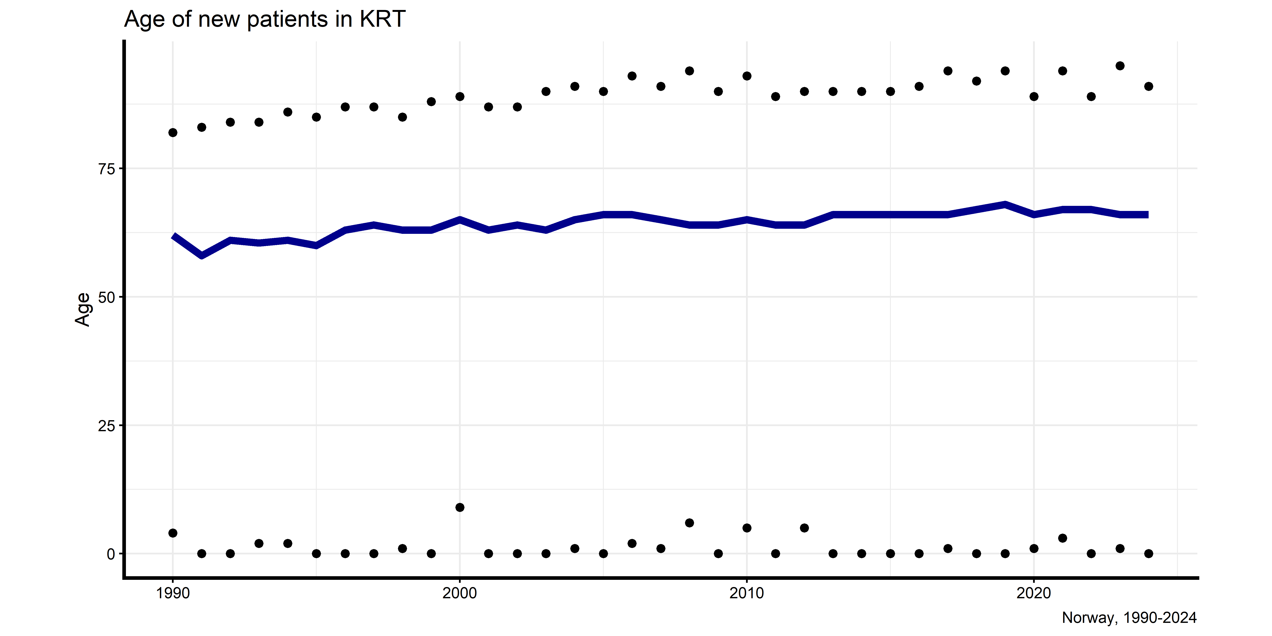
Age of New patients in KRT (from 1990)

Slide 36
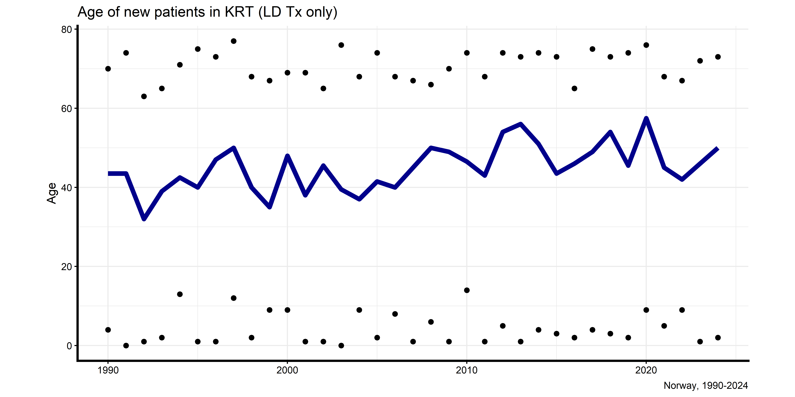
Age of New patients in KRT (LD only) (from 1990)

Slide 37
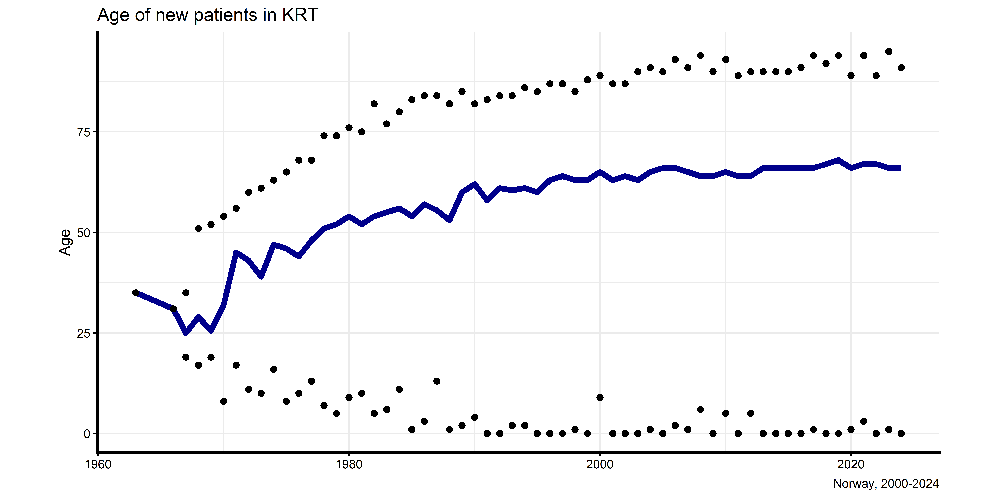
Age of New patients in KRT (from 1960)

Slide 38
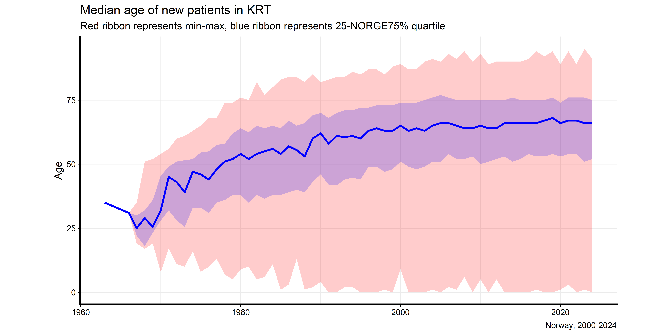
Age of New patients in KRT (IQR ribbon from 1960)

Slide 39
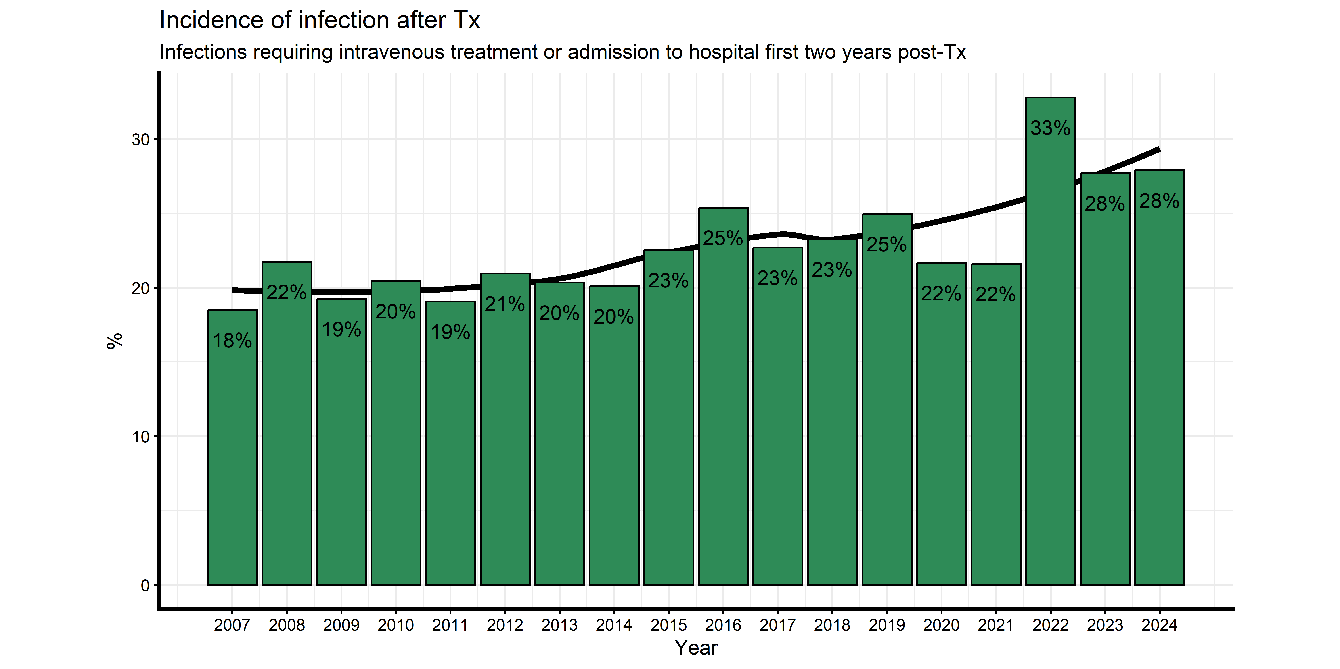
Prevalence of infection after Tx

Slide 40
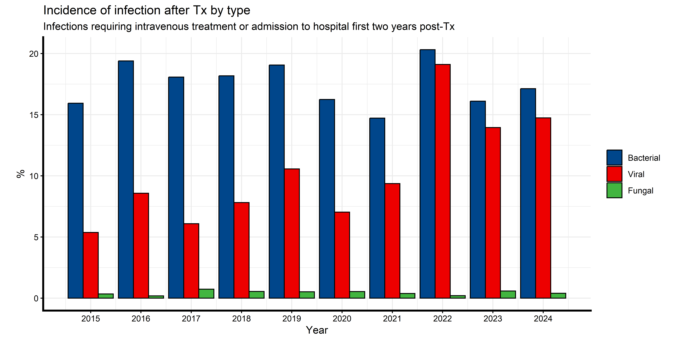
Prevalence of infection after Tx by type

Slide 41
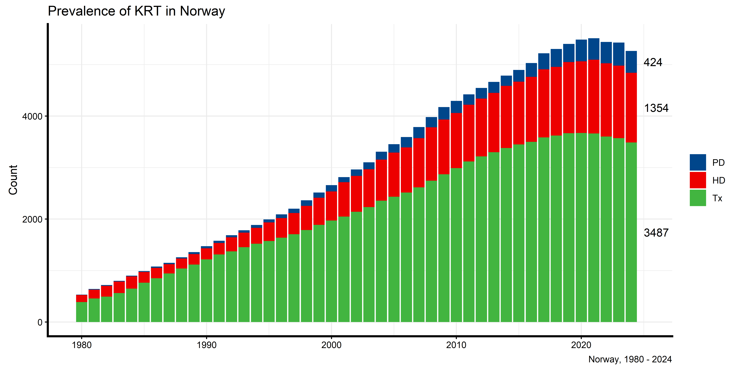
RRT prevalence

Slide 42
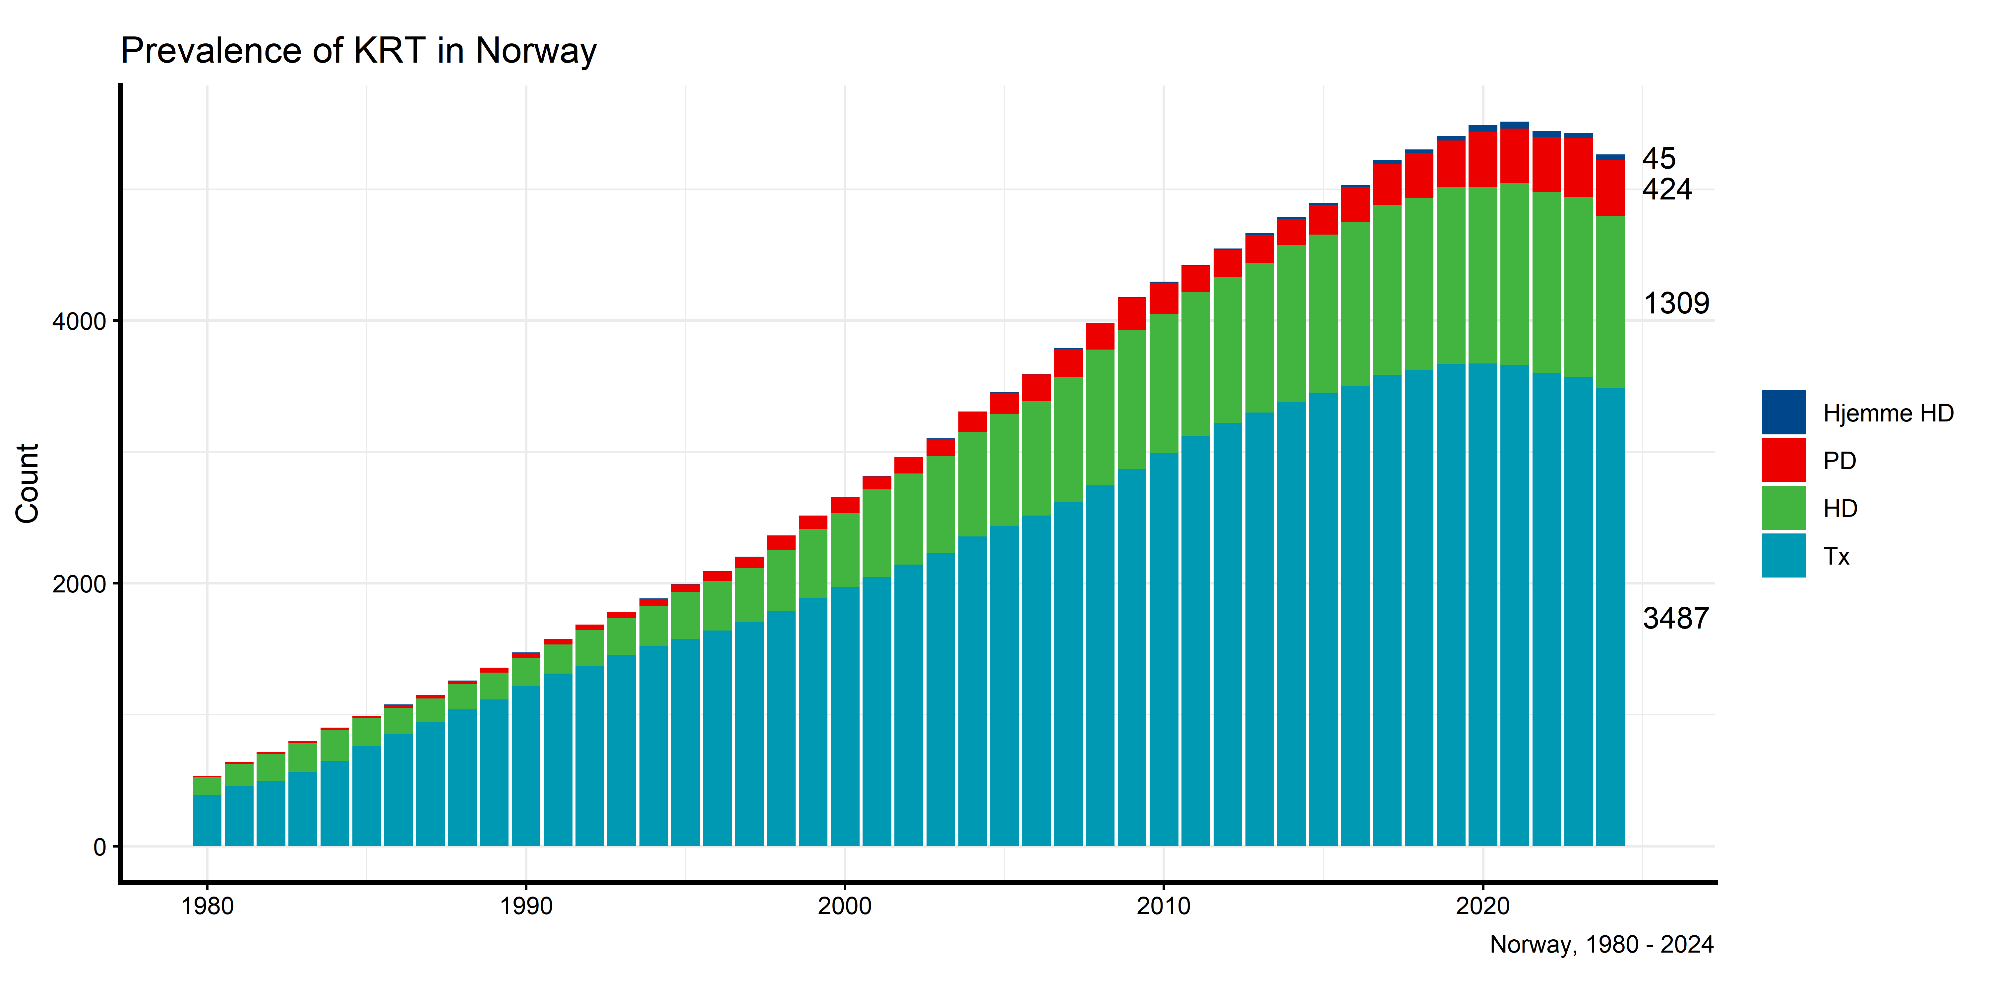

Slide 43
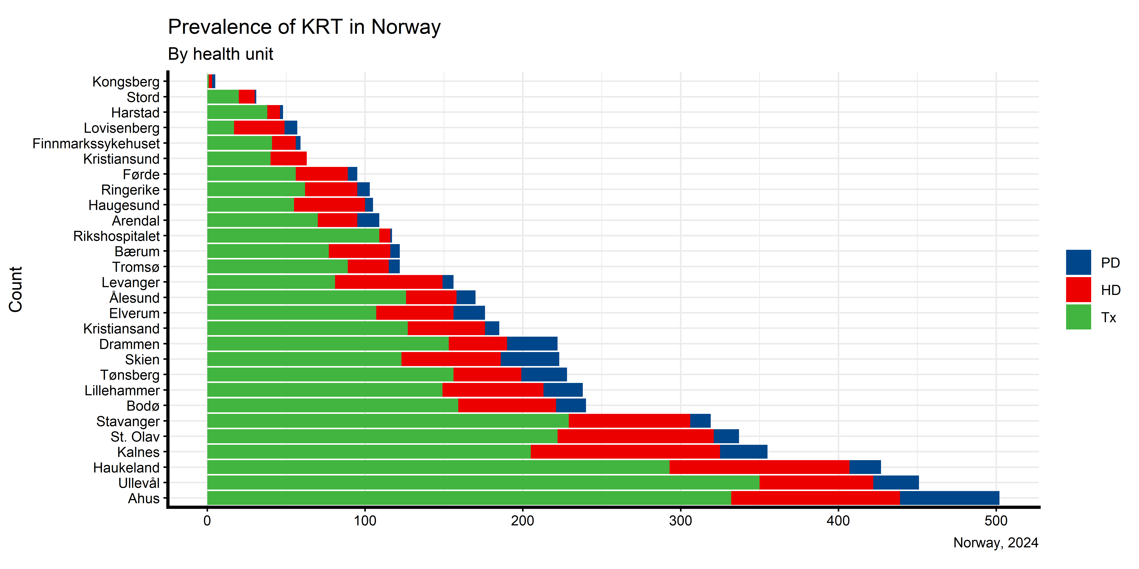

Slide 44

SURVIVAL ANALYSIS

Slide 45
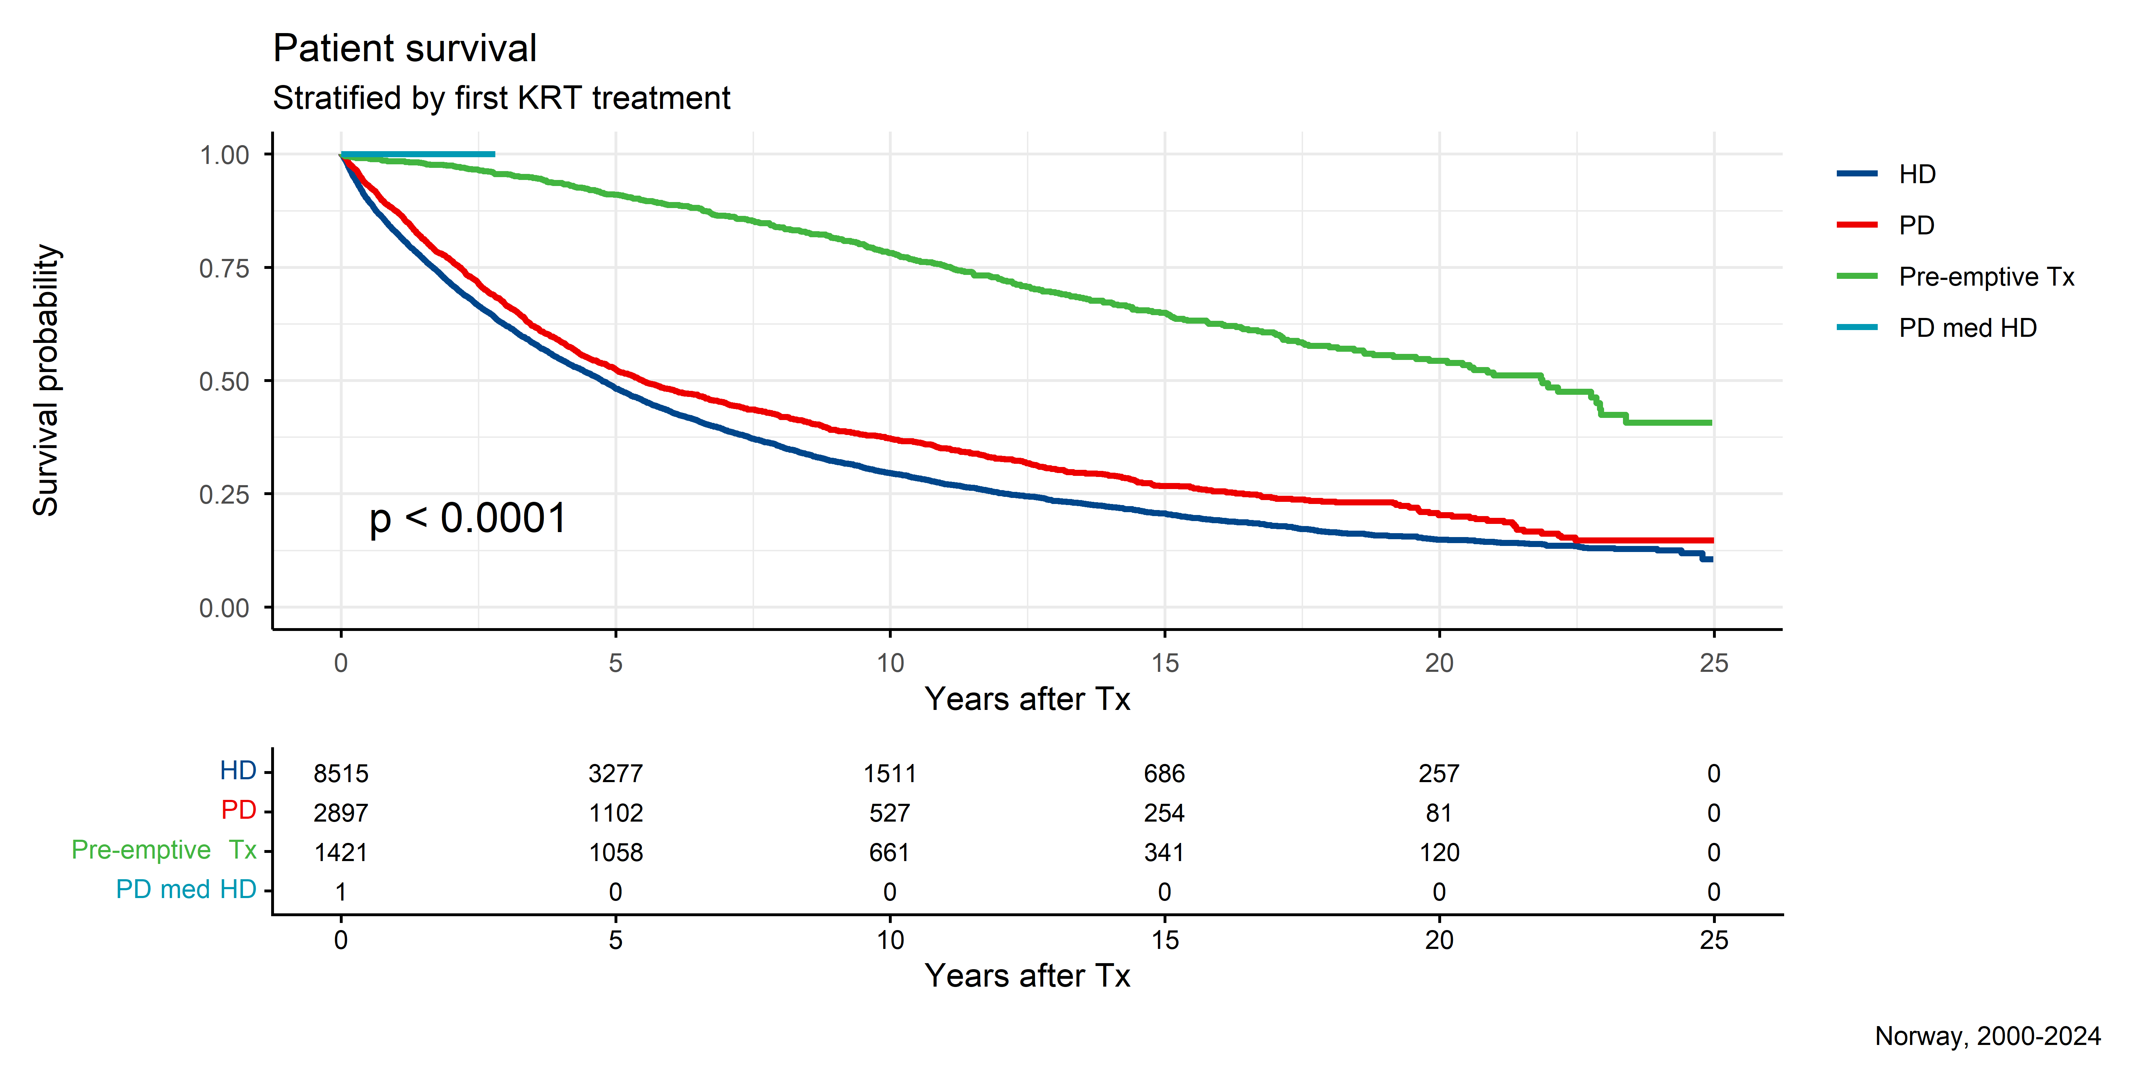
Survival (first KRT)

Slide 46
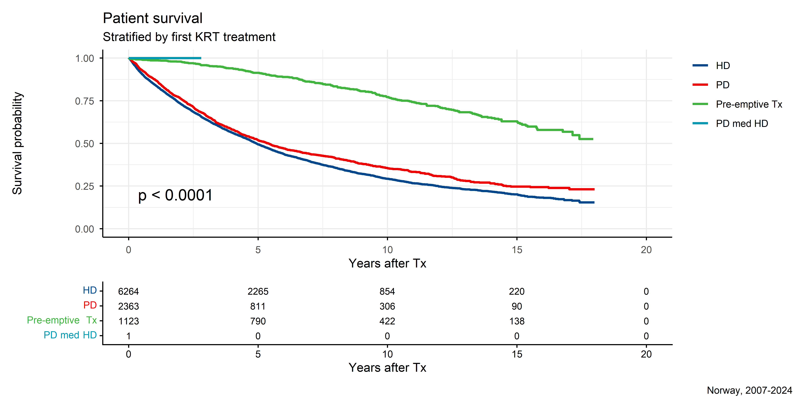

Slide 47
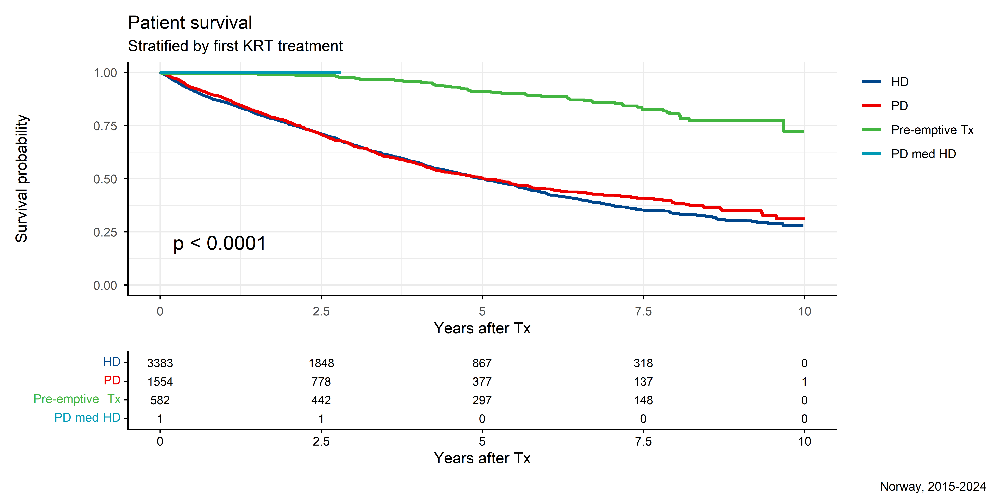

Slide 48
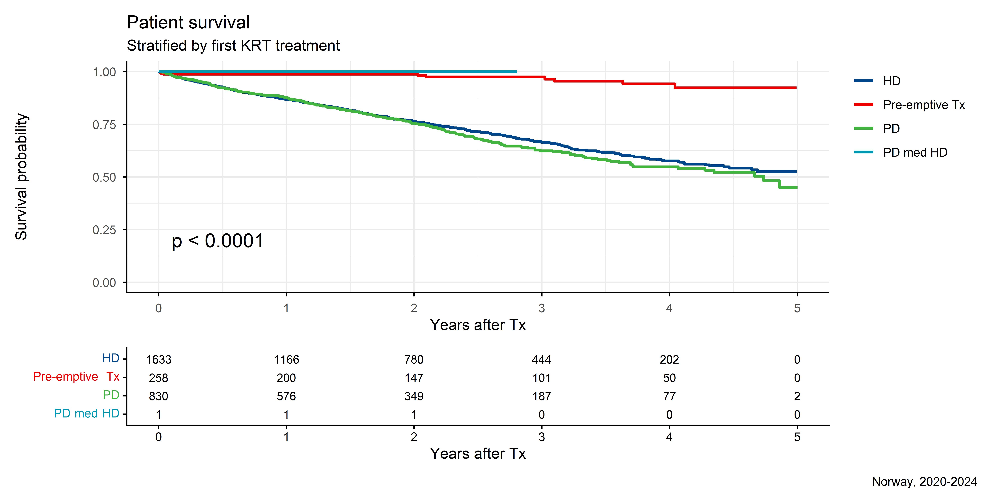

Slide 49
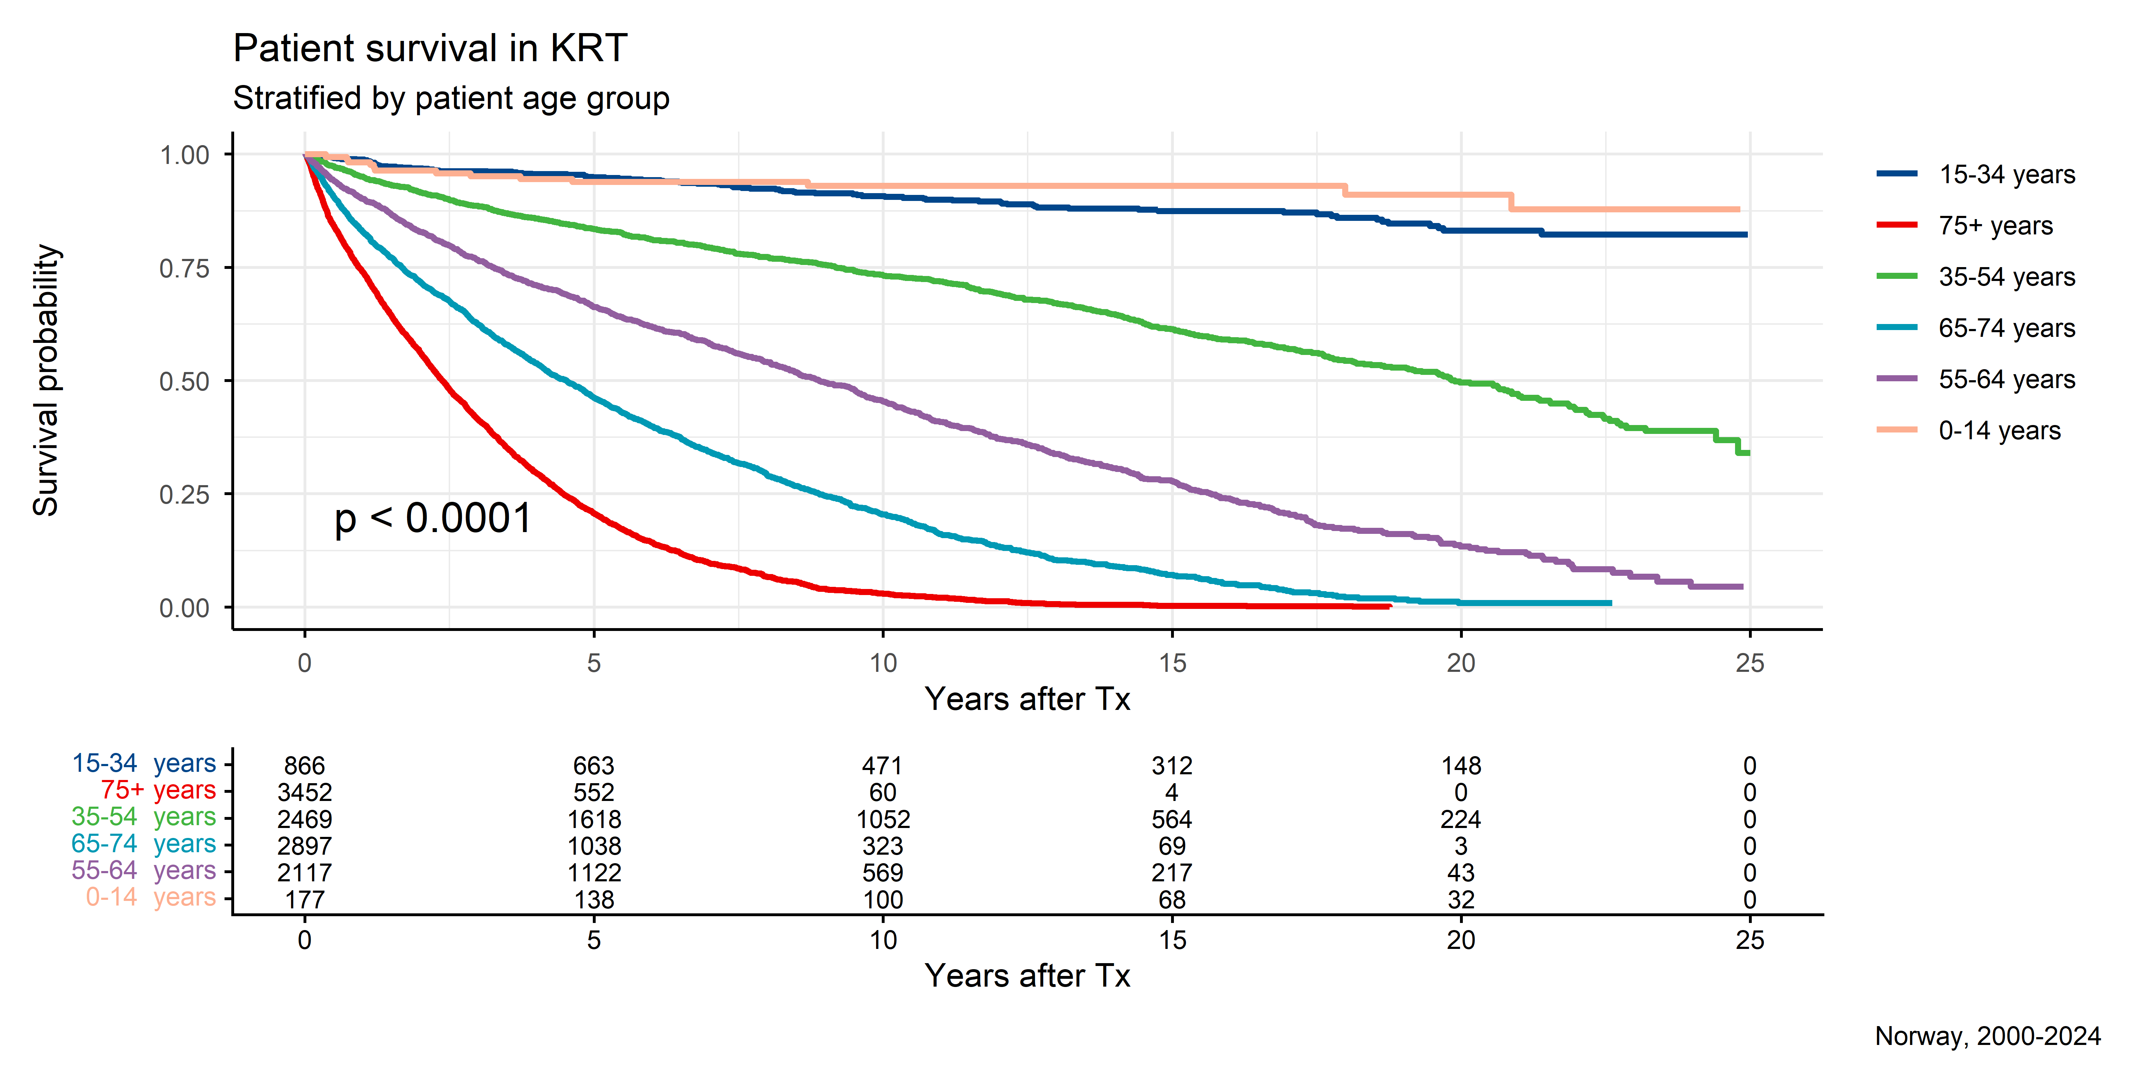
Survival (first KRT and patient age)

Slide 50
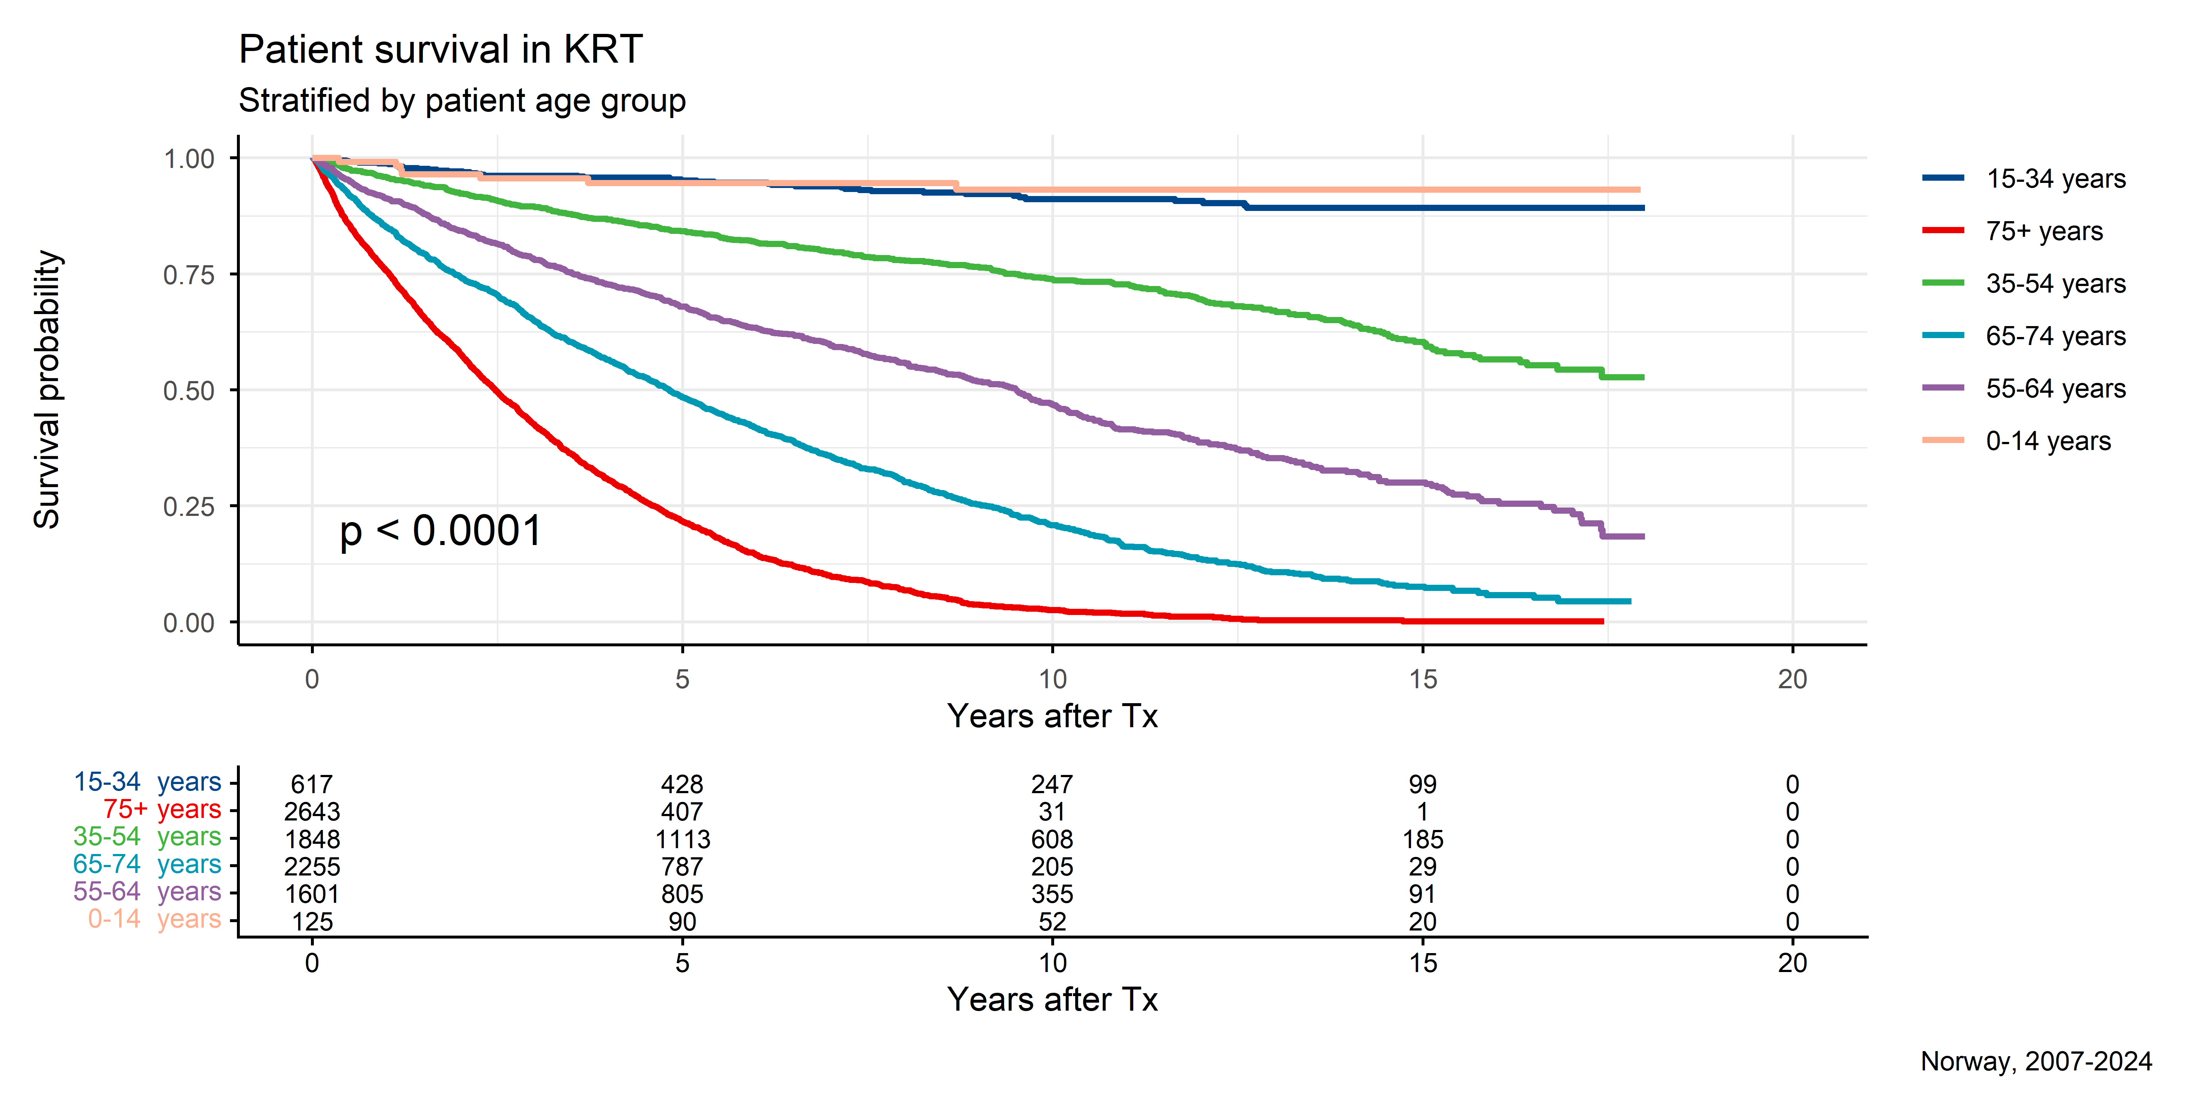

Slide 51
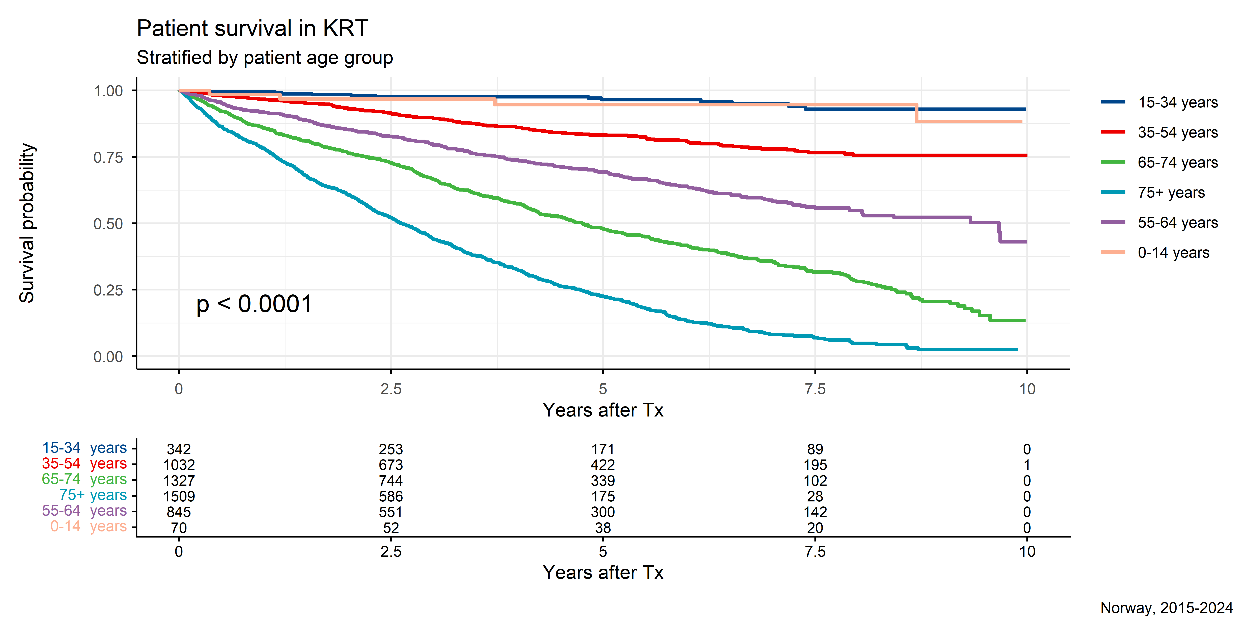

Slide 52
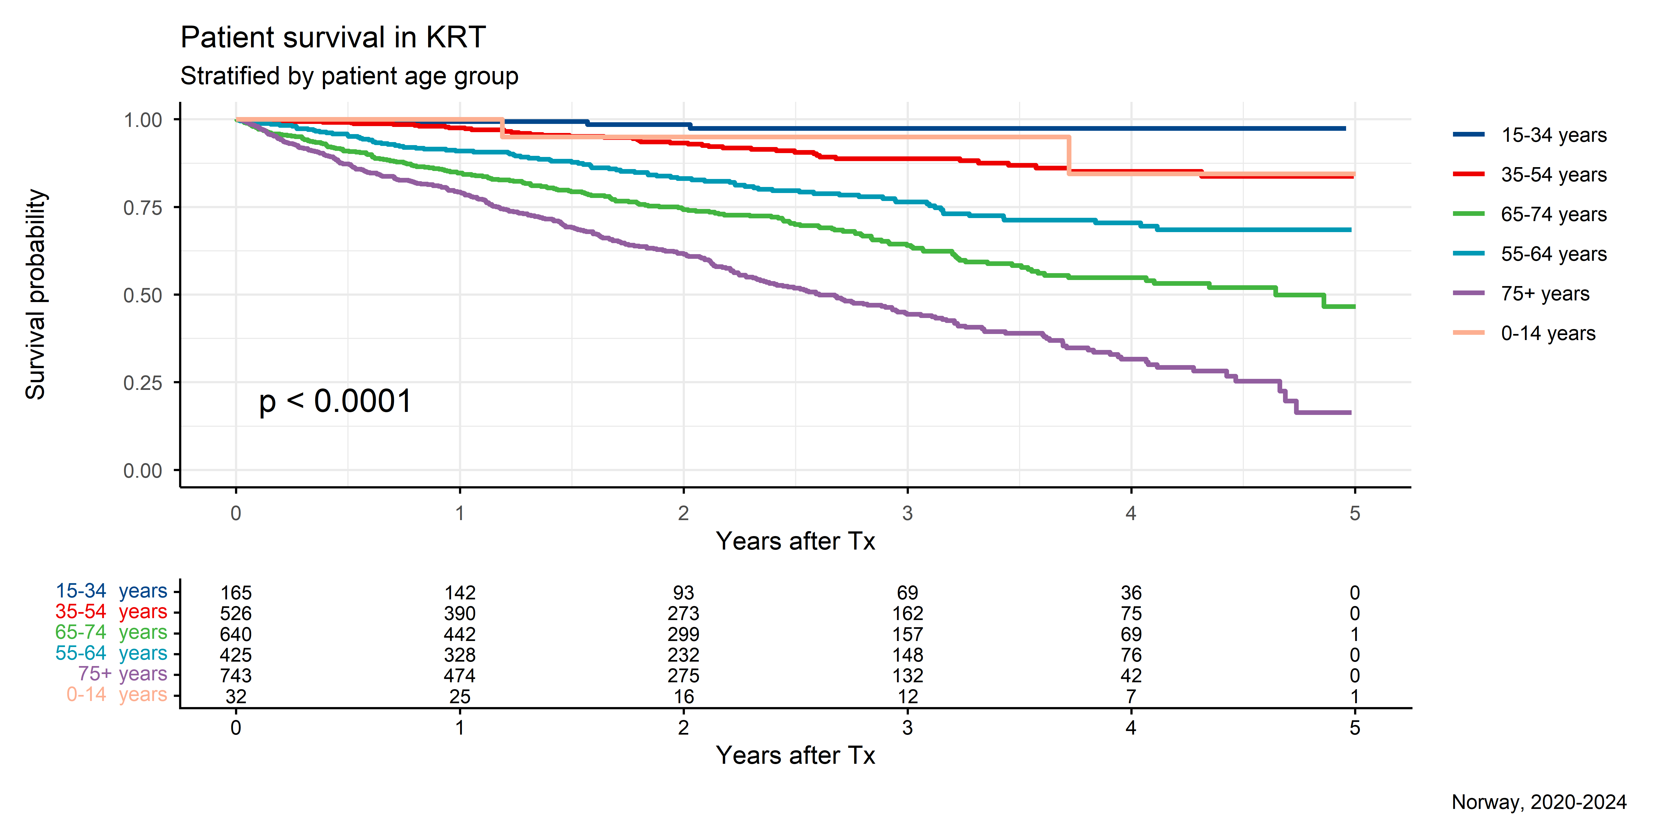

Slide 53
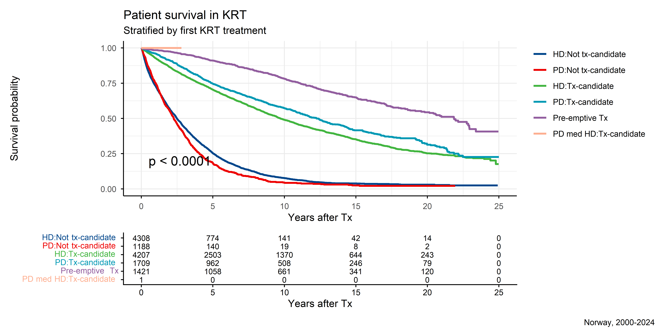
Survival (first KRT and Tx-candidacy)

Slide 54
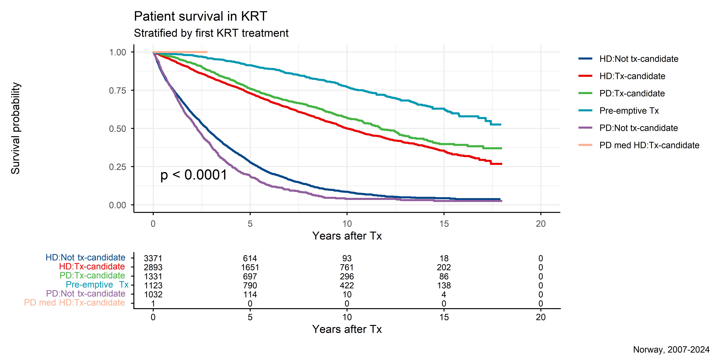

Slide 55
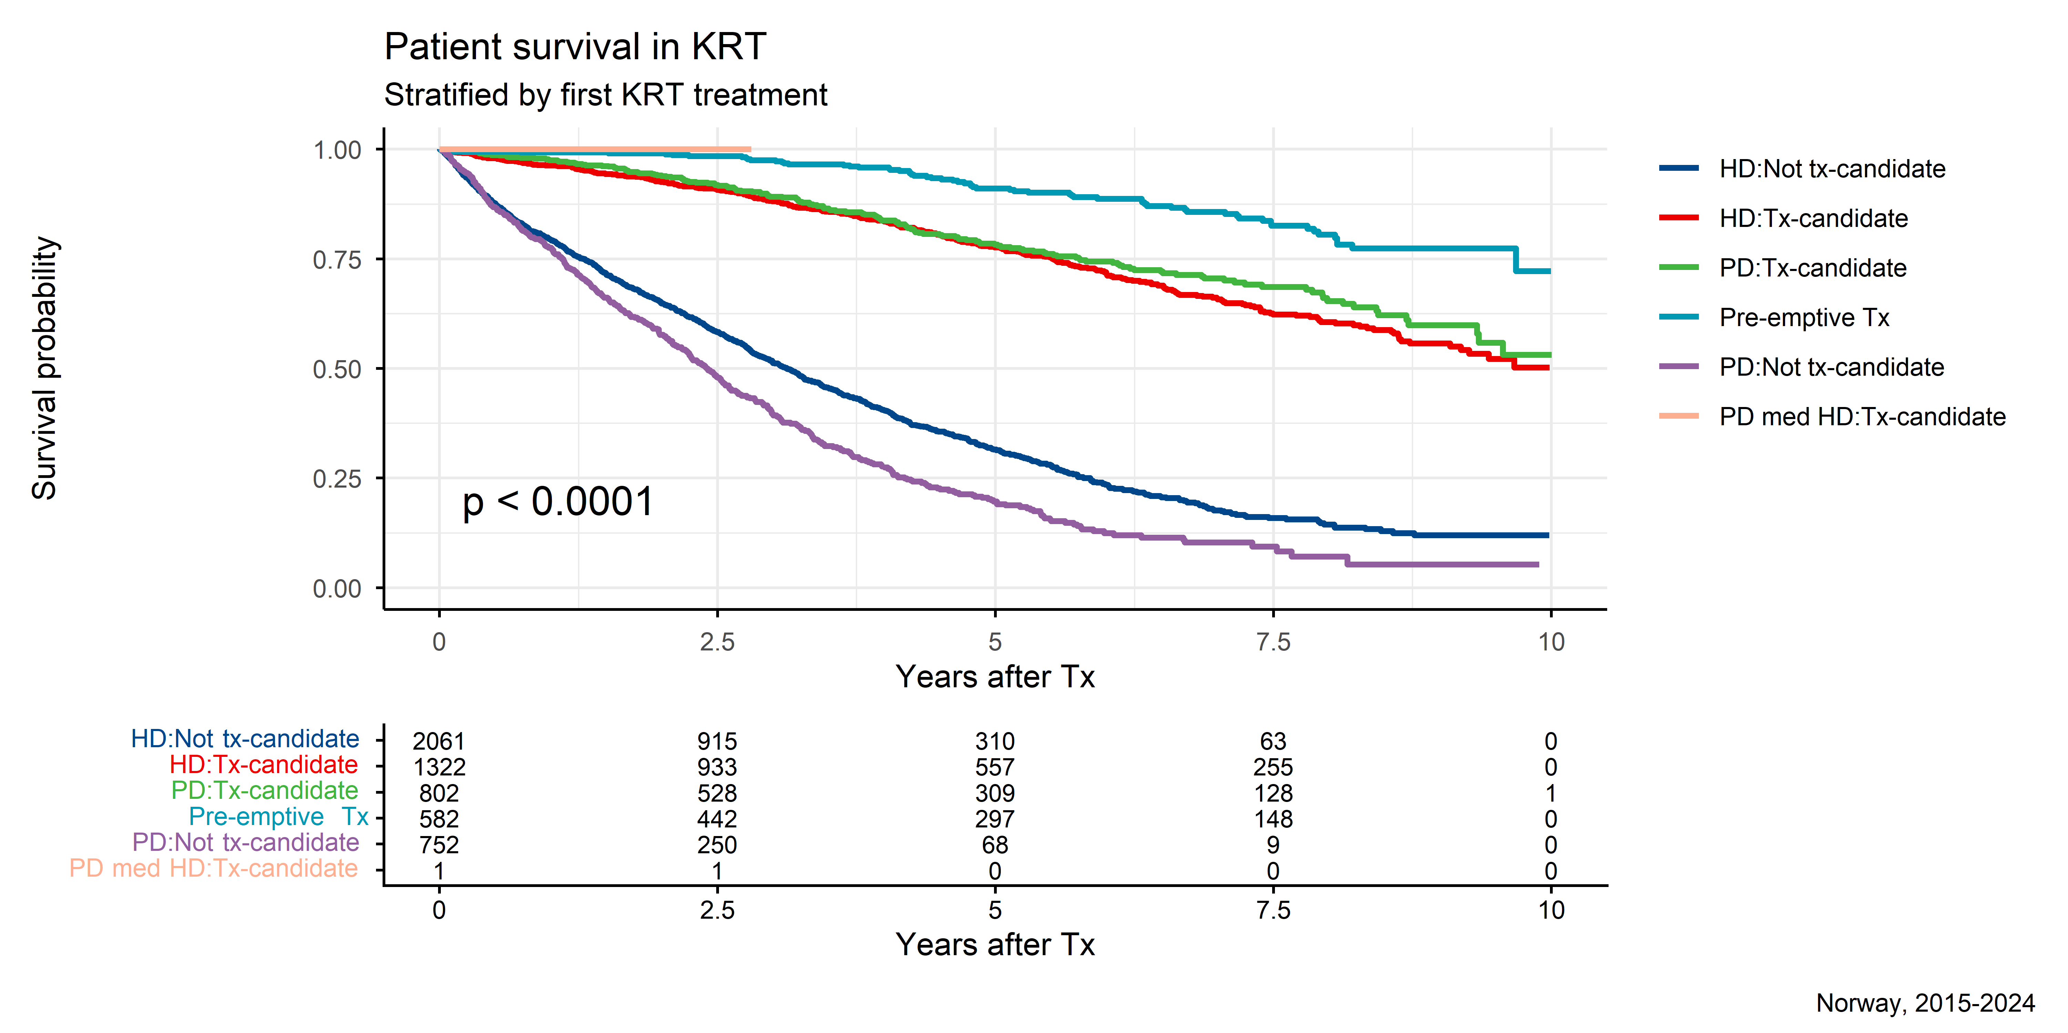

Slide 56
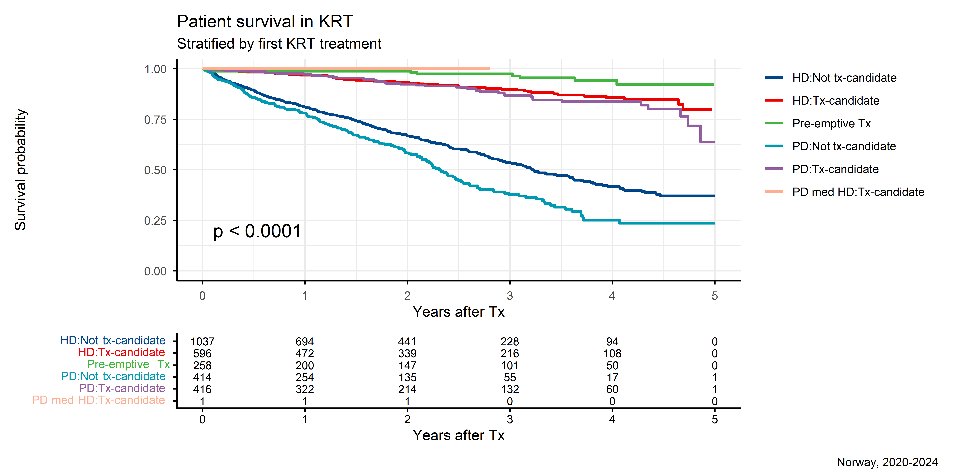

Slide 57

Survival (related, unrelated, deceased)

Slide 58


Slide 59


Slide 60


Slide 61


Slide 62


Slide 63


Slide 64


Slide 65


Slide 66


Slide 67


Slide 68


Slide 69

Survival (DD vs LD)

Slide 70


Slide 71


Slide 72


Slide 73


Slide 74


Slide 75


Slide 76


Slide 77


Slide 78


Slide 79


Slide 80


Slide 81

Survival (CMV, LD+DD)

Slide 82


Slide 83


Slide 84


Slide 85


Slide 86


Slide 87


Slide 88


Slide 89


Slide 90


Slide 91


Slide 92


Slide 93

Survival (CMV by donor type)

Slide 94


Slide 95


Slide 96


Slide 97


Slide 98


Slide 99


Slide 100


Slide 101


Slide 102


Slide 103


Slide 104


Slide 105

Survival (CMV and Tx-period)

Slide 106


Slide 107


Slide 108

Survival (DR-mismatch, LD+DD)

Slide 109


Slide 110


Slide 111


Slide 112


Slide 113


Slide 114


Slide 115


Slide 116


Slide 117


Slide 118


Slide 119


Slide 120

Survival (DR-mismatch by donor type)

Slide 121


Slide 122


Slide 123


Slide 124


Slide 125


Slide 126


Slide 127


Slide 128


Slide 129


Slide 130


Slide 131


Slide 132

Survival (DR-mismatch, DD only)

Slide 133


Slide 134


Slide 135


Slide 136


Slide 137


Slide 138


Slide 139


Slide 140


Slide 141


Slide 142


Slide 143


Slide 144

Survival (DR-mismatch, LD only)

Slide 145


Slide 146


Slide 147


Slide 148


Slide 149


Slide 150


Slide 151


Slide 152


Slide 153


Slide 154


Slide 155


Slide 156

Survival (DR-mismatch 2, LD+DD)

Slide 157


Slide 158


Slide 159


Slide 160


Slide 161


Slide 162


Slide 163


Slide 164


Slide 165


Slide 166


Slide 167


Slide 168

Survival (DR-mismatch 2 by donor type)

Slide 169


Slide 170


Slide 171


Slide 172


Slide 173


Slide 174


Slide 175


Slide 176


Slide 177


Slide 178


Slide 179


Slide 180

Survival (DR-mismatch 2, DD only)

Slide 181


Slide 182


Slide 183


Slide 184


Slide 185


Slide 186


Slide 187


Slide 188


Slide 189


Slide 190


Slide 191


Slide 192

Survival (DR-mismatch 2, LD only)

Slide 193


Slide 194


Slide 195


Slide 196


Slide 197


Slide 198


Slide 199


Slide 200


Slide 201


Slide 202


Slide 203


Slide 204

Survival (Patient age)

Slide 205


Slide 206


Slide 207


Slide 208


Slide 209


Slide 210


Slide 211


Slide 212


Slide 213


Slide 214


Slide 215


Slide 216

Survival (Patient age, DD only)

Slide 217


Slide 218


Slide 219


Slide 220


Slide 221


Slide 222


Slide 223


Slide 224


Slide 225


Slide 226


Slide 227


Slide 228

Survival (Patient age, LD only)

Slide 229


Slide 230


Slide 231


Slide 232


Slide 233


Slide 234


Slide 235


Slide 236


Slide 237


Slide 238


Slide 239


Slide 240

Survival (Patient age 2)

Slide 241


Slide 242


Slide 243


Slide 244


Slide 245


Slide 246


Slide 247


Slide 248


Slide 249


Slide 250


Slide 251


Slide 252

Survival (Patient age 2, DD only)

Slide 253


Slide 254


Slide 255


Slide 256


Slide 257


Slide 258


Slide 259


Slide 260


Slide 261


Slide 262


Slide 263


Slide 264

Survival (Patient age 2, LD only)

Slide 265


Slide 266


Slide 267


Slide 268


Slide 269


Slide 270


Slide 271


Slide 272


Slide 273


Slide 274


Slide 275


Slide 276

Survival (Patient age above/below 65)

Slide 277


Slide 278


Slide 279


Slide 280


Slide 281


Slide 282


Slide 283


Slide 284


Slide 285


Slide 286


Slide 287


Slide 288

Survival (Patient age above/below 65 and donor source)

Slide 289


Slide 290


Slide 291


Slide 292


Slide 293


Slide 294


Slide 295


Slide 296


Slide 297


Slide 298


Slide 299


Slide 300

Survival (time in dialysis)

Slide 301


Slide 302


Slide 303


Slide 304


Slide 305


Slide 306


Slide 307


Slide 308


Slide 309


Slide 310


Slide 311


Slide 312

Survival (time in dialysis, DD only)

Slide 313


Slide 314


Slide 315


Slide 316


Slide 317


Slide 318


Slide 319


Slide 320


Slide 321


Slide 322


Slide 323


Slide 324

Survival (time in dialysis, LD only)

Slide 325


Slide 326


Slide 327


Slide 328


Slide 329


Slide 330


Slide 331


Slide 332


Slide 333


Slide 334


Slide 335


Slide 336

Survival (Tx-period 1)

Slide 337


Slide 338


Slide 339

Survival (Tx-period 1, DD only)

Slide 340


Slide 341


Slide 342

Survival (Tx-period 1, LD only)

Slide 343


Slide 344


Slide 345
GEOGRAPHICAL ANALYSIS

Slide 346

Absolute prevalence of kidney disease

