Slide 1
MRS Slidepack
Norsk Nyreregister

Slide 2
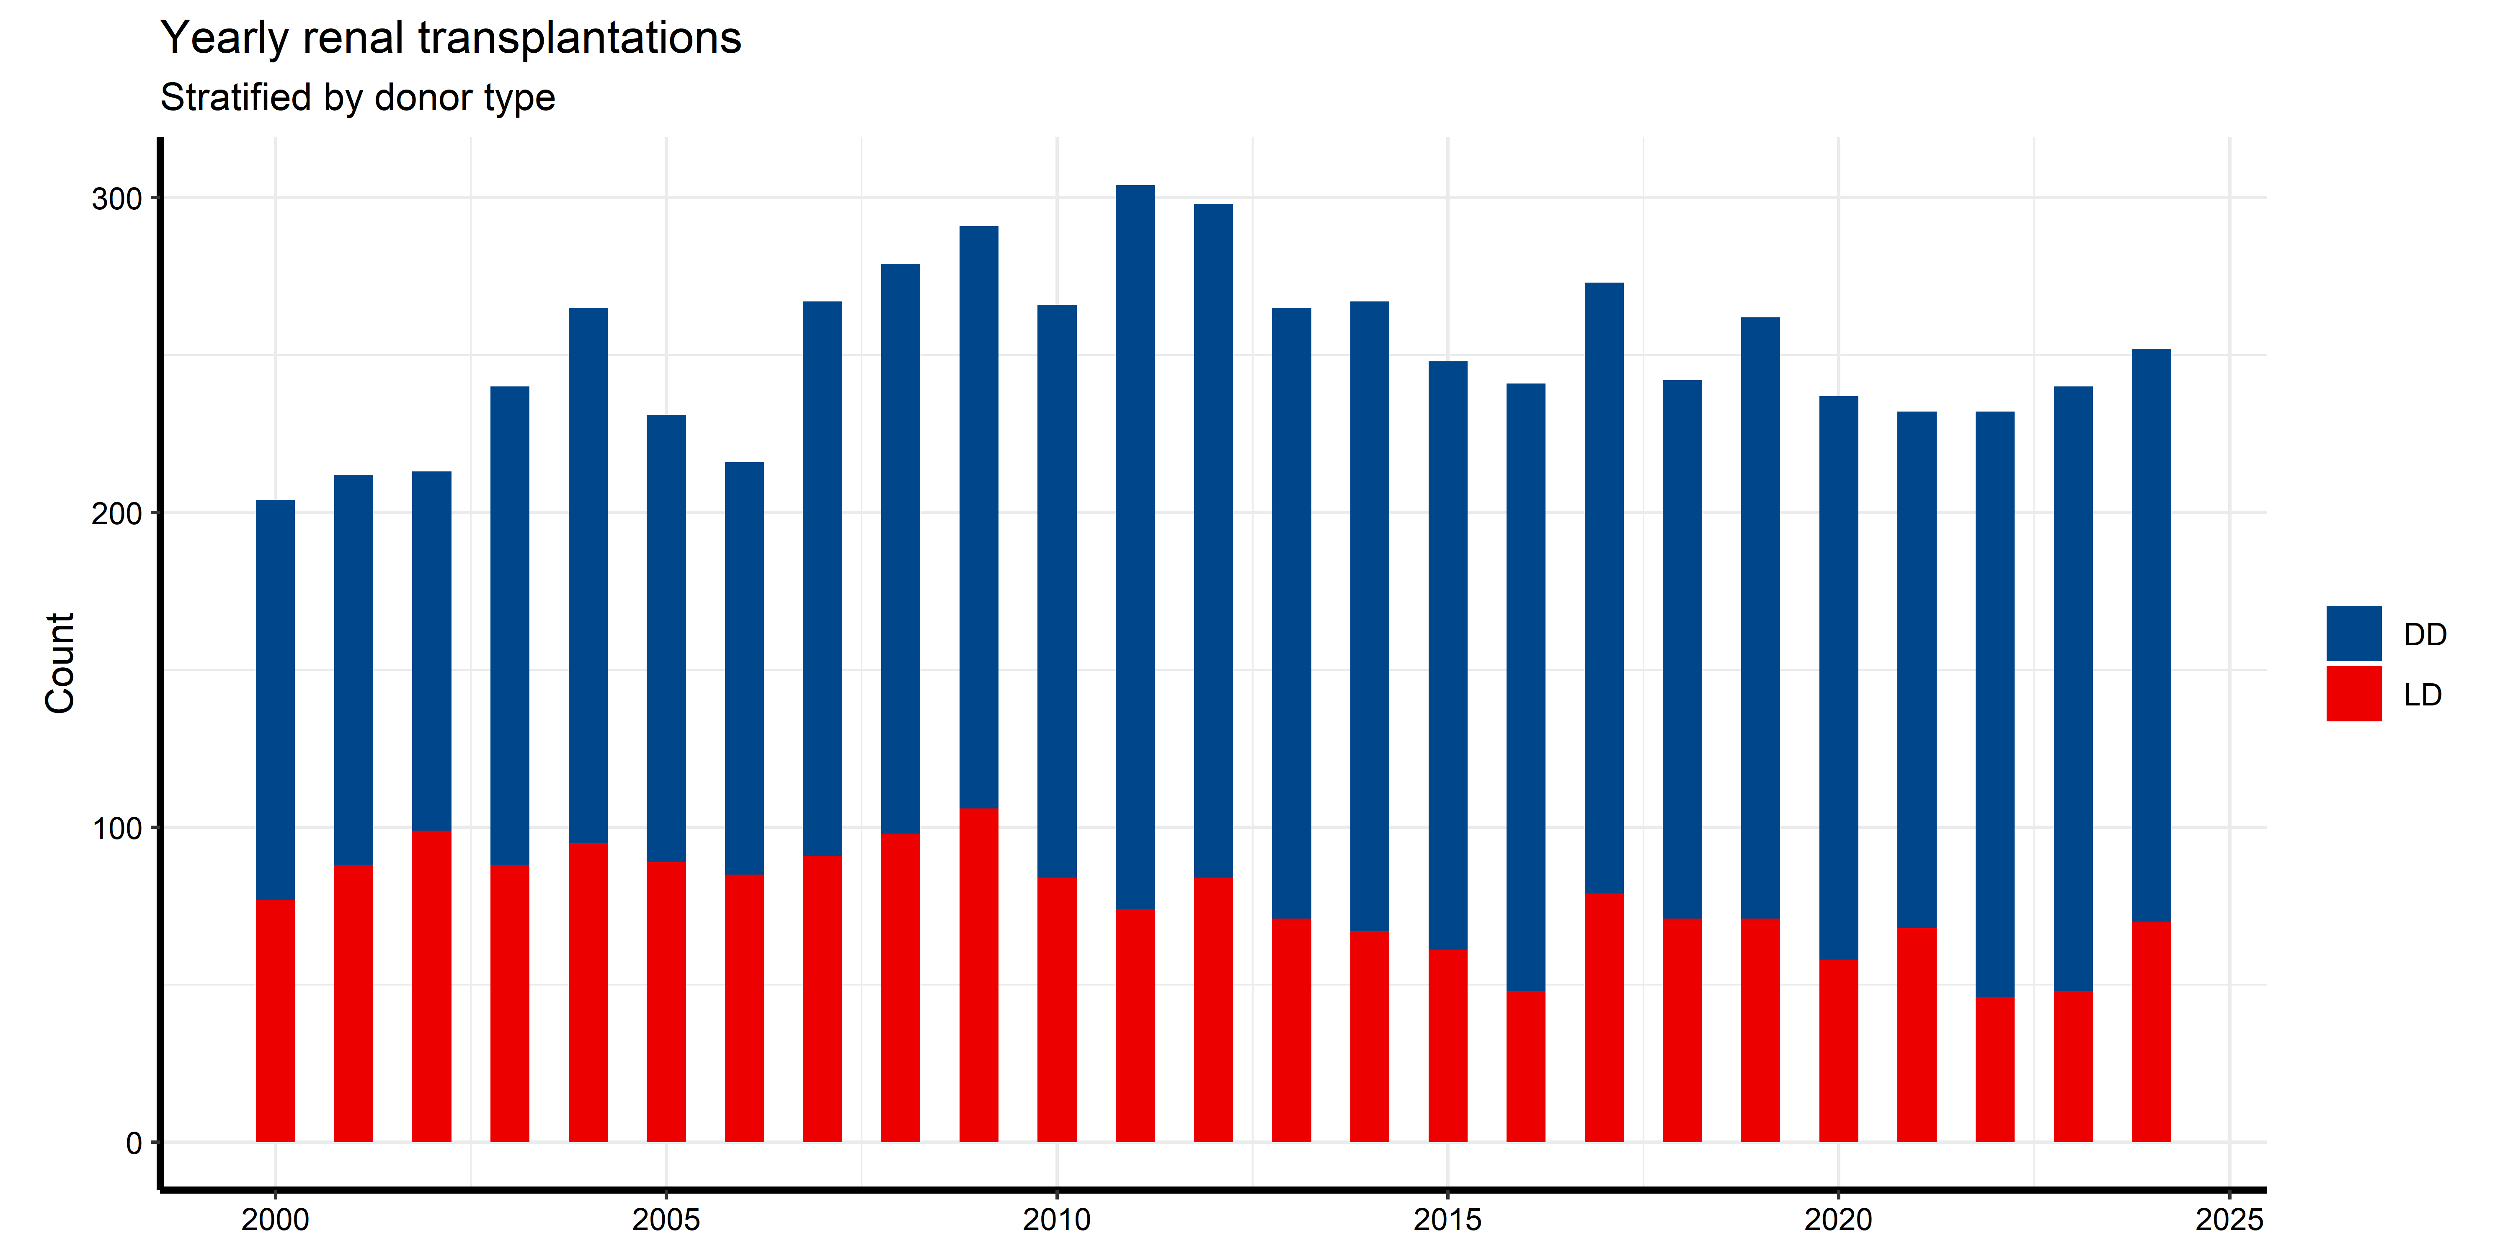
Yearly renal transplantations (including SPK)

Slide 3
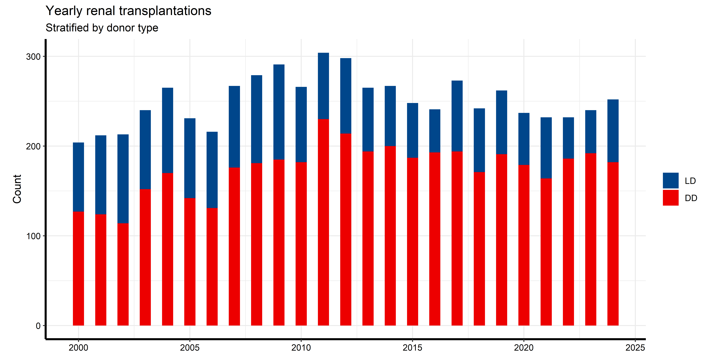

Slide 4
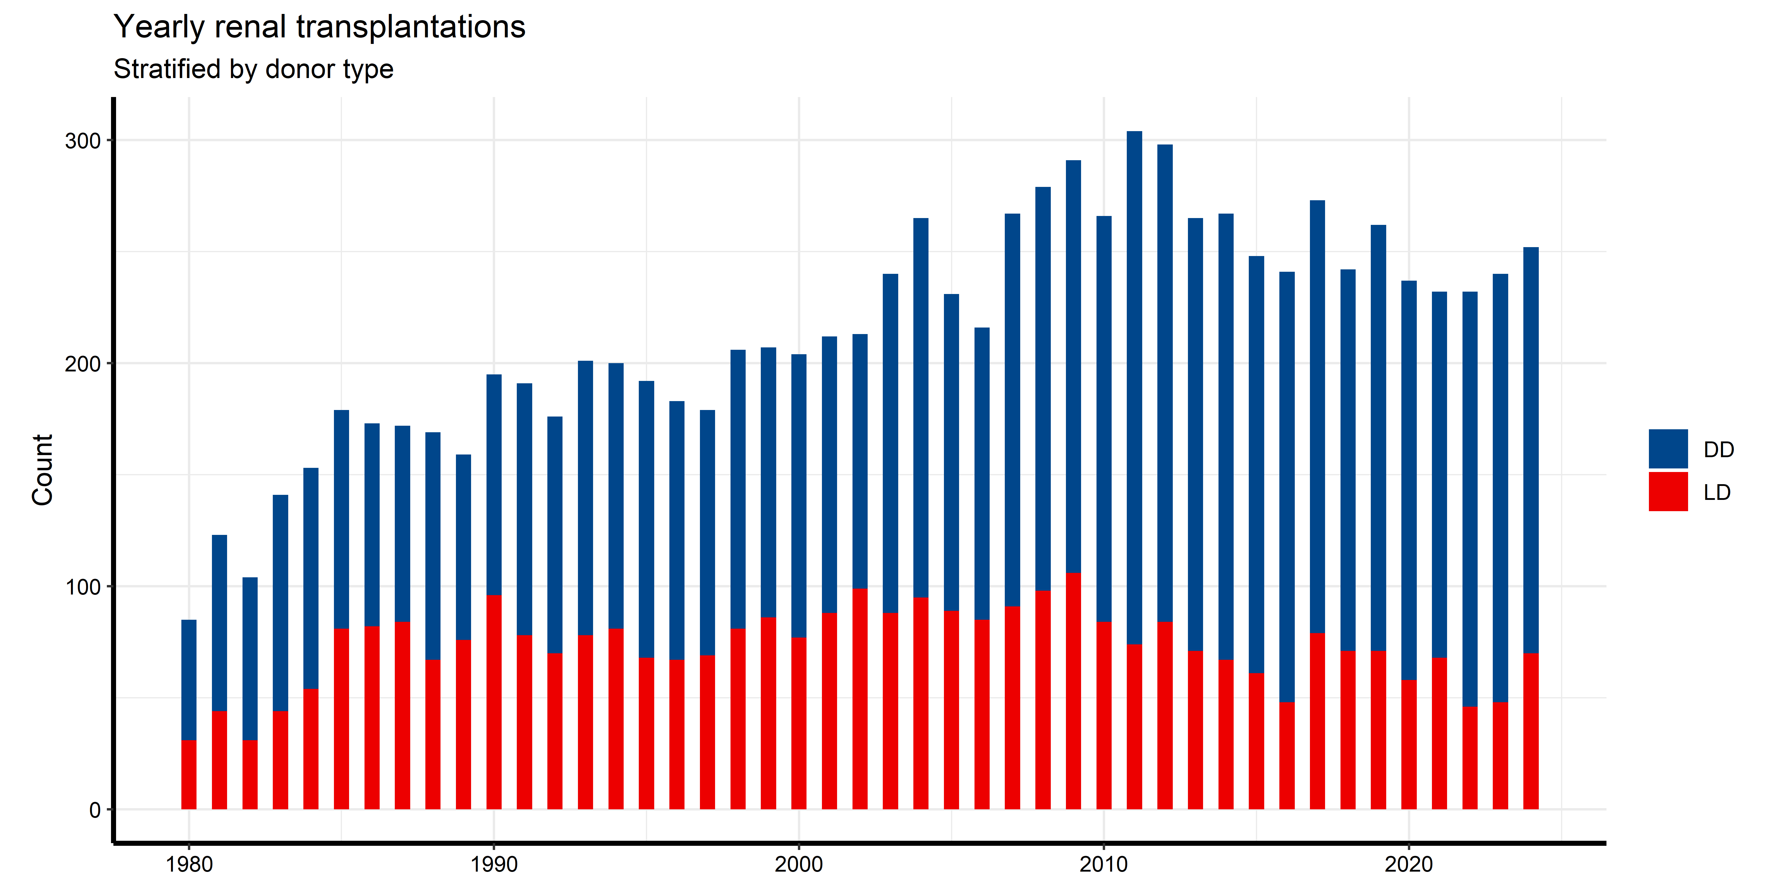

Slide 5
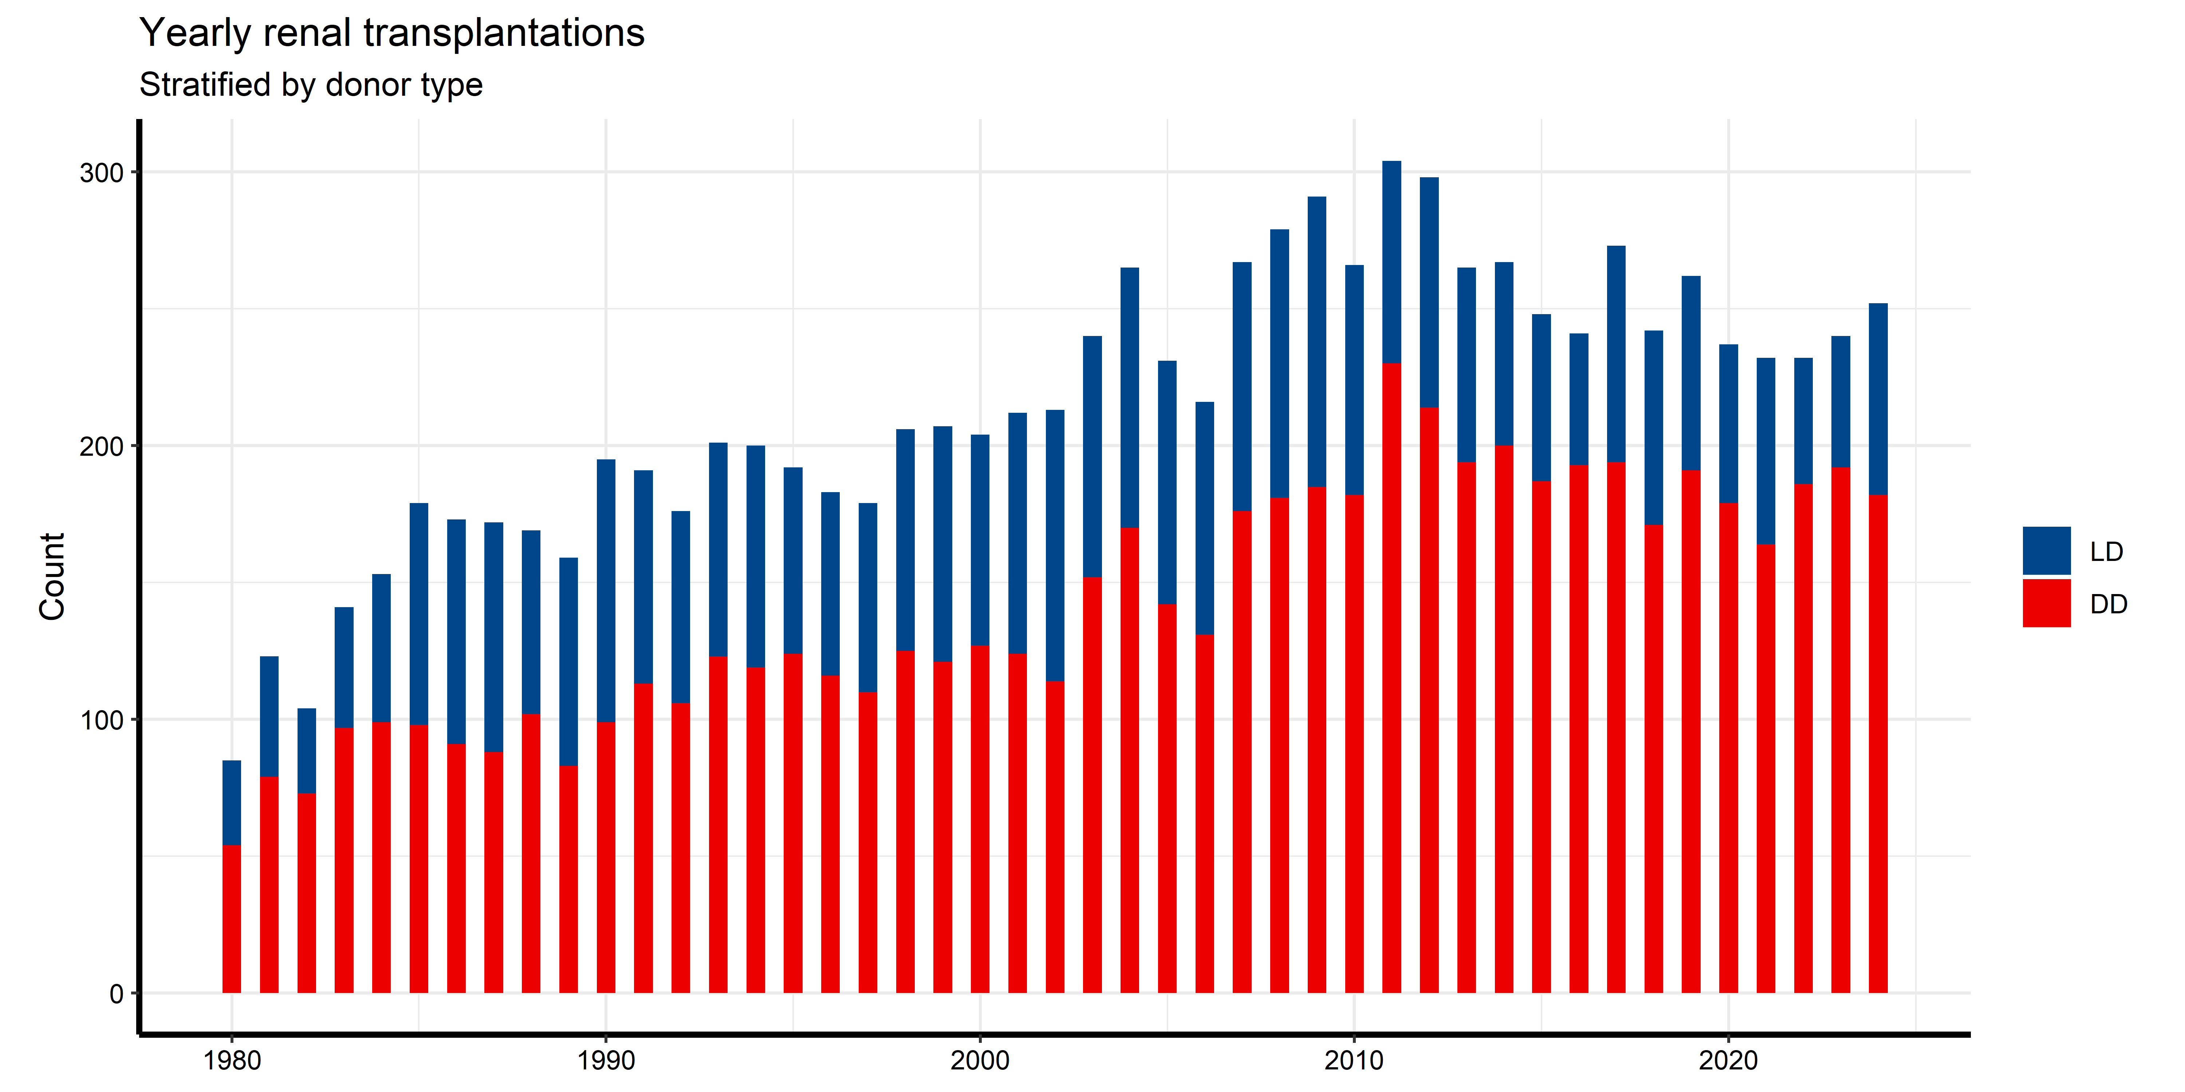

Slide 6
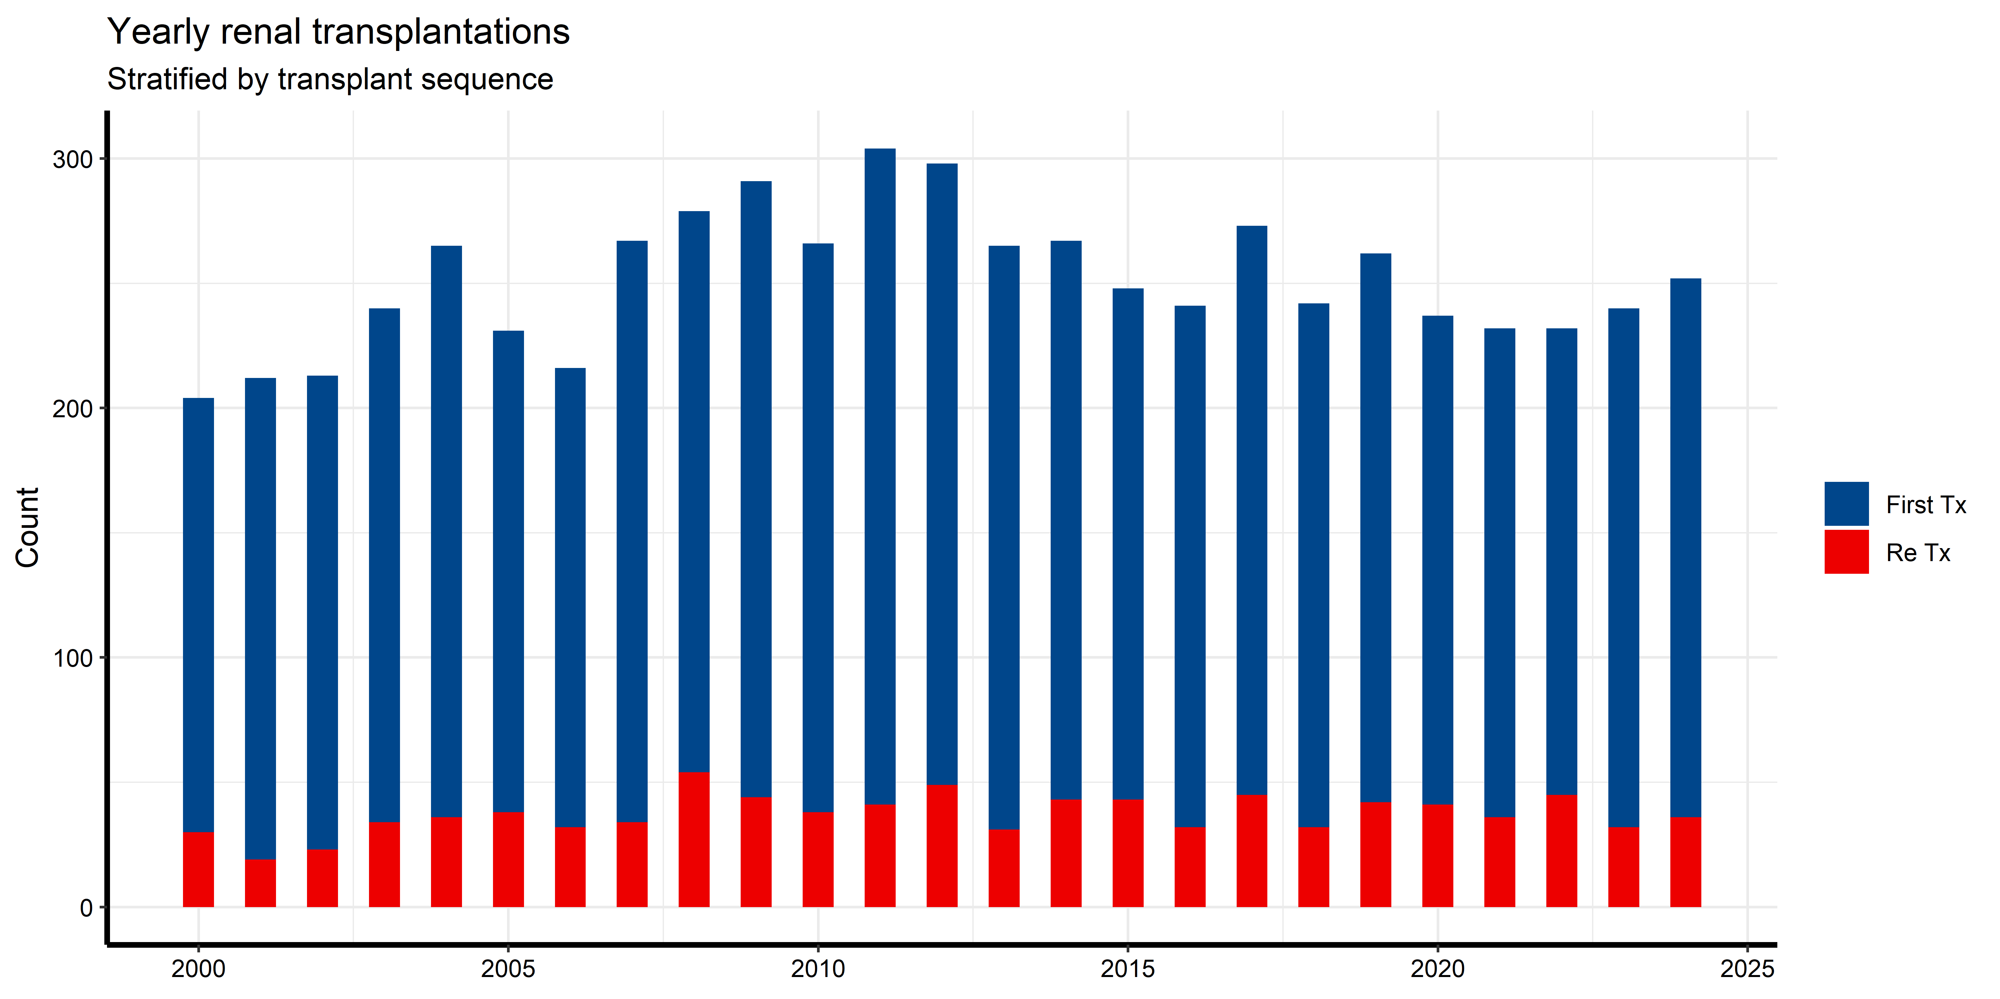
Yearly renal transplantations (first vs reTx)

Slide 7
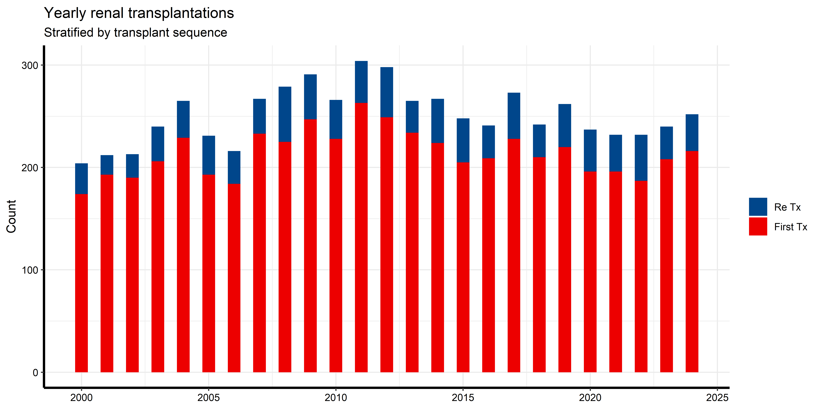

Slide 8
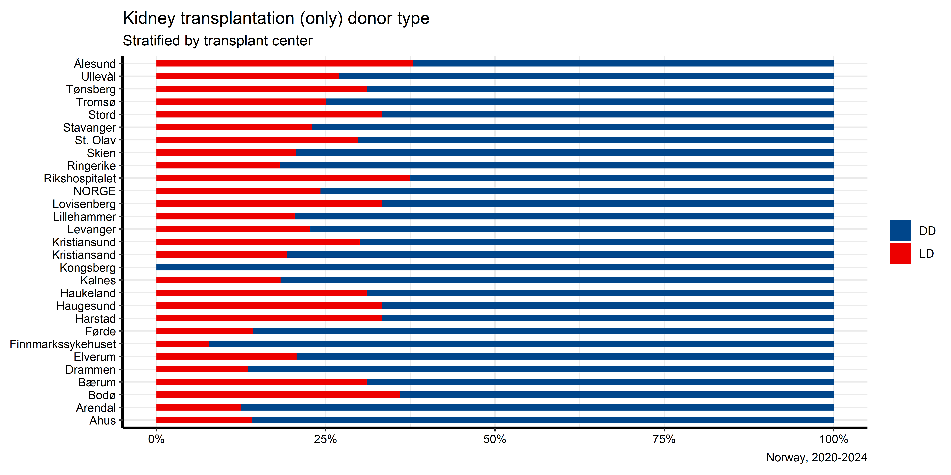
Fraction LD/DD by center (last 5 years)

Slide 9
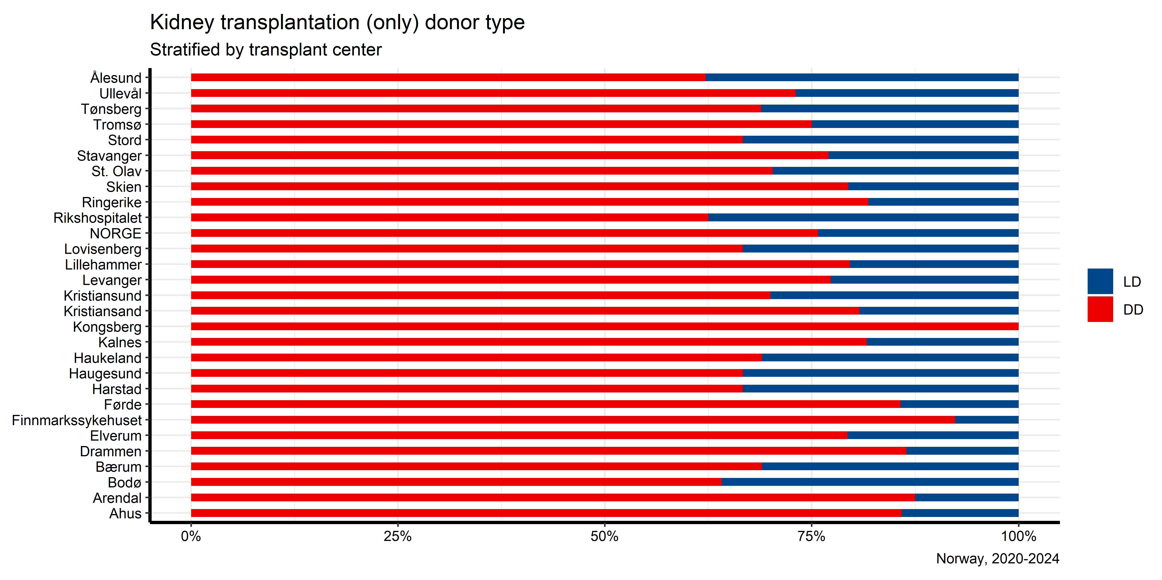

Slide 10
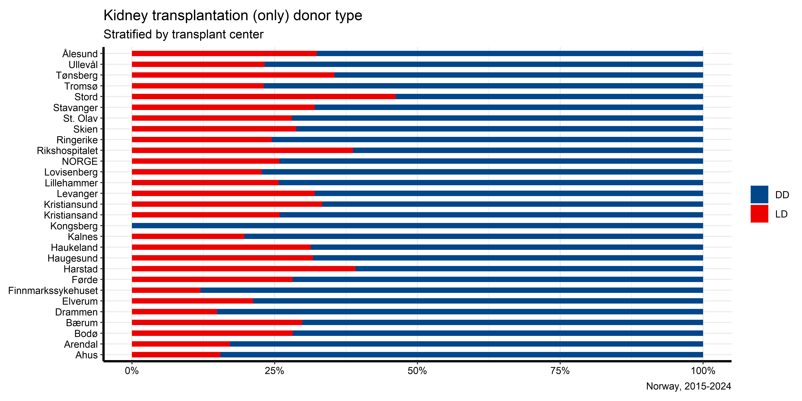
Fraction LD/DD by center (last 10 years)

Slide 11
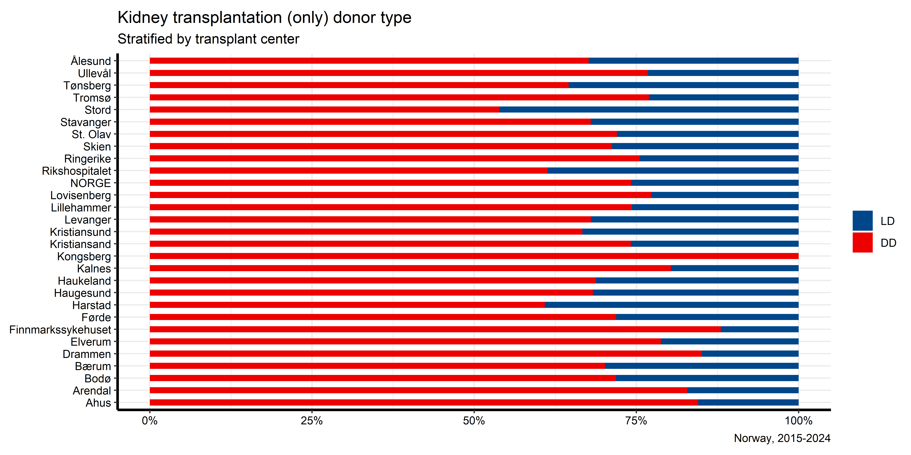

Slide 12
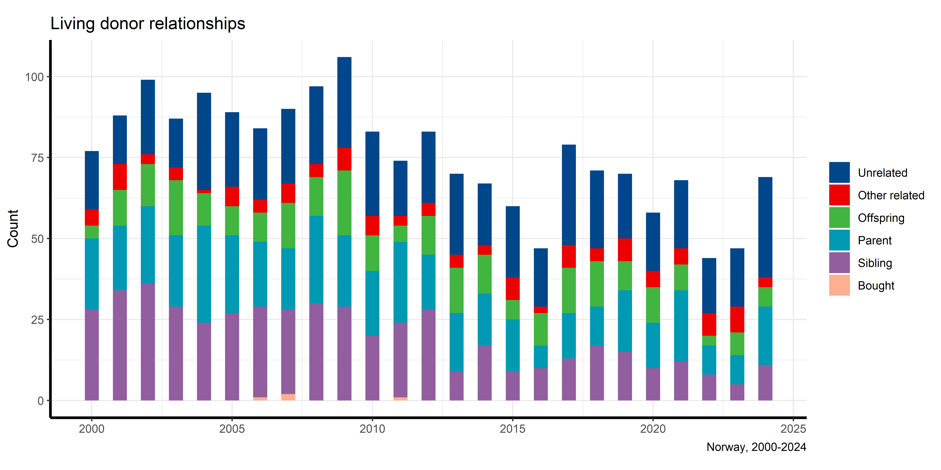
Living donor relationships

Slide 13
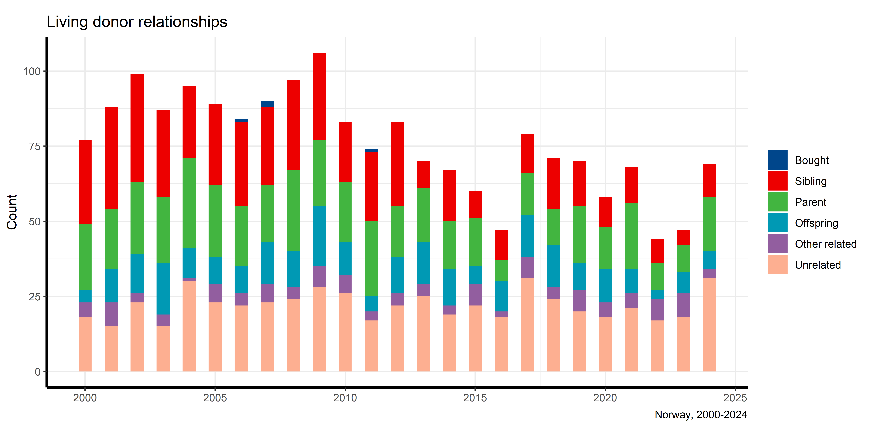

Slide 14
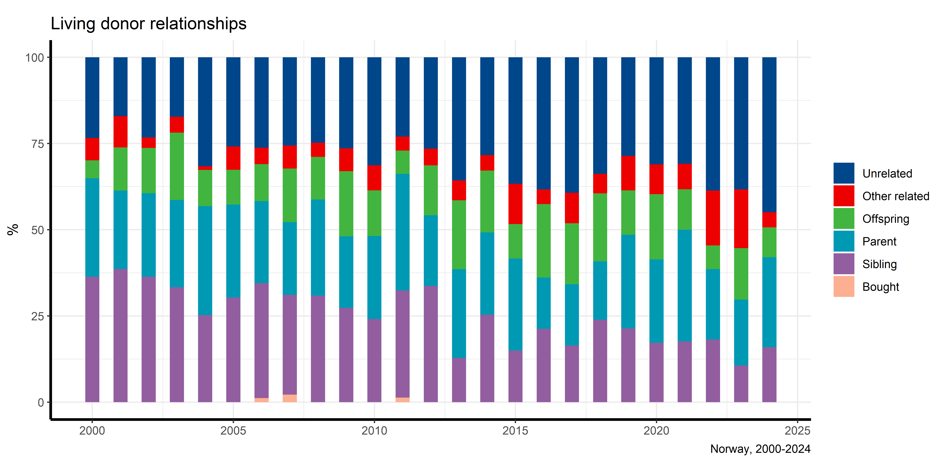
Living donor relationships (proportion)

Slide 15
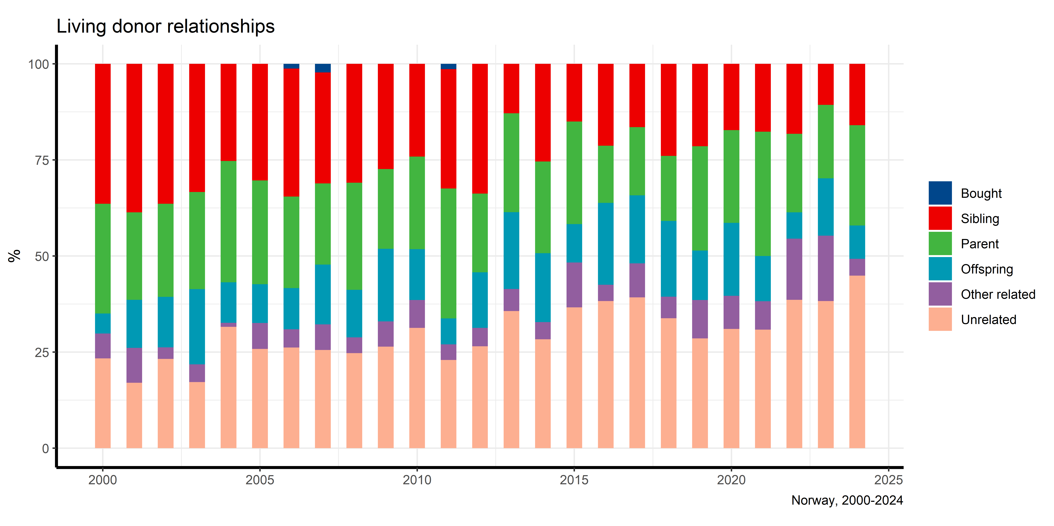

Slide 16
# RRT prevalence

Slide 17
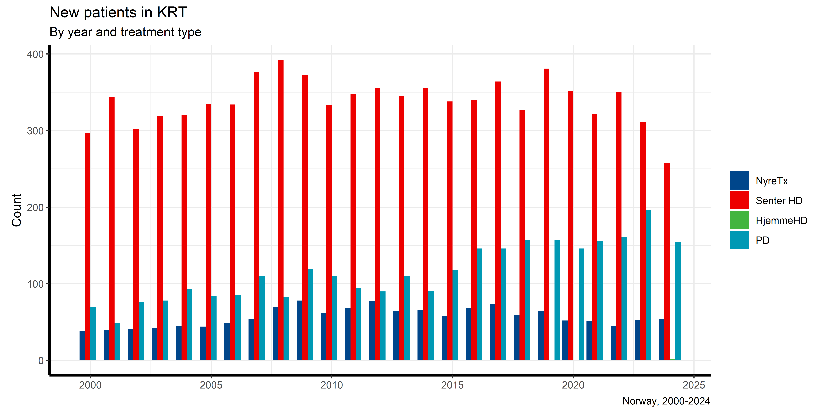
New patients in KRT

Slide 18
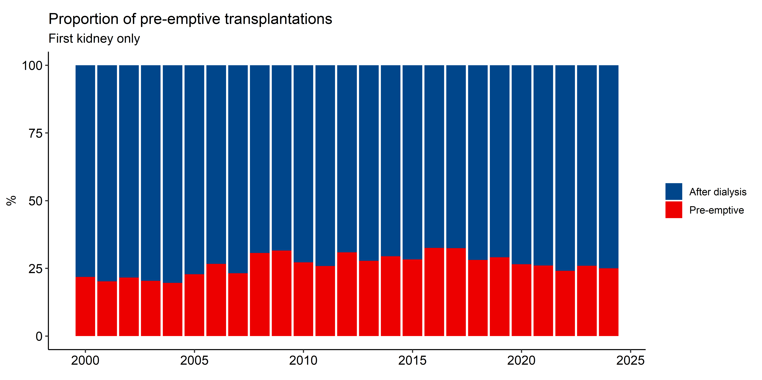
Pre-emptive transplantations by year

Slide 19
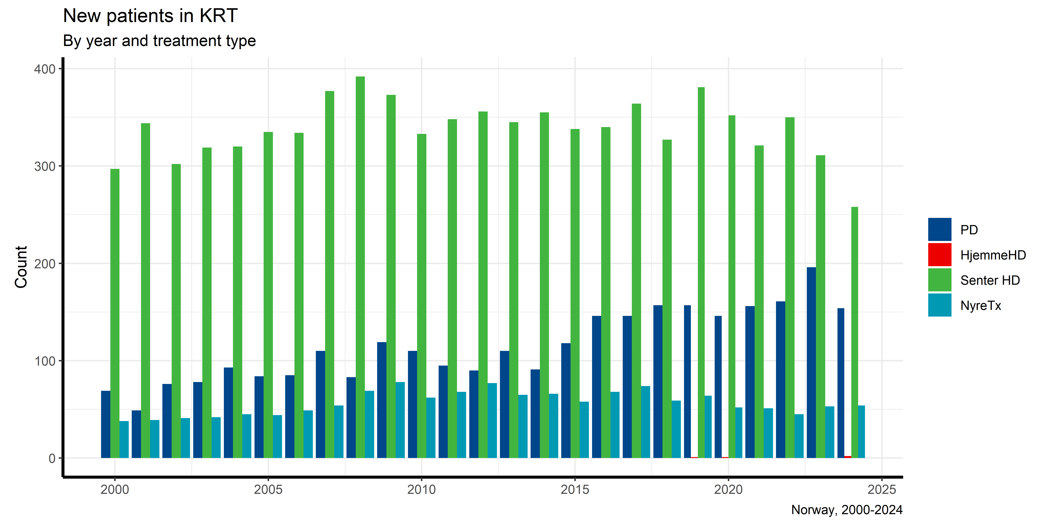

Slide 20
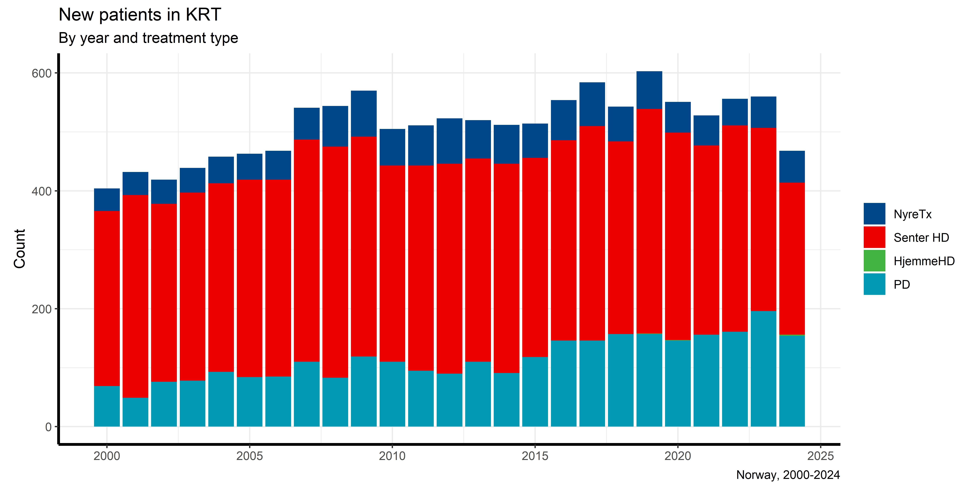
New patients in KRT (stacked)

Slide 21
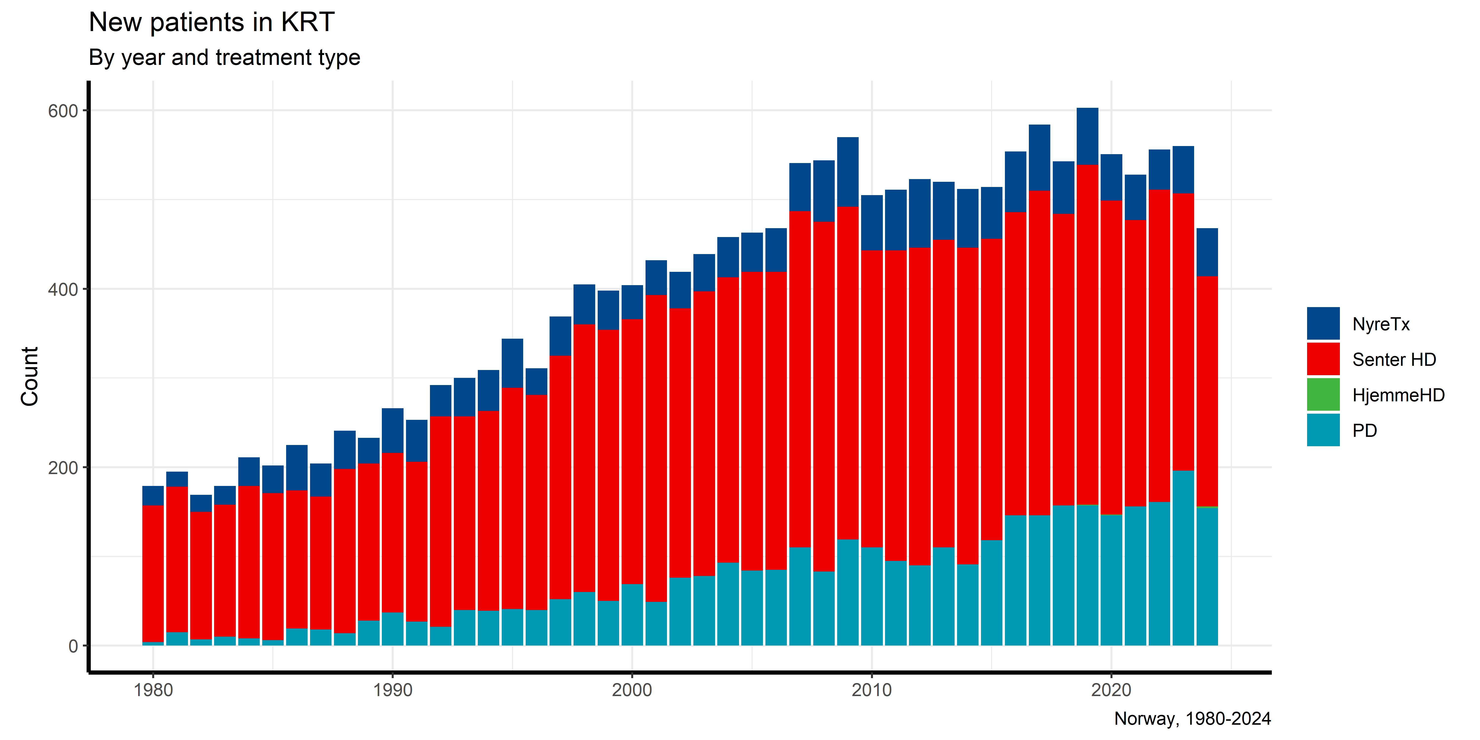
New patients in KRT (stacked, from 1980)

Slide 22
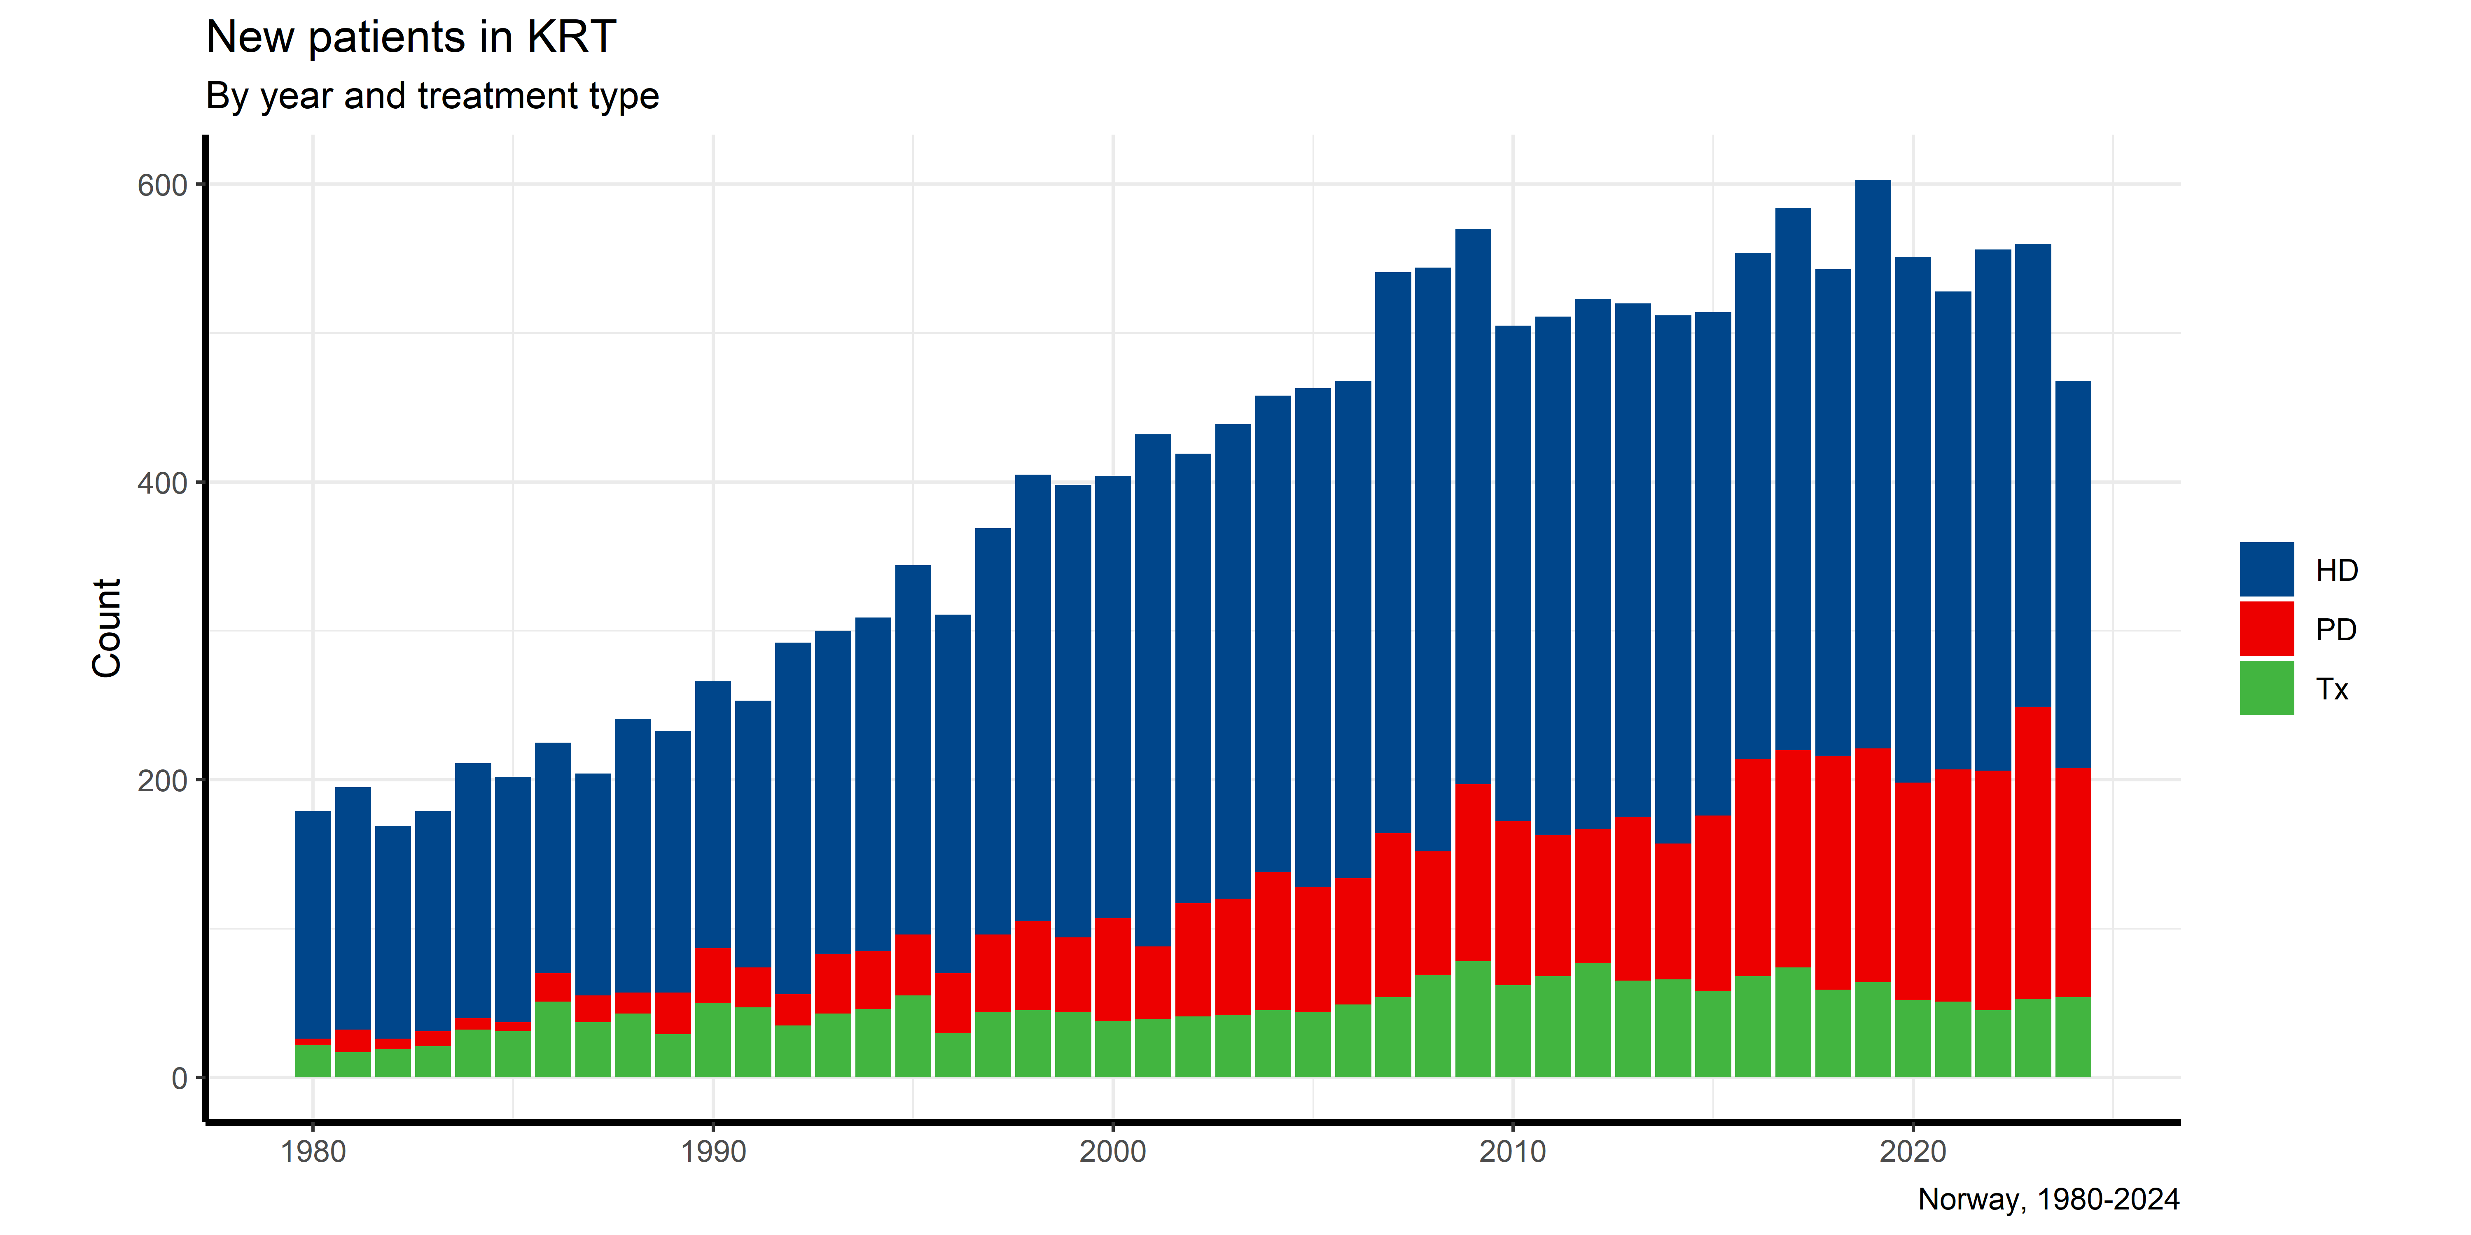
New patients in KRT (stacked, from 1980)

Slide 23
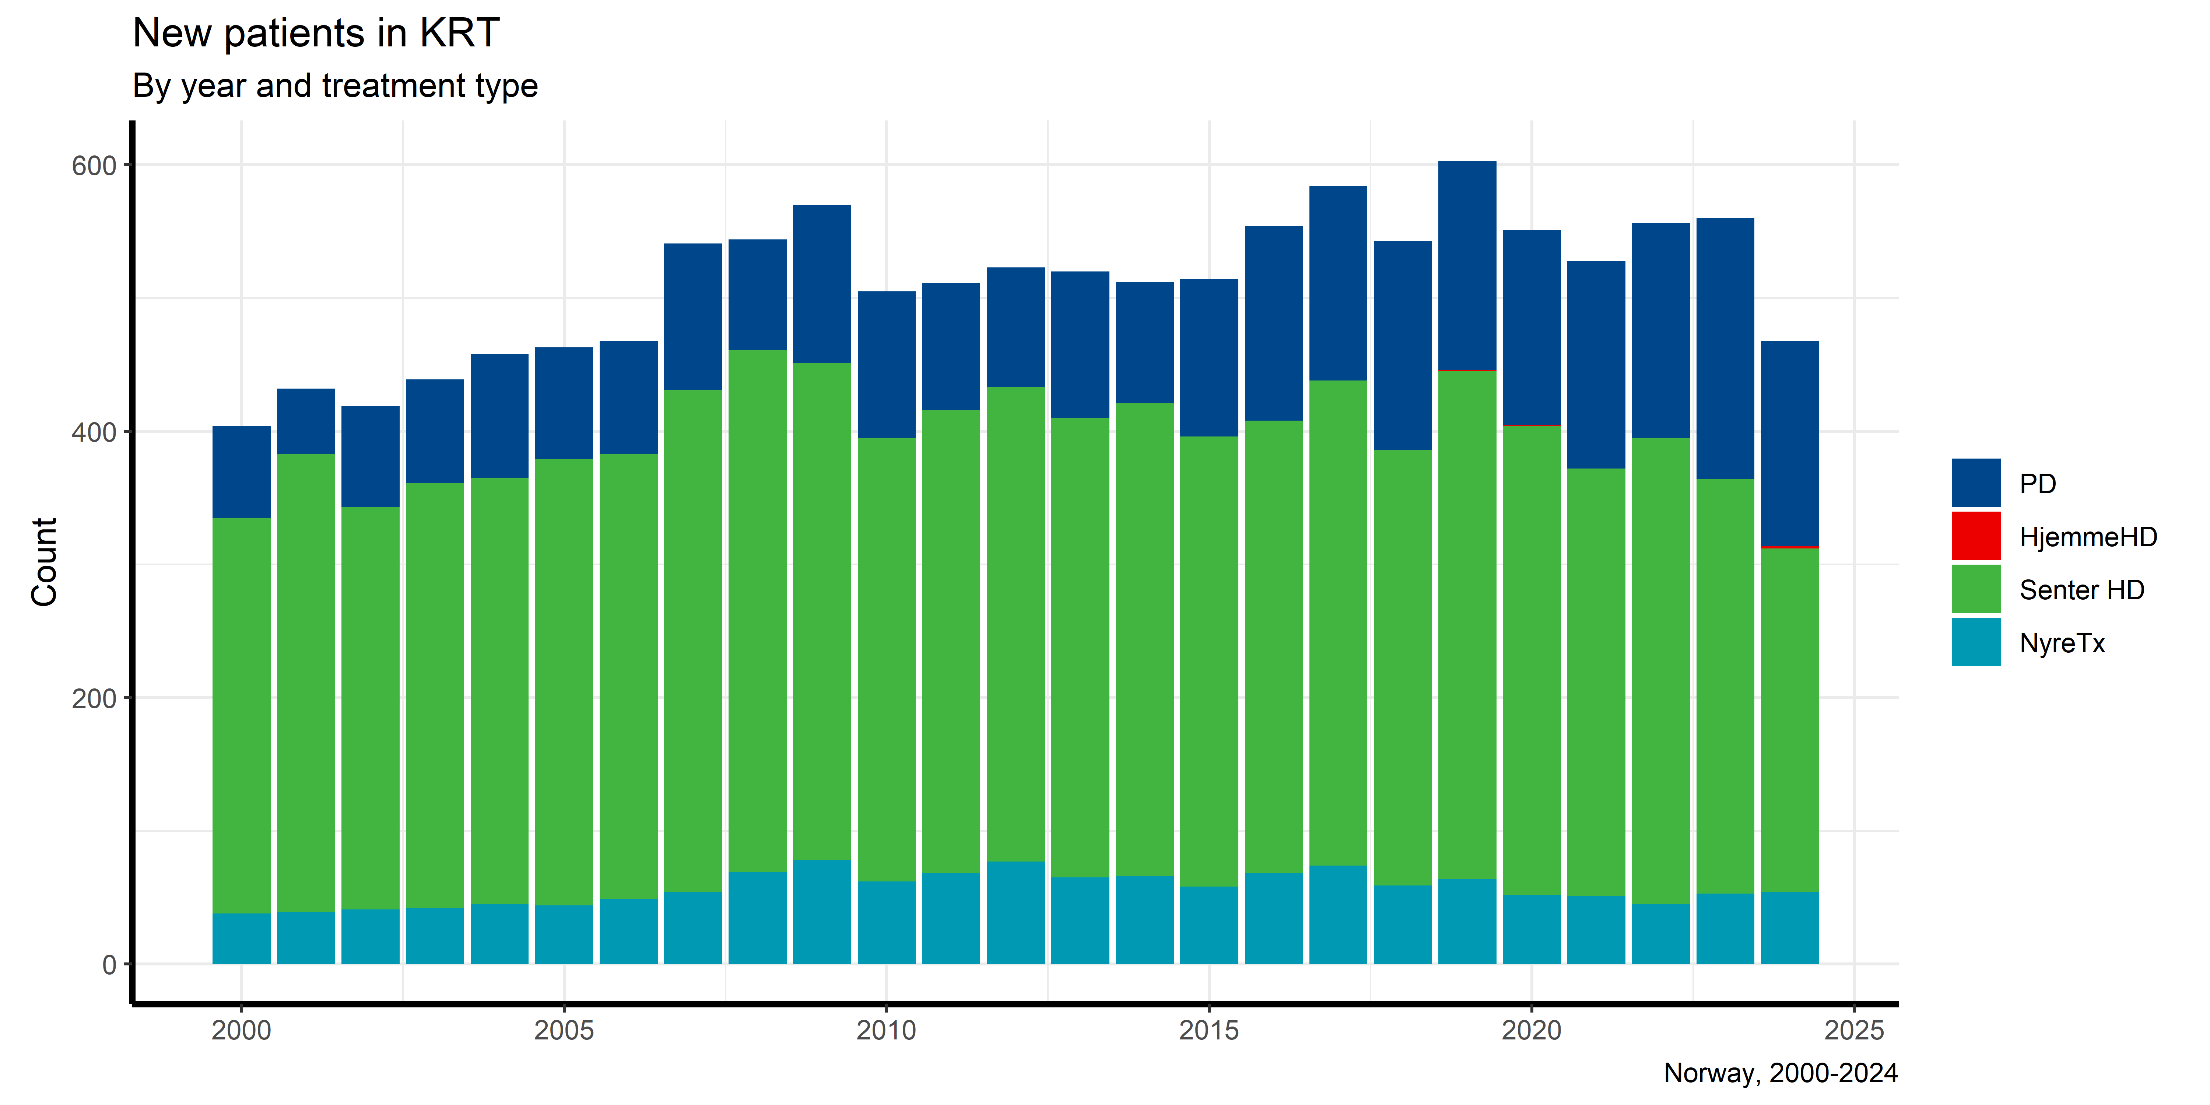

Slide 24
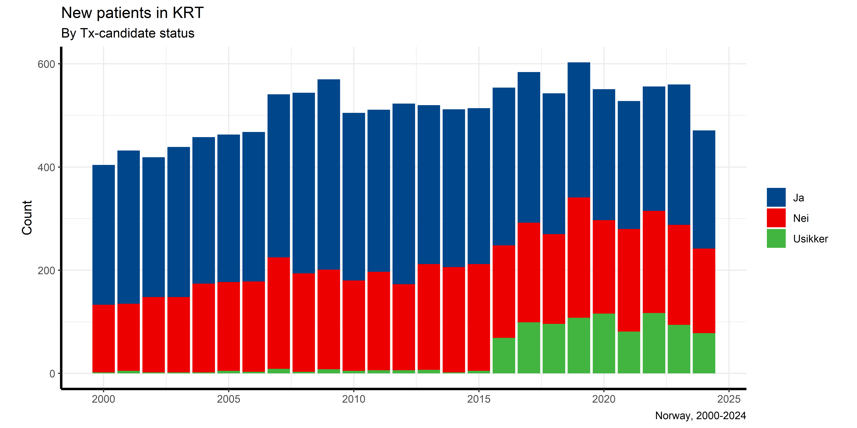
New patients in KRT by Tx-candidacy

Slide 25
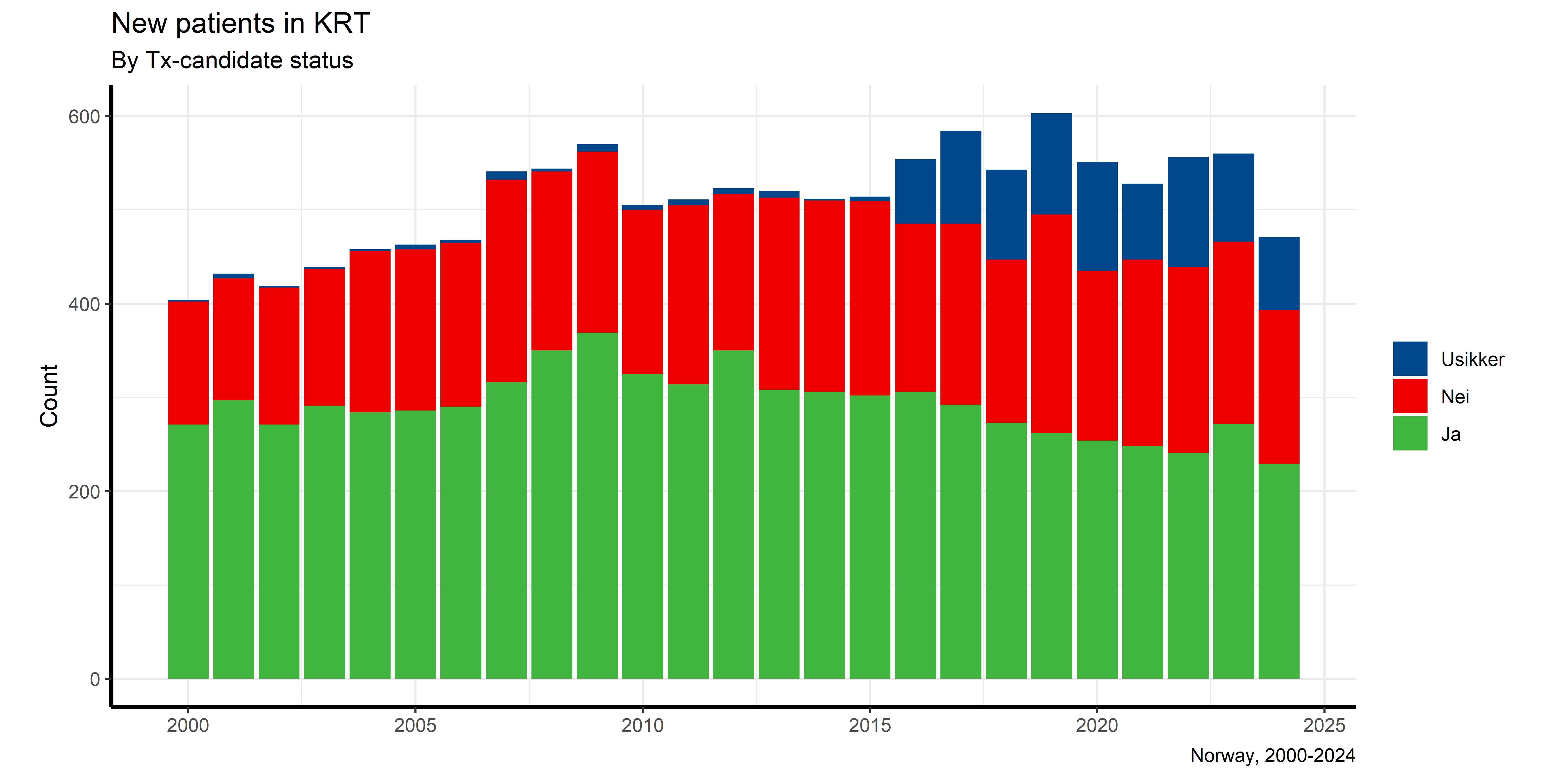

Slide 26
New patients in KRT by Tx-candidacy (relative)

Slide 28
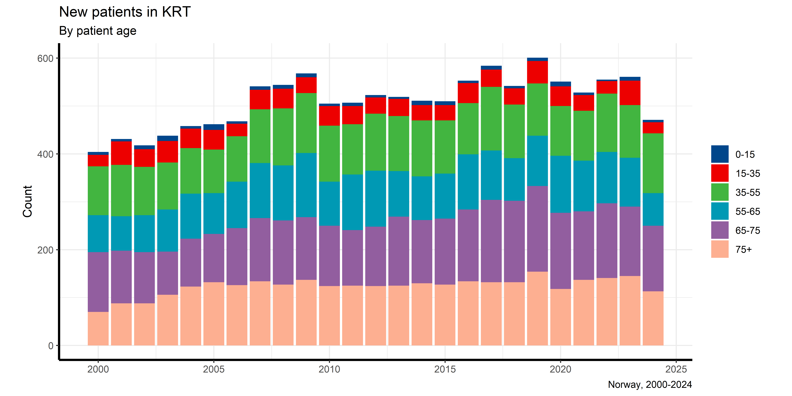
New patients in KRT by age

Slide 29
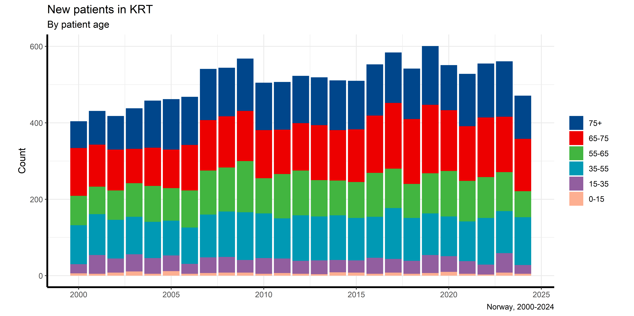

Slide 30
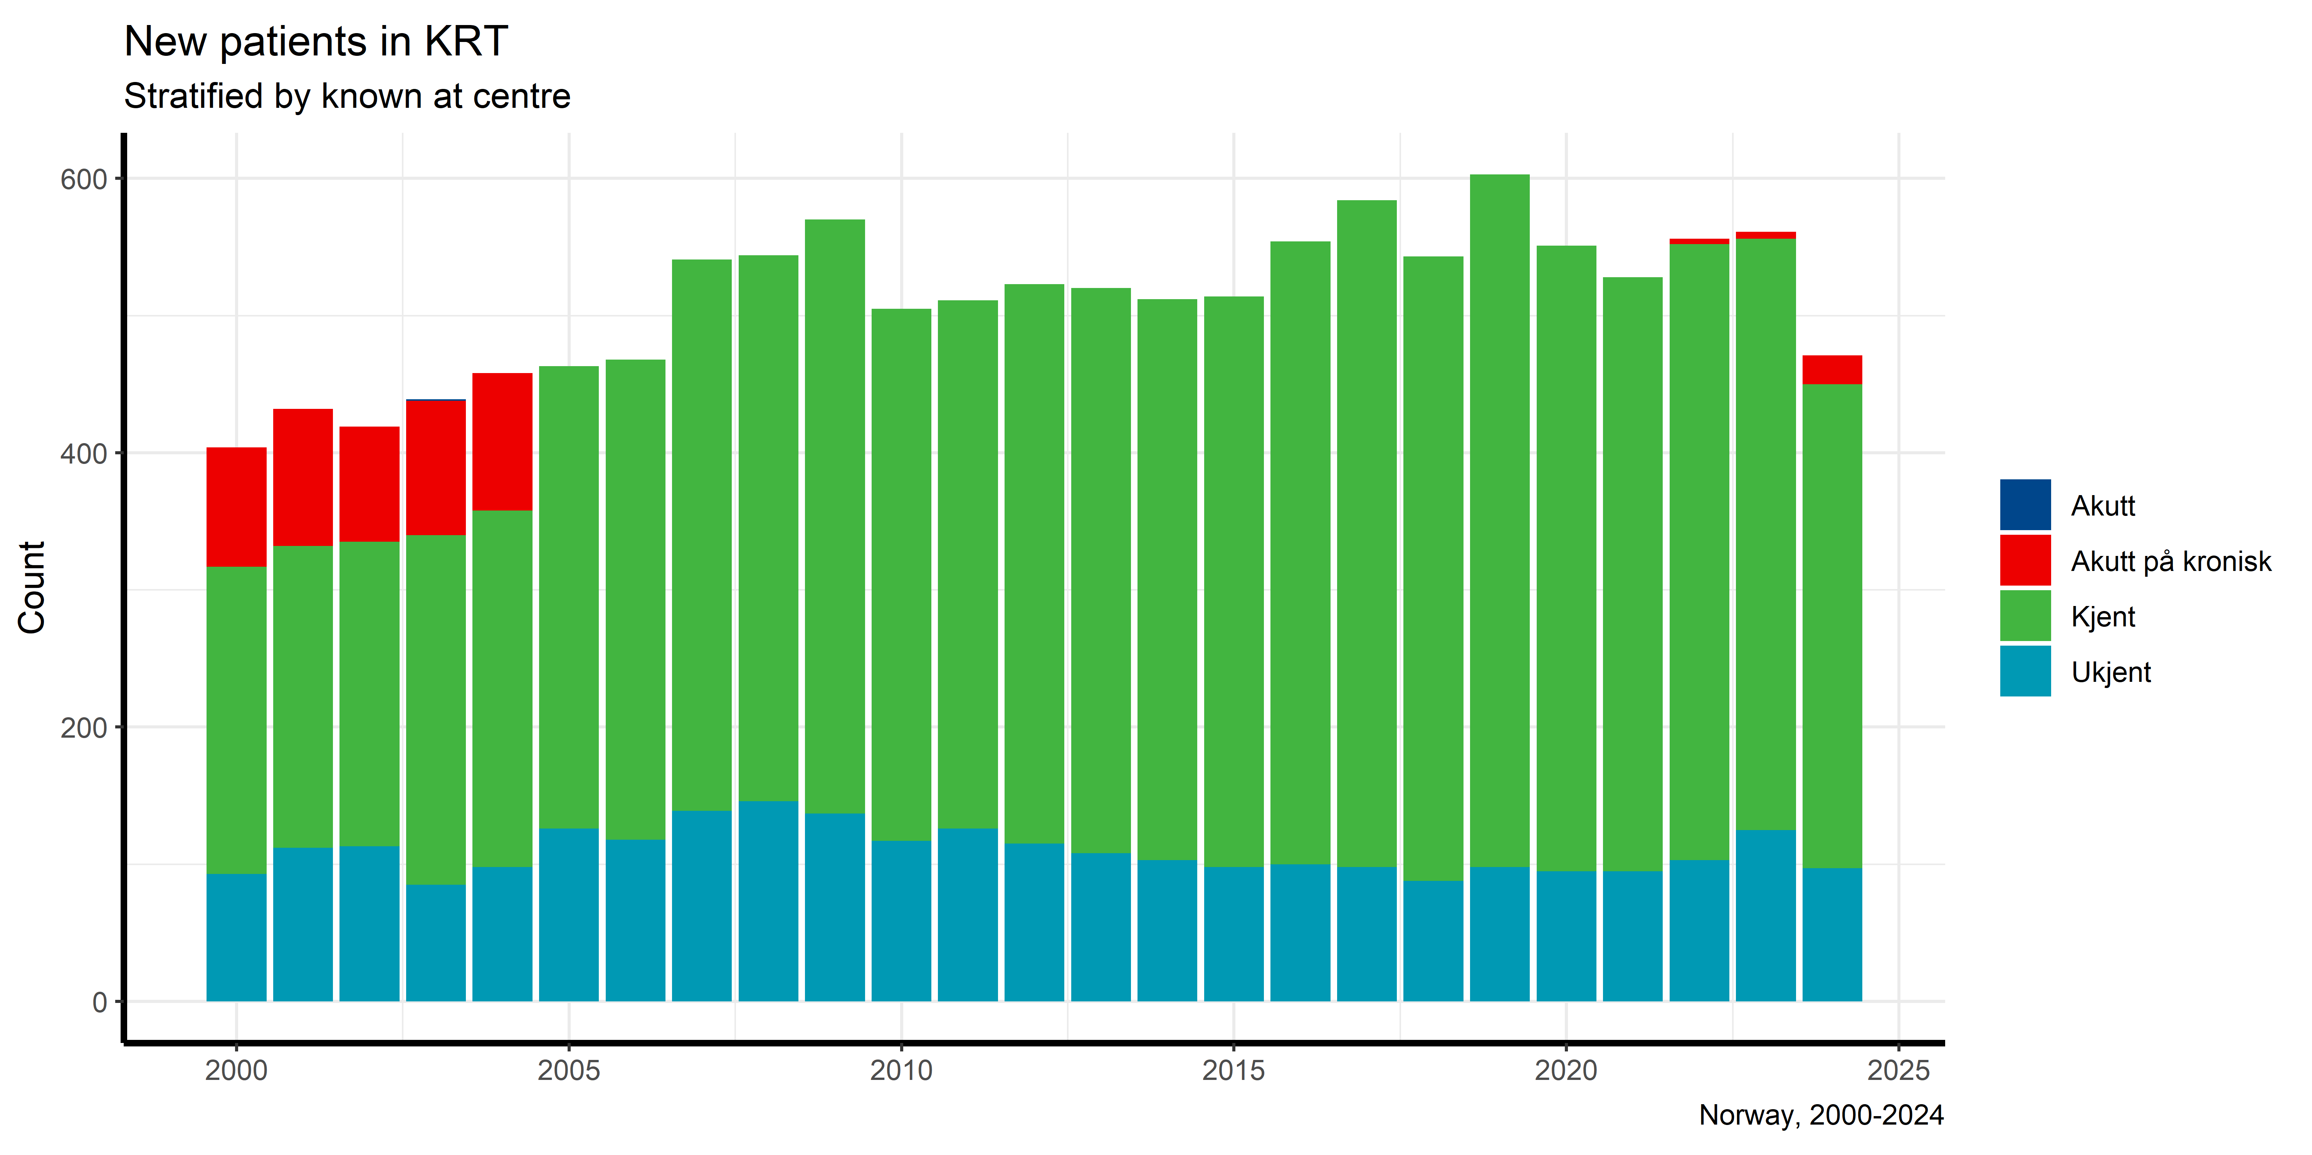
New patients in KRT by known

Slide 32
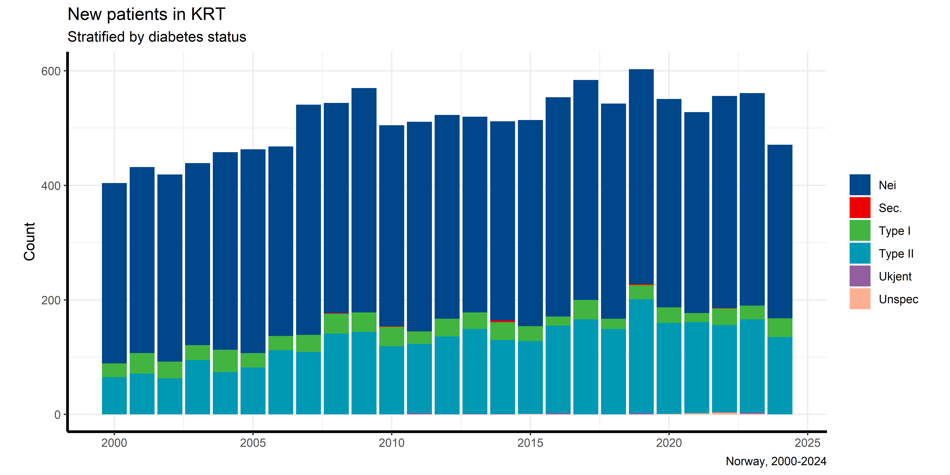
New patients in KRT by year and diabetes status at first RRT

Slide 33
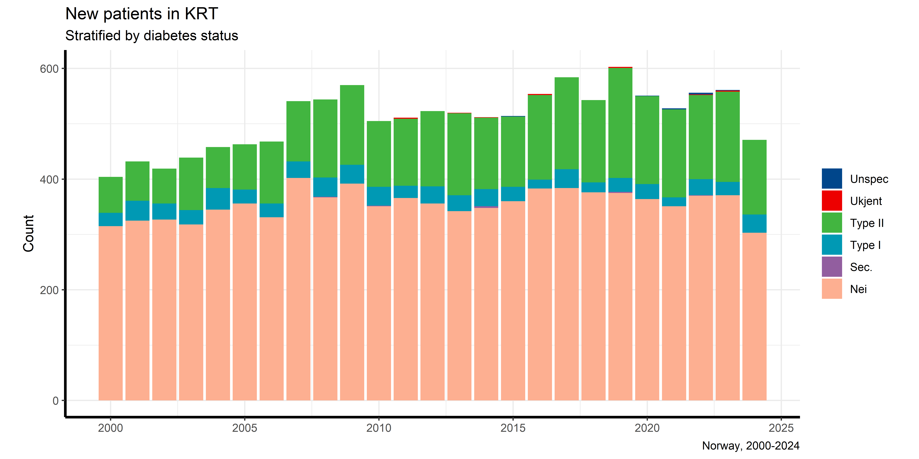

Slide 34
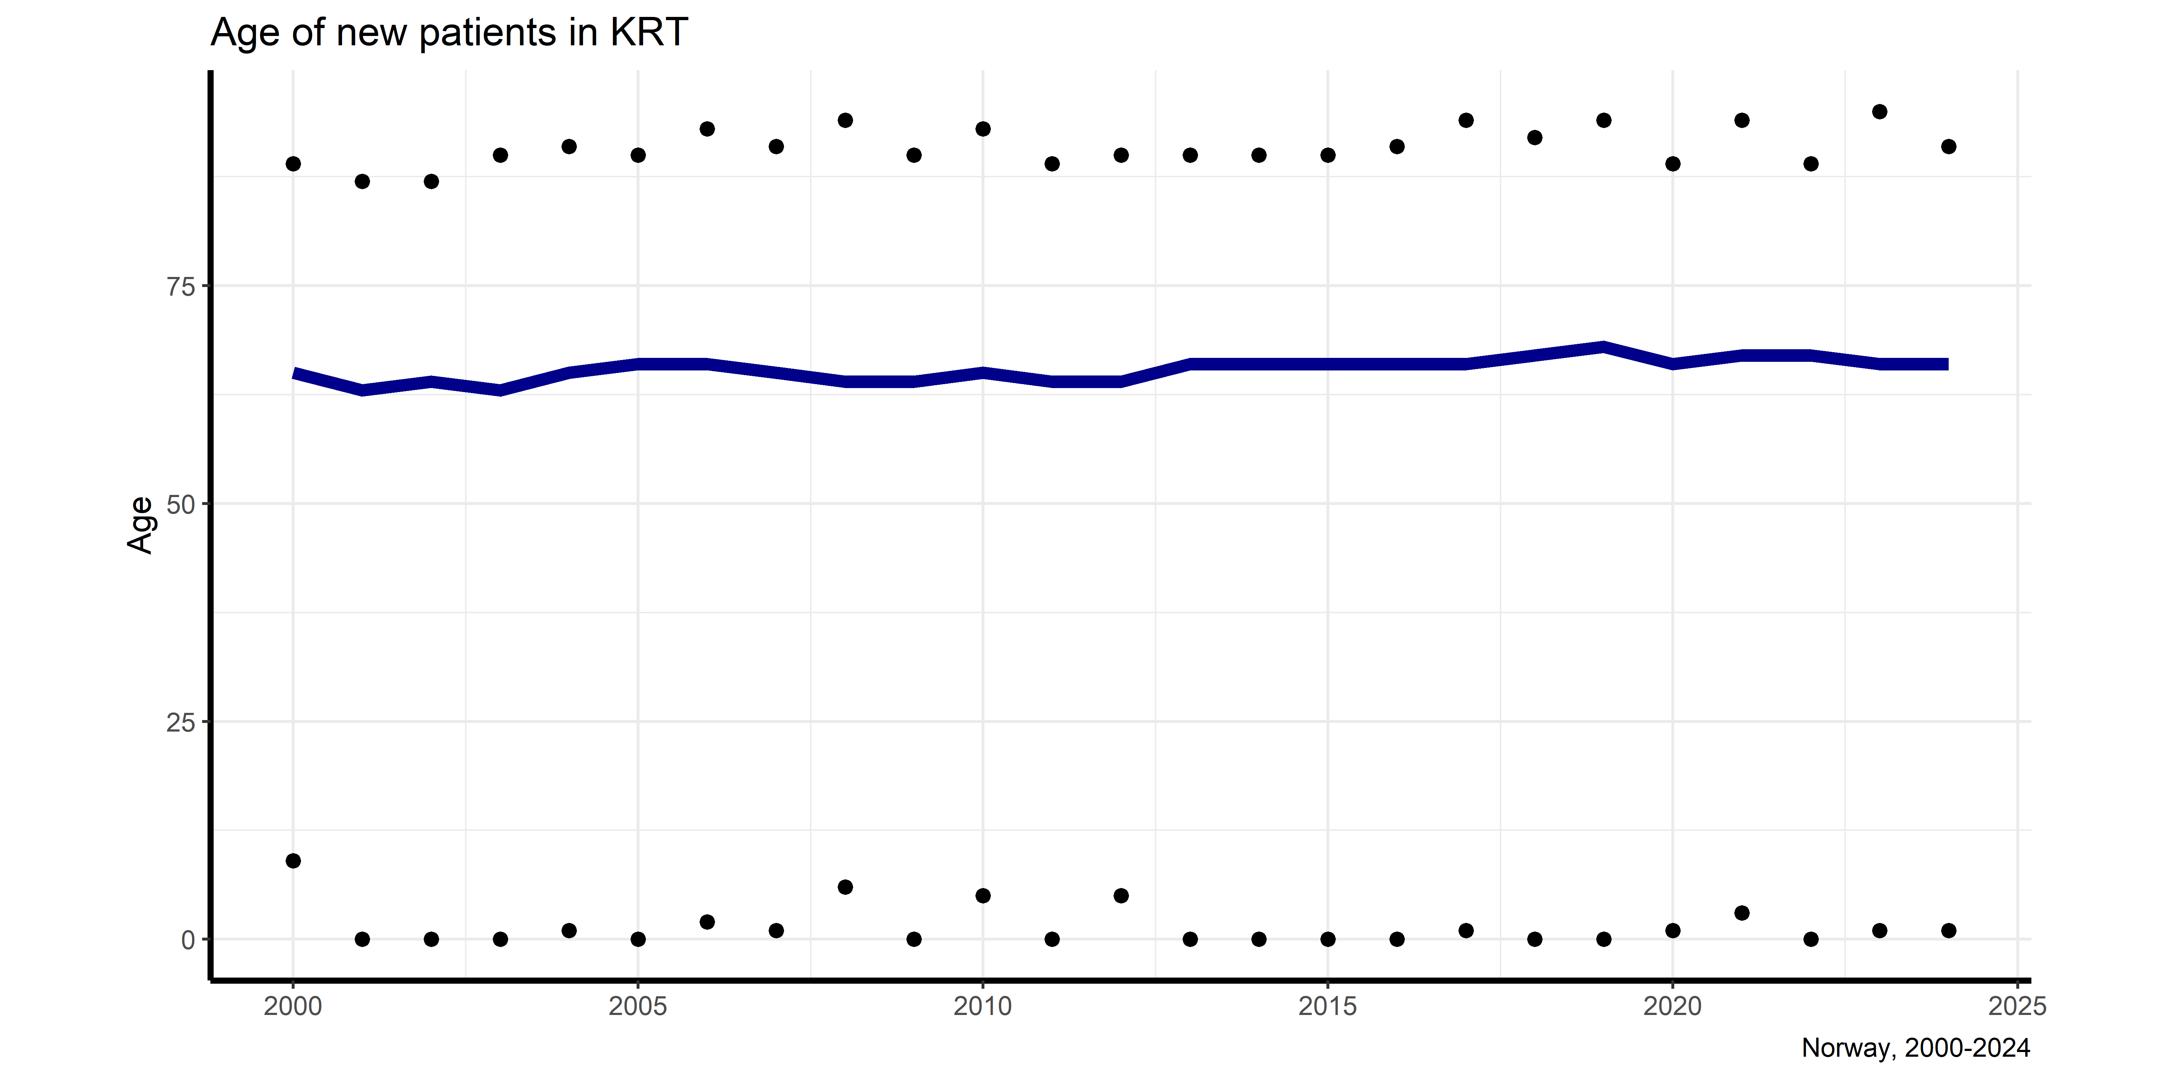
Age of New patients in KRT

Slide 35
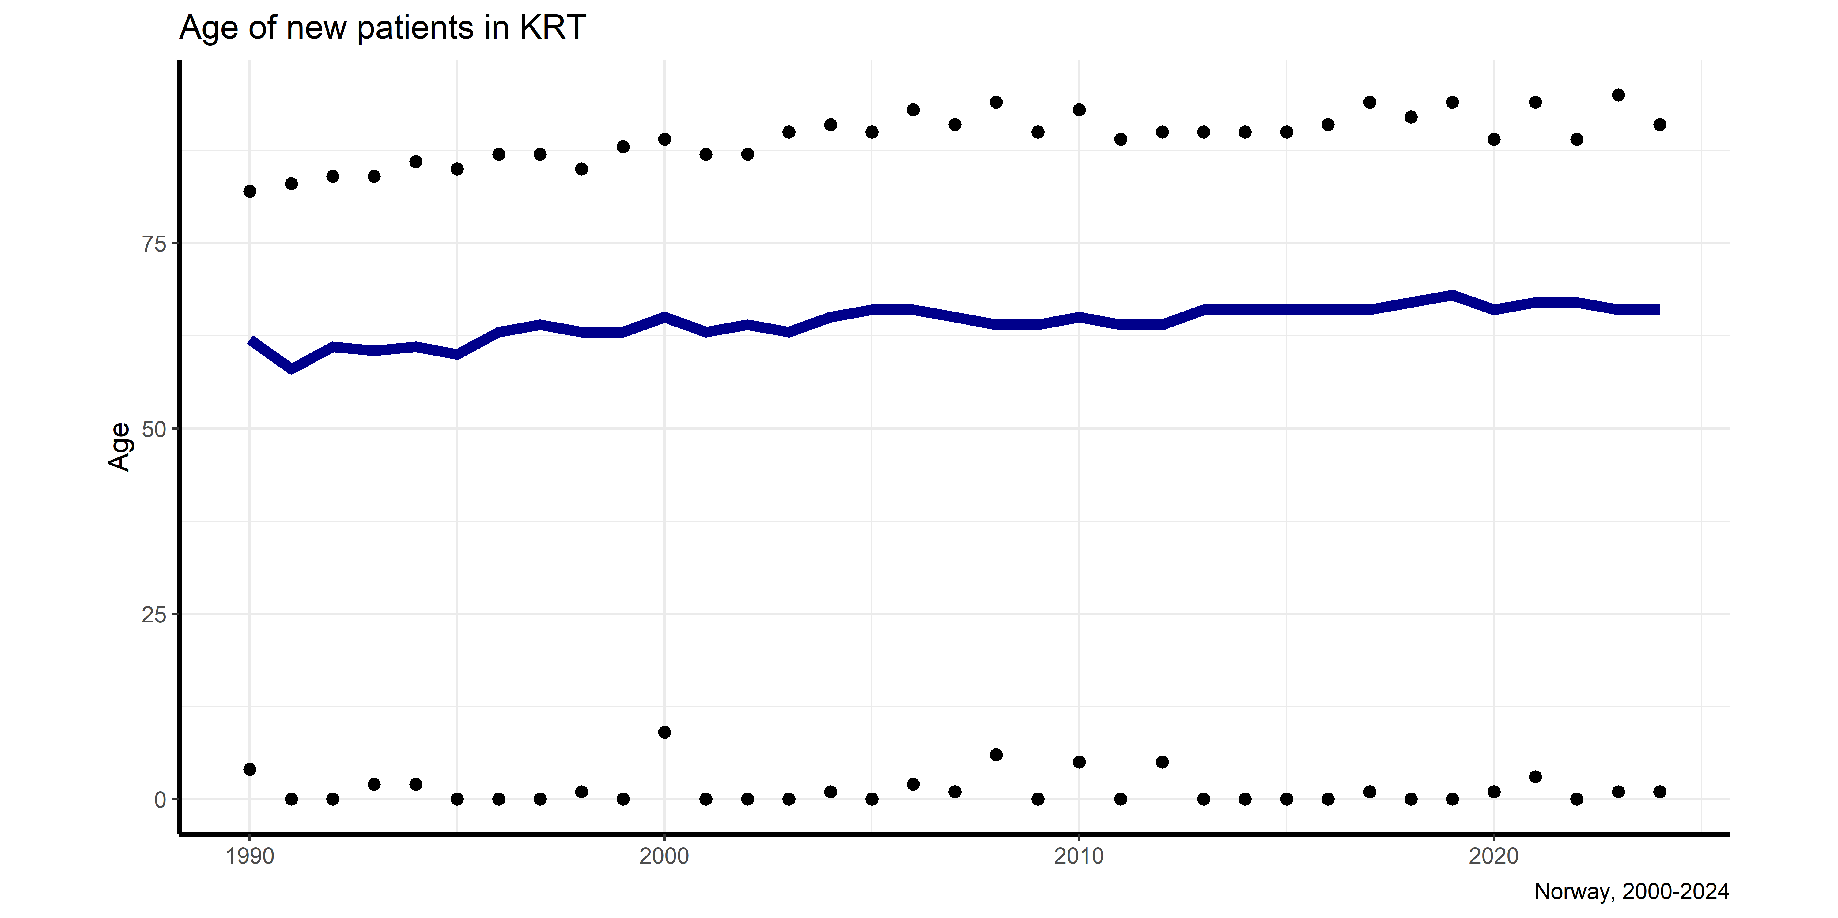
Age of New patients in KRT (from 1990)

Slide 36
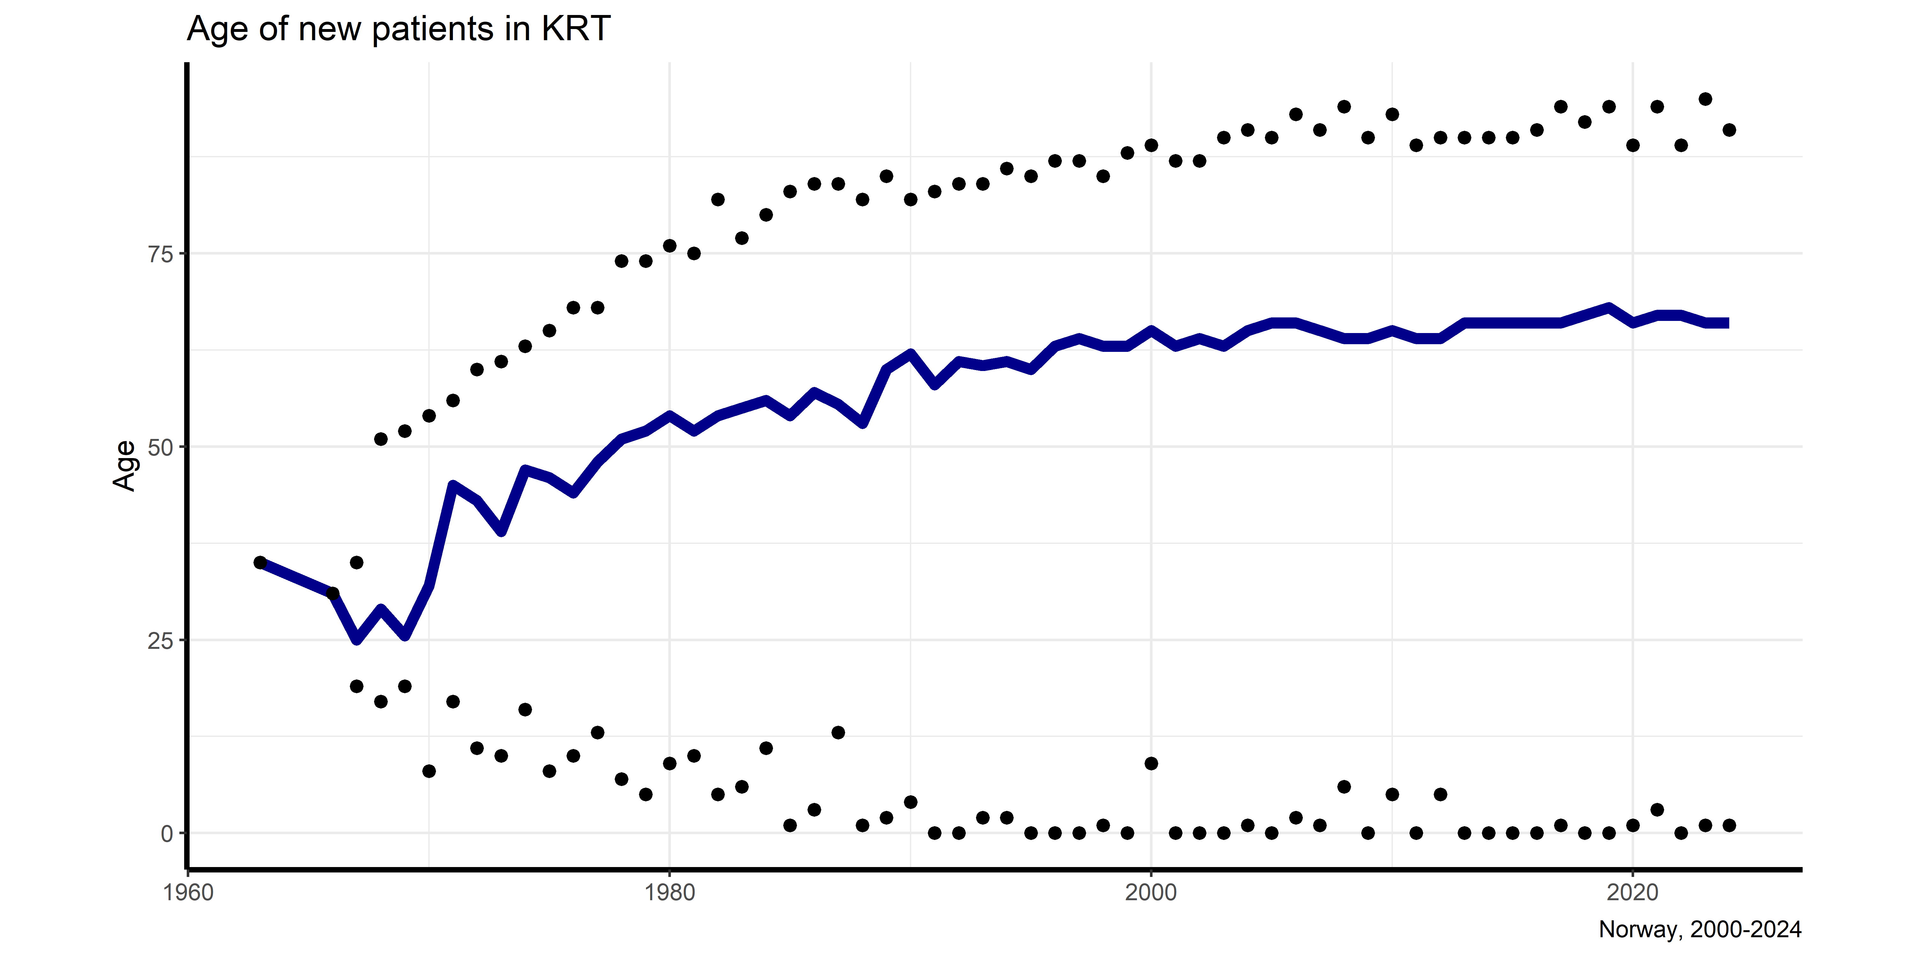
Age of New patients in KRT (from 1960)

Slide 37
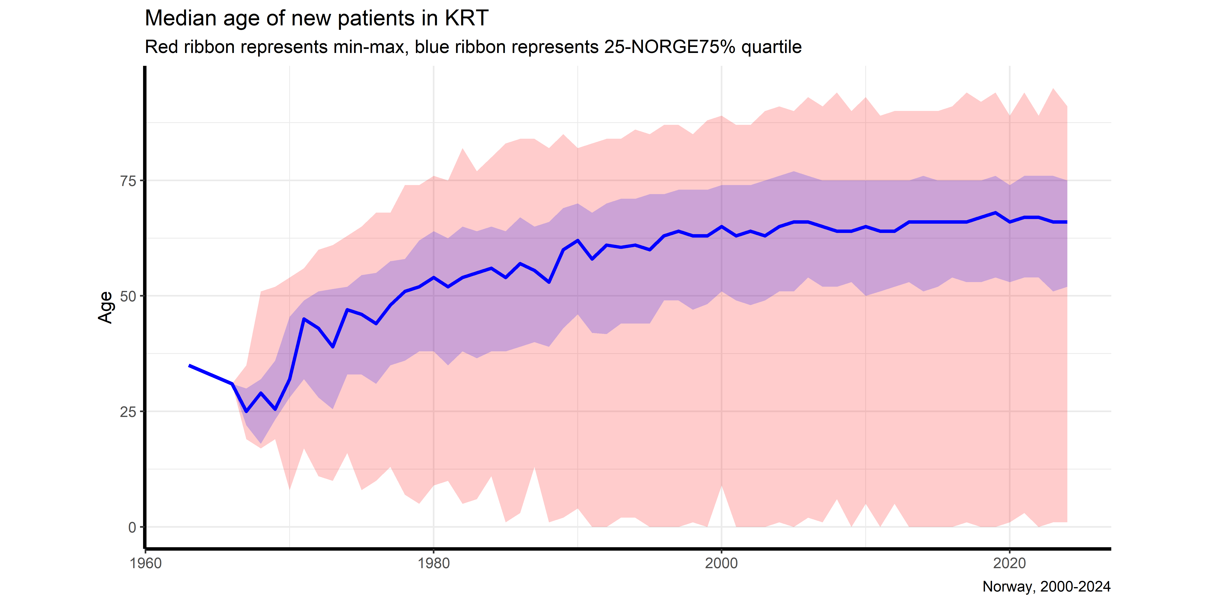
Age of New patients in KRT (IQR ribbon from 1960)

Slide 38
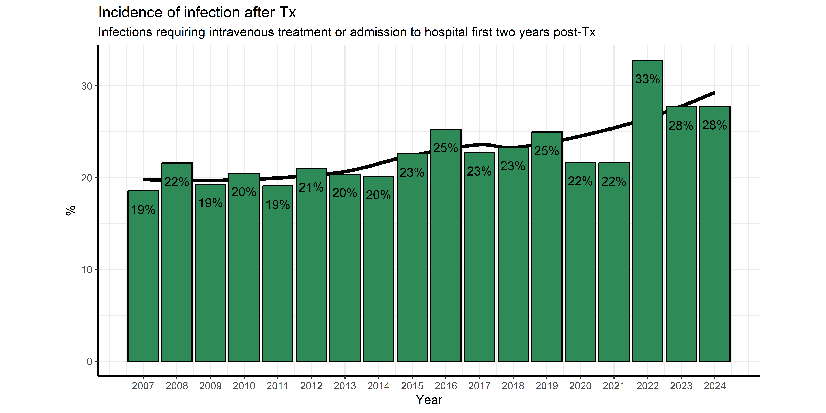
Prevalence of infection after Tx

Slide 39
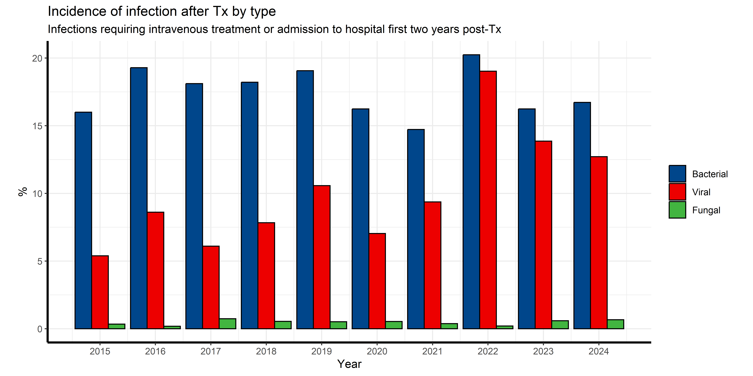
Prevalence of infection after Tx by type

Slide 40
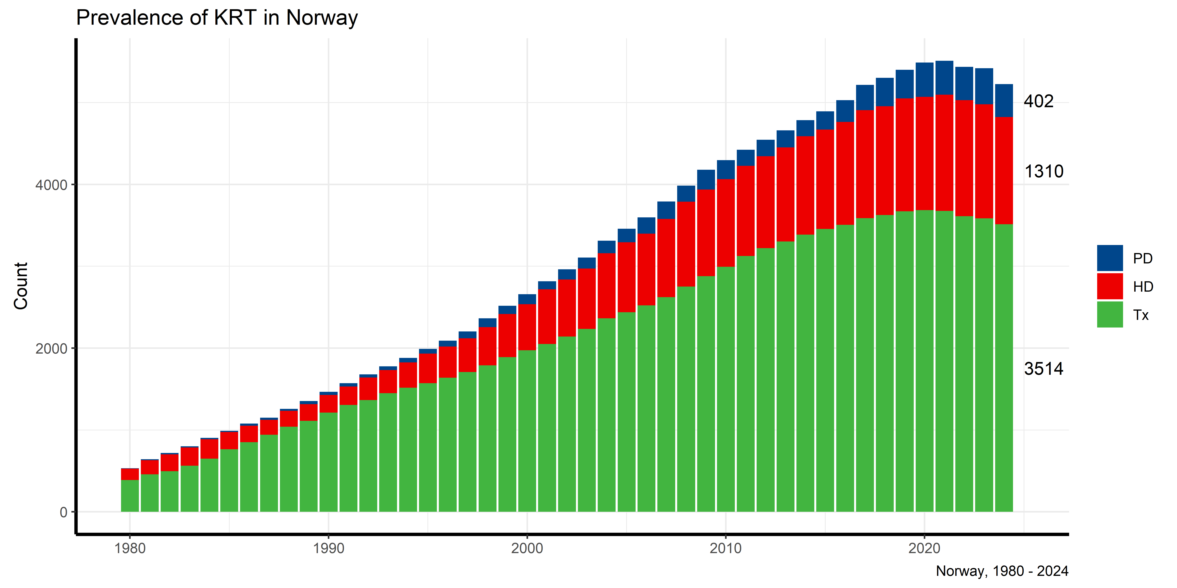
RRT prevalence

Slide 41
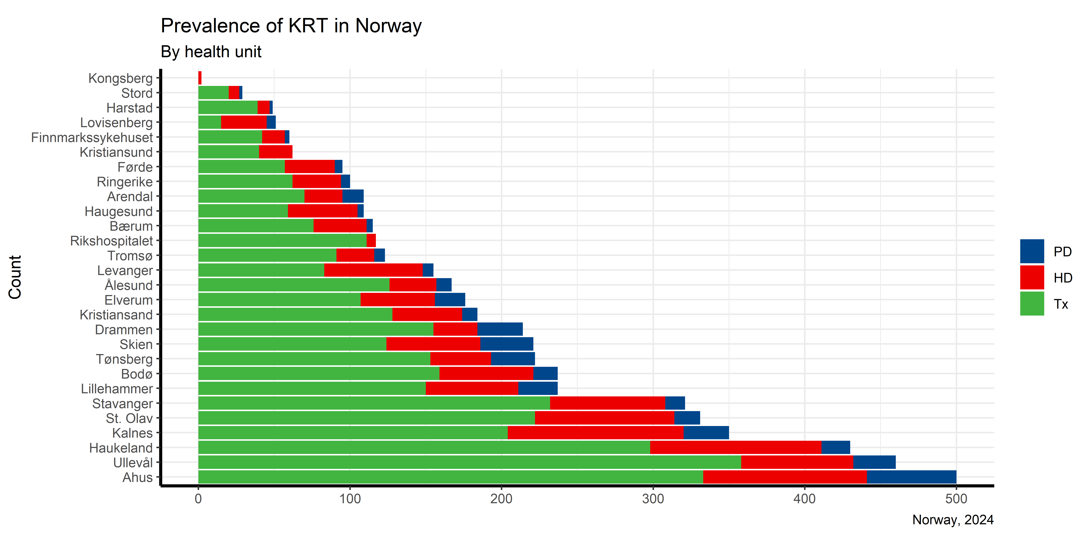

Slide 42

SURVIVAL ANALYSIS

Slide 43
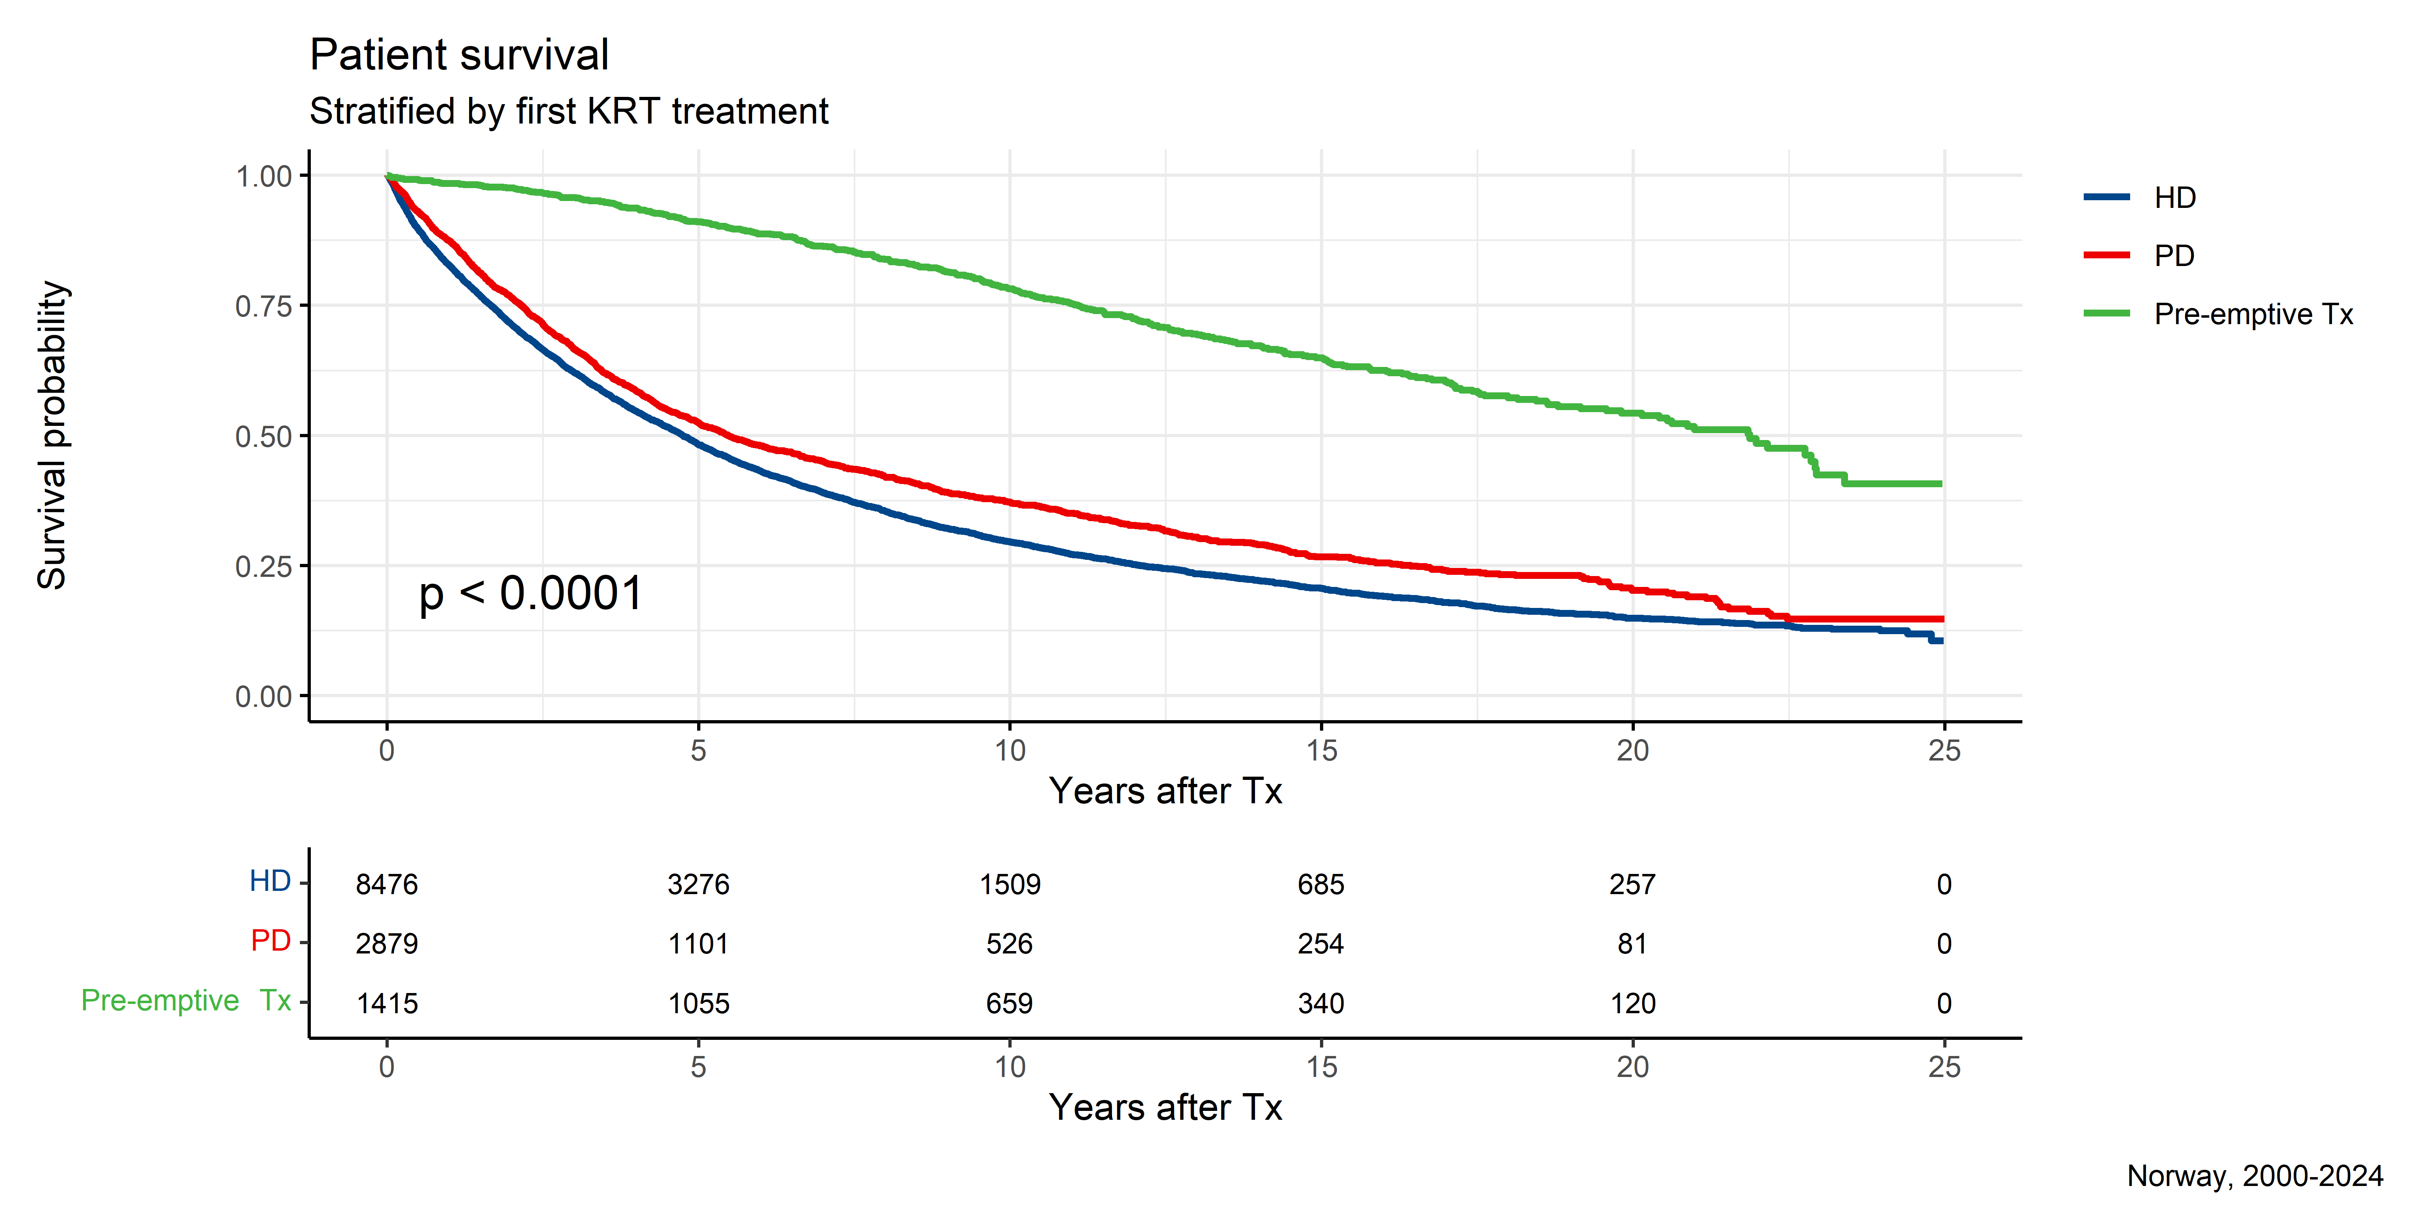
Survival (first KRT)

Slide 44
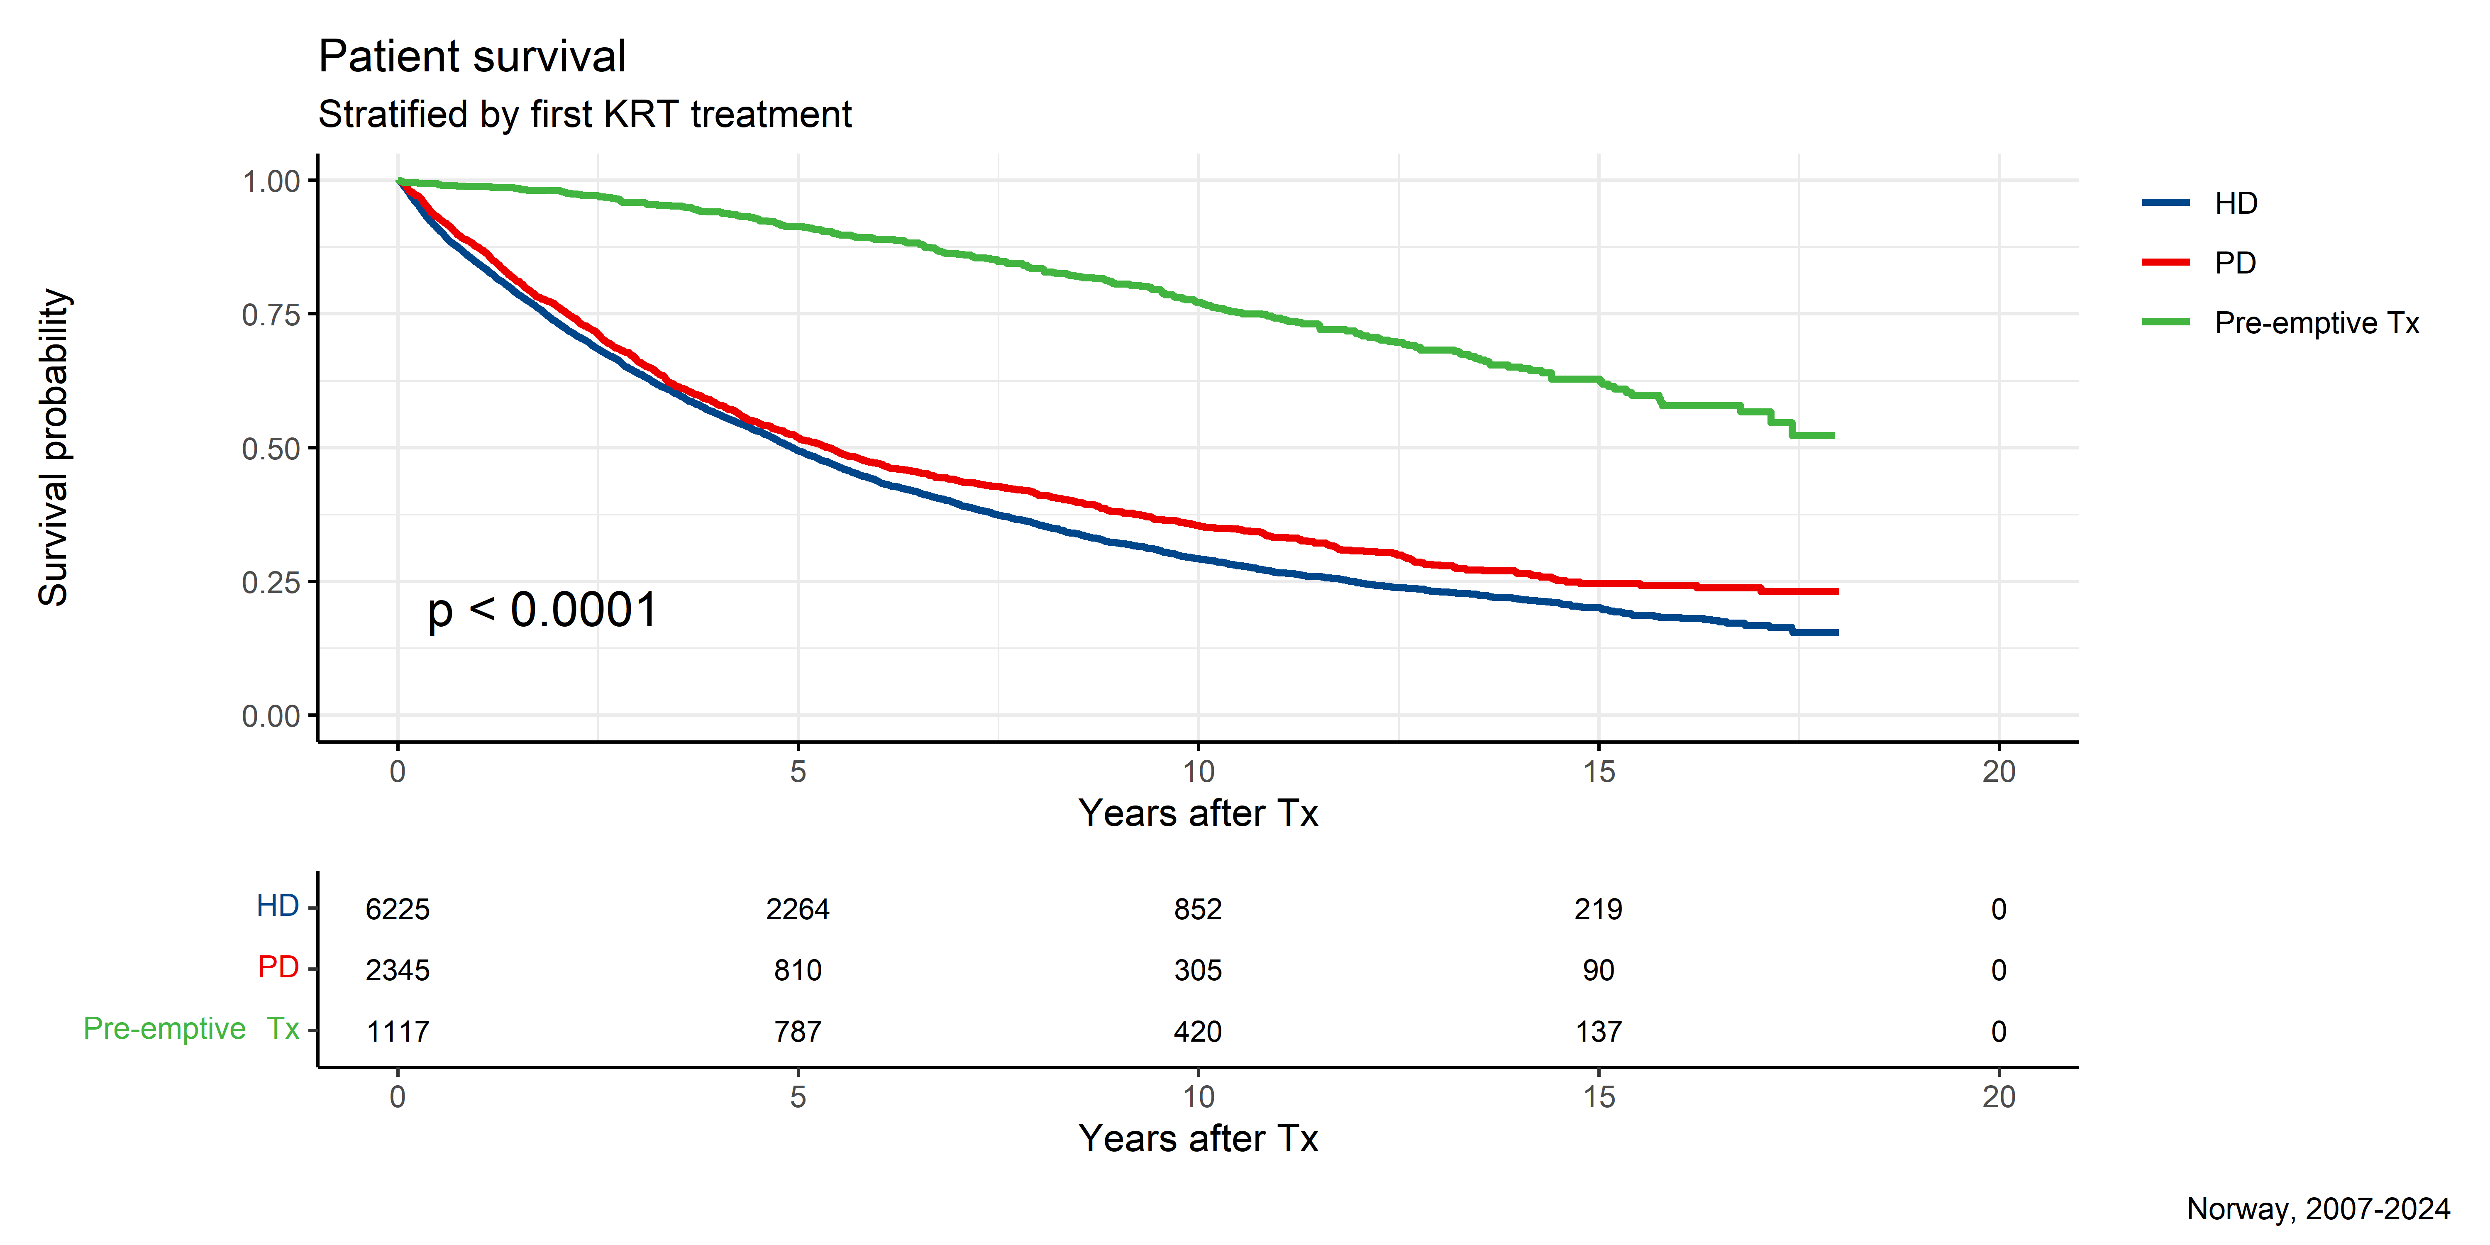

Slide 45
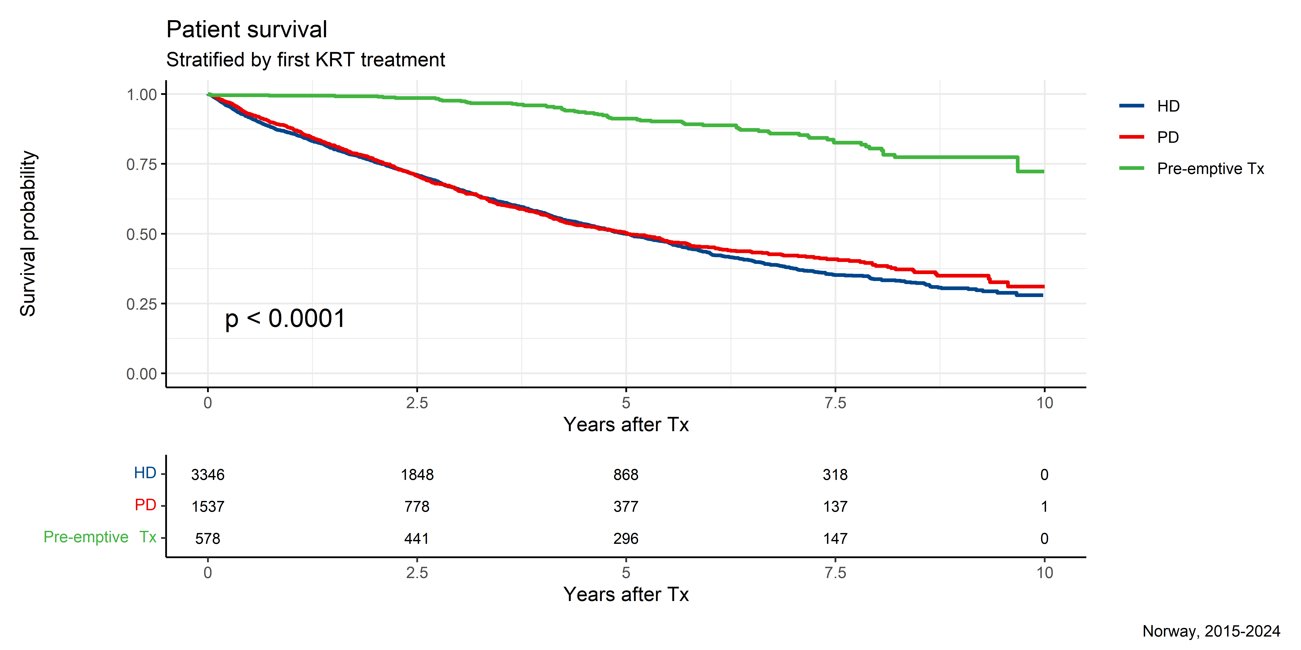

Slide 46
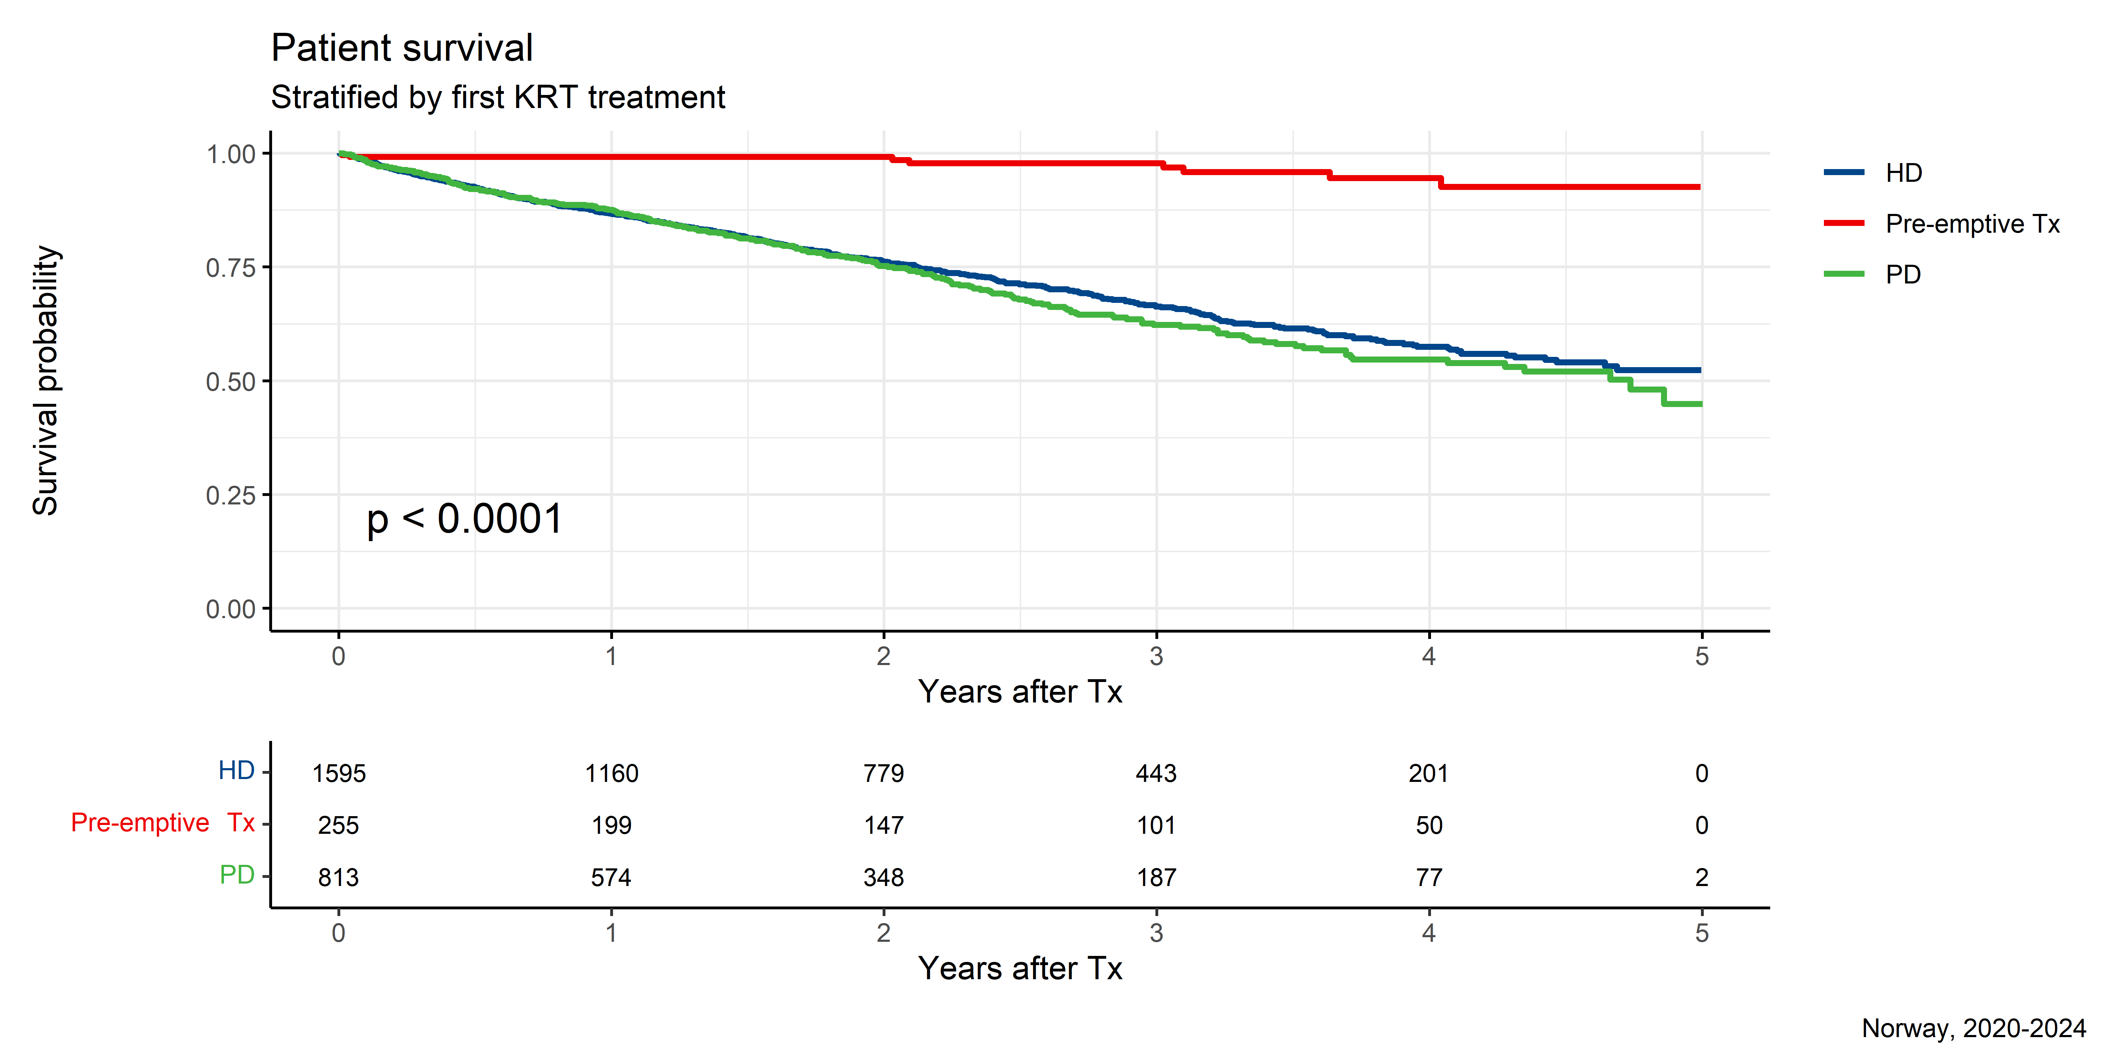

Slide 47
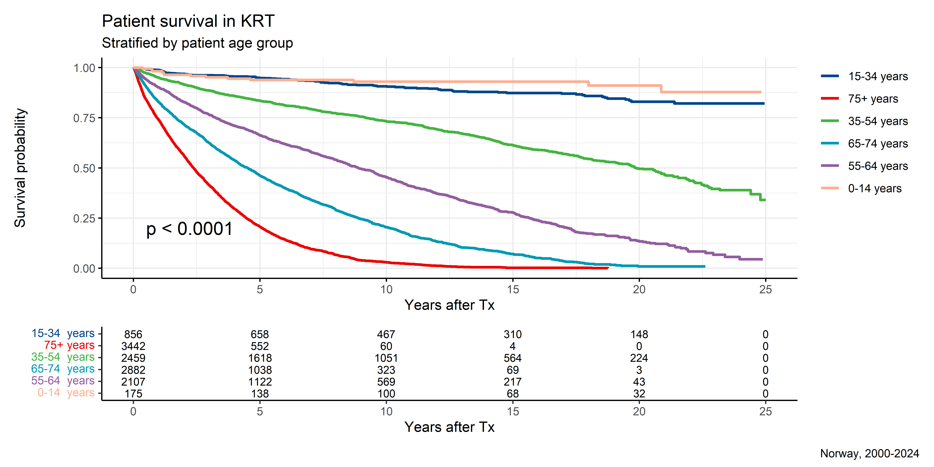
Survival (first KRT and patient age)

Slide 48
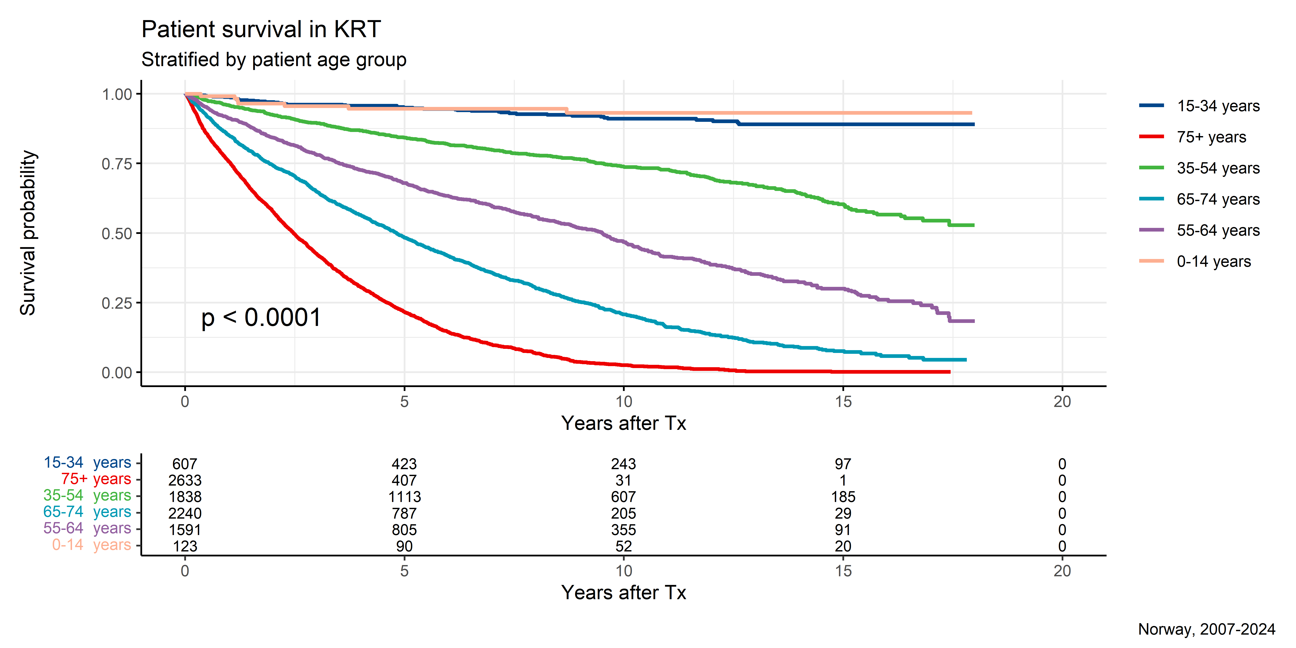

Slide 49
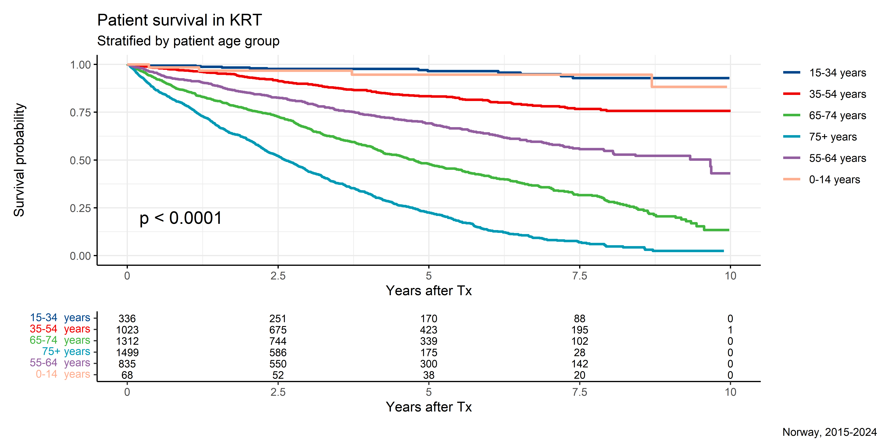

Slide 50
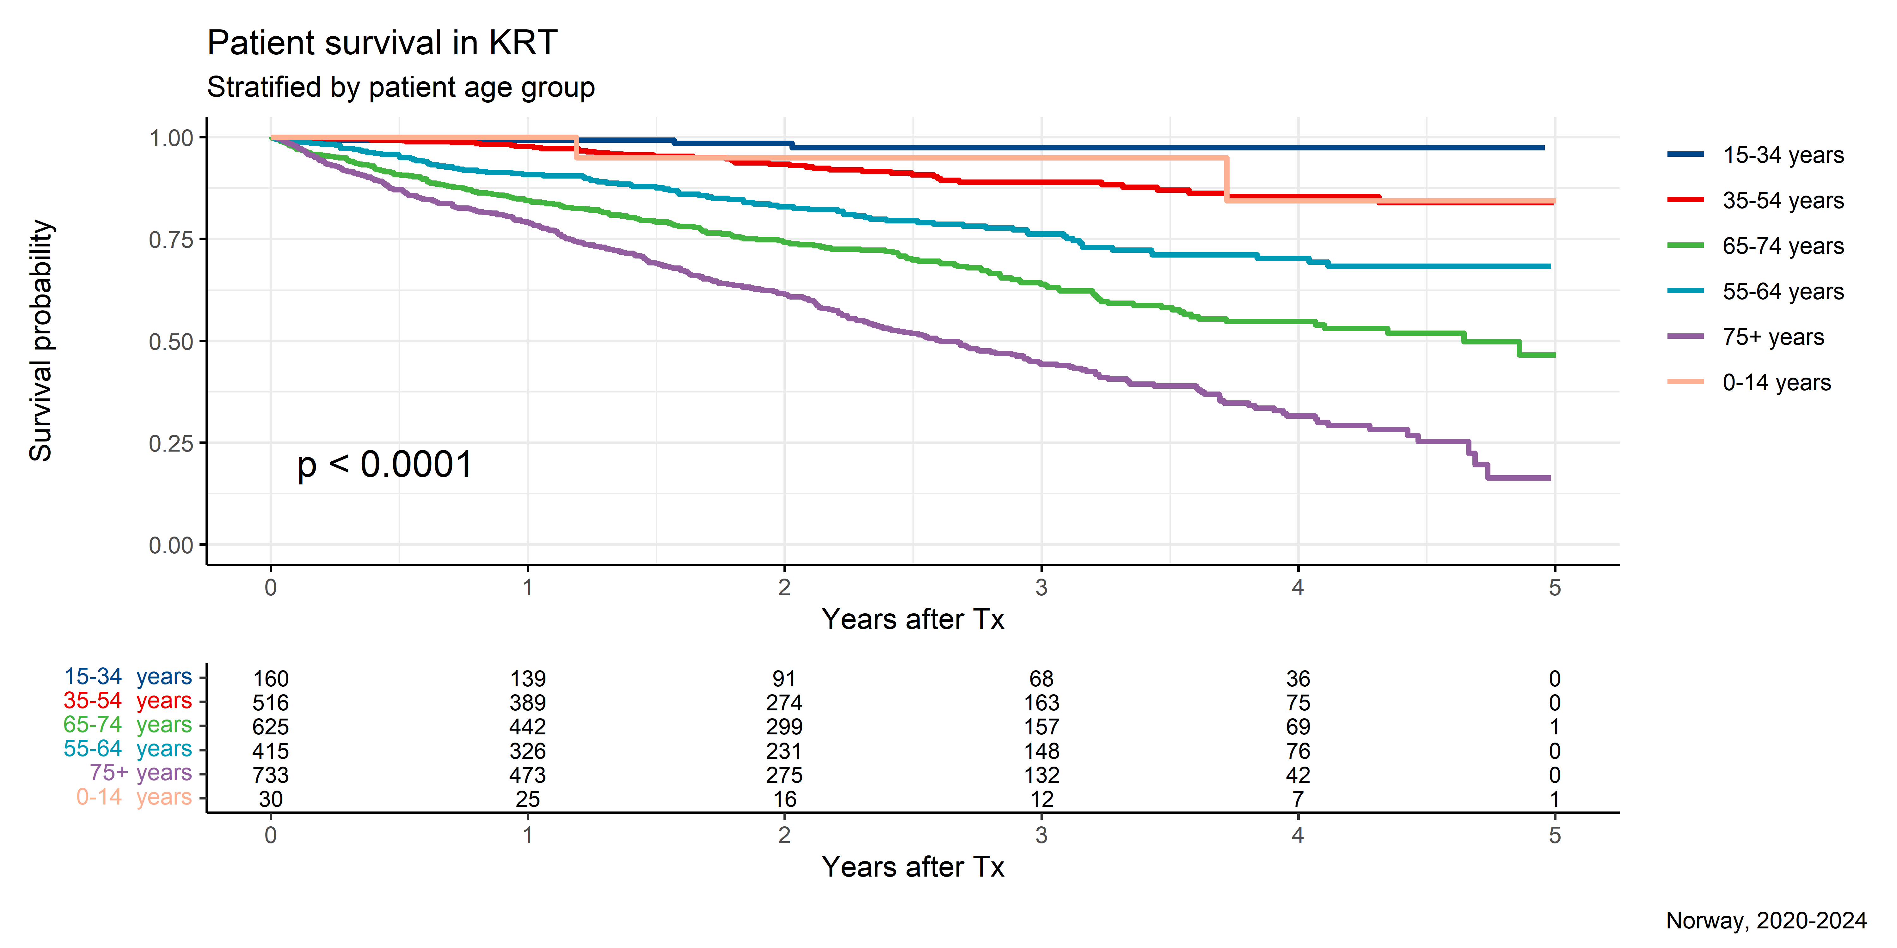

Slide 51
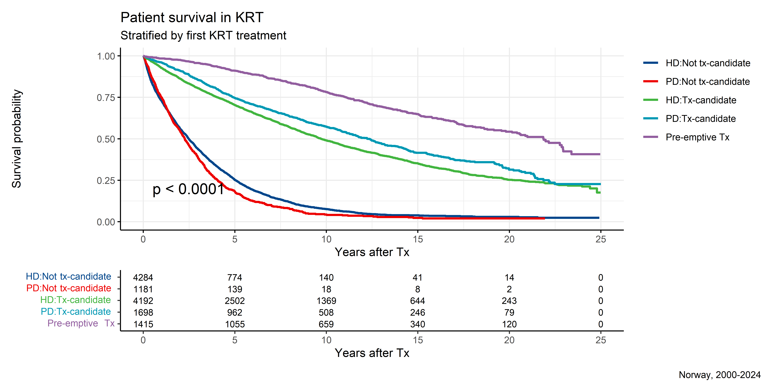
Survival (first KRT and Tx-candidacy)

Slide 52
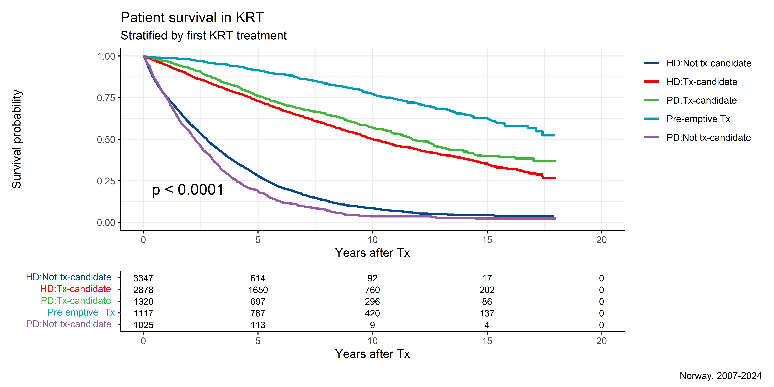

Slide 53
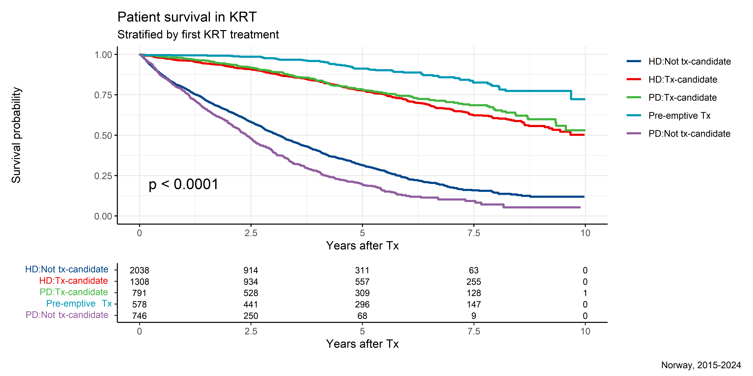

Slide 54
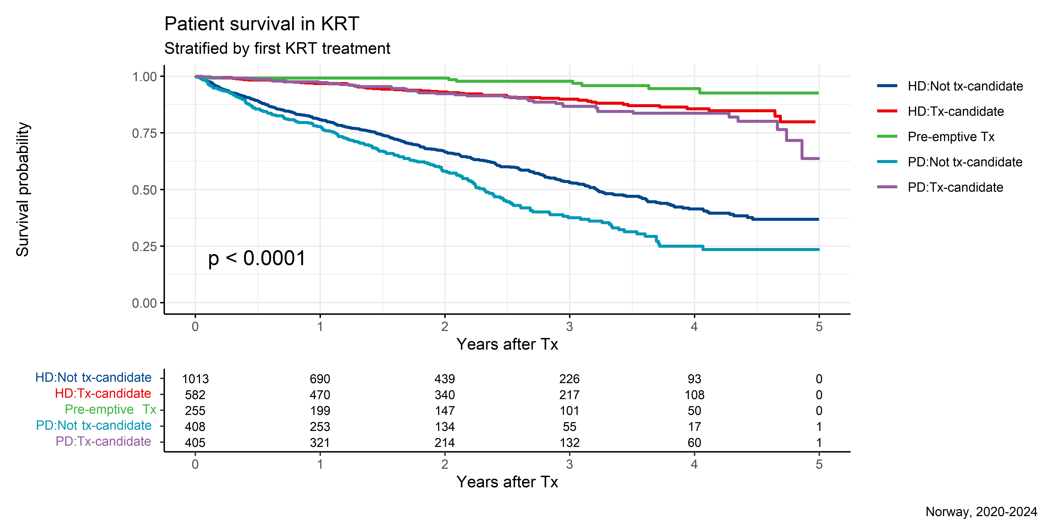

Slide 55
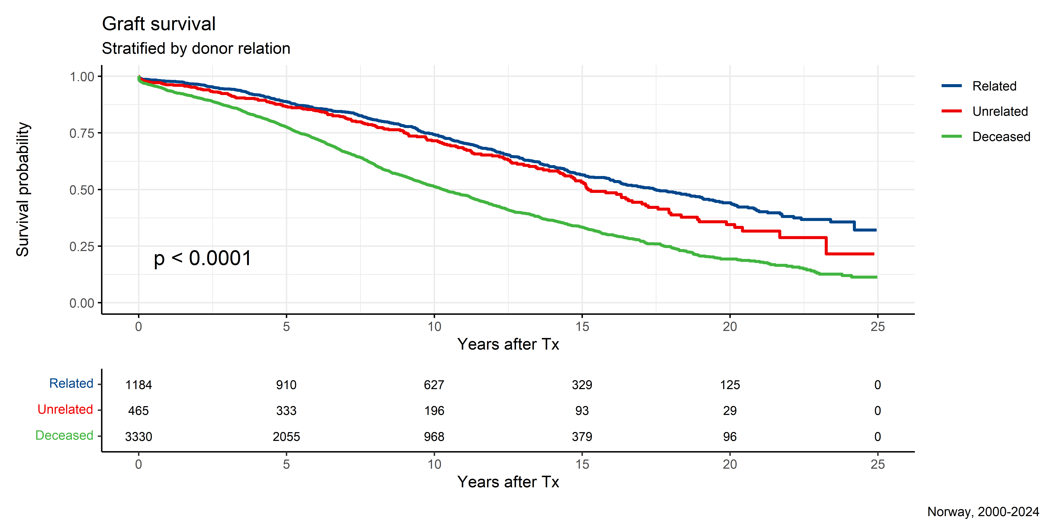
Survival (related, unrelated, deceased)

Slide 56
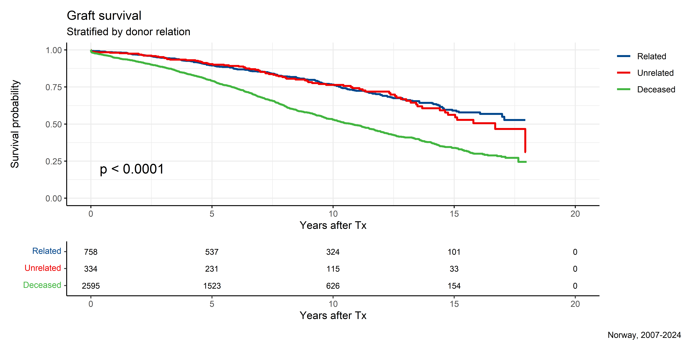

Slide 57


Slide 58


Slide 59


Slide 60


Slide 61


Slide 62


Slide 63


Slide 64


Slide 65


Slide 66


Slide 67

Survival (DD vs LD)

Slide 68


Slide 69


Slide 70


Slide 71


Slide 72


Slide 73


Slide 74


Slide 75


Slide 76


Slide 77


Slide 78


Slide 79

Survival (CMV, LD+DD)

Slide 80


Slide 81


Slide 82


Slide 83


Slide 84


Slide 85


Slide 86


Slide 87


Slide 88


Slide 89


Slide 90


Slide 91

Survival (CMV by donor type)

Slide 92


Slide 93


Slide 94


Slide 95


Slide 96


Slide 97


Slide 98


Slide 99


Slide 100


Slide 101


Slide 102


Slide 103

Survival (CMV and Tx-period)

Slide 104


Slide 105


Slide 106

Survival (DR-mismatch, LD+DD)

Slide 107


Slide 108


Slide 109


Slide 110


Slide 111


Slide 112


Slide 113


Slide 114


Slide 115


Slide 116


Slide 117


Slide 118

Survival (DR-mismatch by donor type)

Slide 119


Slide 120


Slide 121


Slide 122


Slide 123


Slide 124


Slide 125


Slide 126


Slide 127


Slide 128


Slide 129


Slide 130

Survival (DR-mismatch, DD only)

Slide 131


Slide 132


Slide 133


Slide 134


Slide 135


Slide 136


Slide 137


Slide 138


Slide 139


Slide 140


Slide 141


Slide 142

Survival (DR-mismatch, LD only)

Slide 143


Slide 144


Slide 145


Slide 146


Slide 147


Slide 148


Slide 149


Slide 150


Slide 151


Slide 152


Slide 153


Slide 154

Survival (DR-mismatch 2, LD+DD)

Slide 155


Slide 156


Slide 157


Slide 158


Slide 159


Slide 160


Slide 161


Slide 162


Slide 163


Slide 164


Slide 165


Slide 166

Survival (DR-mismatch 2 by donor type)

Slide 167


Slide 168


Slide 169


Slide 170


Slide 171


Slide 172


Slide 173


Slide 174


Slide 175


Slide 176


Slide 177


Slide 178

Survival (DR-mismatch 2, DD only)

Slide 179


Slide 180


Slide 181


Slide 182


Slide 183


Slide 184


Slide 185


Slide 186


Slide 187


Slide 188


Slide 189


Slide 190

Survival (DR-mismatch 2, LD only)

Slide 191


Slide 192


Slide 193


Slide 194


Slide 195


Slide 196


Slide 197


Slide 198


Slide 199


Slide 200


Slide 201


Slide 202

Survival (Patient age)

Slide 203


Slide 204


Slide 205


Slide 206


Slide 207


Slide 208


Slide 209


Slide 210


Slide 211


Slide 212


Slide 213


Slide 214

Survival (Patient age, DD only)

Slide 215


Slide 216


Slide 217


Slide 218


Slide 219


Slide 220


Slide 221


Slide 222


Slide 223


Slide 224


Slide 225


Slide 226

Survival (Patient age, LD only)

Slide 227


Slide 228


Slide 229


Slide 230


Slide 231


Slide 232


Slide 233


Slide 234


Slide 235


Slide 236


Slide 237


Slide 238

Survival (Patient age 2)

Slide 239


Slide 240


Slide 241


Slide 242


Slide 243


Slide 244


Slide 245


Slide 246


Slide 247


Slide 248


Slide 249


Slide 250

Survival (Patient age 2, DD only)

Slide 251


Slide 252


Slide 253


Slide 254


Slide 255


Slide 256


Slide 257


Slide 258


Slide 259


Slide 260


Slide 261


Slide 262

Survival (Patient age 2, LD only)

Slide 263


Slide 264


Slide 265


Slide 266


Slide 267


Slide 268


Slide 269


Slide 270


Slide 271


Slide 272


Slide 273


Slide 274

Survival (Patient age above/below 65)

Slide 275


Slide 276


Slide 277


Slide 278


Slide 279


Slide 280


Slide 281


Slide 282


Slide 283


Slide 284


Slide 285


Slide 286

Survival (Patient age above/below 65 and donor source)

Slide 287


Slide 288


Slide 289


Slide 290


Slide 291


Slide 292


Slide 293


Slide 294


Slide 295


Slide 296


Slide 297


Slide 298

Survival (time in dialysis)

Slide 299


Slide 300


Slide 301


Slide 302


Slide 303


Slide 304


Slide 305


Slide 306


Slide 307


Slide 308


Slide 309


Slide 310

Survival (time in dialysis, DD only)

Slide 311


Slide 312


Slide 313


Slide 314


Slide 315


Slide 316


Slide 317


Slide 318


Slide 319


Slide 320


Slide 321


Slide 322

Survival (time in dialysis, LD only)

Slide 323


Slide 324


Slide 325


Slide 326


Slide 327


Slide 328


Slide 329


Slide 330


Slide 331


Slide 332


Slide 333


Slide 334

Survival (Tx-period 1)

Slide 335


Slide 336


Slide 337

Survival (Tx-period 1, DD only)

Slide 338


Slide 339


Slide 340

Survival (Tx-period 1, LD only)

Slide 341


Slide 342


Slide 343
GEOGRAPHICAL ANALYSIS

Slide 344

Absolute prevalence of kidney disease

Slide 345
CKD5 not in RRT
Text information
Status at first time reported as CKD5 (without RRT)
type | V1 | V2 | V3 | V4
year | 2021 | 2022 | 2023 | 2024
n | 314 | 342 | 338 | 349
% Male | 68% | 70% | 70% | 71%
Age (mean) | 66.3 | 66.0 | 66.5 | 65.5
Age (median) | 70 | 70 | 71 | 70
Age (min) | 20 | 19 | 11 | 19
Age (max) | 96 | 93 | 92 | 93
BMI (mean) | 27.7 | 26.8 | 27.1 | 27.0
Kjent | 91% | 89% | 90% | 91%
RRT kand. | 82% | 84% | 86% | 83%
Ikke RRT kand. | 9% | 8% | 5% | 8%
T2DM | 33% | 28% | 29% | 34%
type | V1
Antall | 349
eGFR (CKD-EPI 2021, mean) [mL/min/1.73m2]) | 11
eGFR (CKD-EPI 2021 - % < 15 mL/min/1.73m2 | 96%
Creatinine (mean) [µmol/L] | 428
Albumin (mean) [g/dL] | 38
Haemoglobin (mean) [g/dL] | 11
Haemoglobin - % with < 10 g/dL) | 22%
Proteinuria (ACR>3 and/or PCR>15) | 99%
ESA use | 30%
Active use of vitamin D | 51%
Statin use | 70%
Not on antihypertensive drugs | 7%
Using ACEi or ARB | 65%
Using >=3 antihypertensive drug | 60%
Using bicarbonate | 59%

Slide 346
CKD5 in RRT
## # A tibble: 5 x 10 ## rrt_year Antall `% Male` `Age (mean)` `Age (median)` `Age (min)` `Age (max)` ## <dbl> <int> <chr> <dbl> <dbl> <dbl> <dbl> ## 1 2020 551 68% 61.8 66 1 89 ## 2 2021 528 66% 63.6 67 3 94 ## 3 2022 556 70% 63.7 67 0 89 ## 4 2023 561 69% 62.0 66 1 95 ## 5 2024 471 69% 62.5 66 1 91 ## # i 3 more variables: `TX kand.` <chr>, `Mulig TX kand.` <chr>, ## # `Ikke TX kand.` <chr>

Slide 347
First dialysis
## # A tibble: 5 x 4 ## rrt_year `TX kand.` `Mulig TX kand.` `Ikke TX kand.` ## <dbl> <chr> <chr> <chr> ## 1 2020 40% 23% 36% ## 2 2021 41% 17% 42% ## 3 2022 38% 23% 39% ## 4 2023 43% 19% 38% ## 5 2024 42% 19% 39%

Slide 348
First HD (known)
## # A tibble: 5 x 3 ## rrt_year Fistel Optimal ## <dbl> <chr> <chr> ## 1 2020 40% NaN% ## 2 2021 38% 100% ## 3 2022 37% 100% ## 4 2023 33% 77% ## 5 2024 34% 68%

Slide 349
ERA diagnoses

Slide 350
Table 14
## # A tibble: 7 x 6 ## group `2020` `2021` `2022` `2023` `2024` ## <chr> <chr> <chr> <chr> <chr> <chr> ## 1 Hypertension / Renal vascular disease 23% 45% 24% 43% 11% ## 2 Familial / hereditary nephropathies 17% 10% 9% 33% 25% ## 3 Diabetes Mellitus 10% 17% 48% 7% 7% ## 4 Glomerular disease 20% 15% 8% 7% 27% ## 5 Miscellaneous renal disorders 8% 4% 3% 5% 4% ## 6 Tubulointerstitial disease 16% 7% 7% 4% 25% ## 7 Other systemic diseases affecting the kidn~ 6% 2% 2% 1% 1%

Slide 351
Table 15
type | V3 | V1 | V2 | V4
treatgroup | Total | HD | PD | Tx
Antall | 471 | 260 | 157 | 54
eGFR (CKD-EPI 2021, mean) [mL/min/1.73m2]) | 8 | 7 | 7 | 12
eGFR (CKD-EPI 2021 - % < 15 mL/min/1.73m2 | 97% | 98% | 99% | 89%
Creatinine (mean) [µmol/L] | 671 | 711 | 661 | 508
Albumin (mean) [g/dL] | 36 | 34 | 36 | 43
Haemoglobin (mean) [g/dL] | 10.1 | 9.8 | 10.3 | 11
Haemoglobin - % with < 10 g/dL) | 47% | 57% | 39% | 19%
Proteinuria (ACR>3 and/or PCR>15) | 95% | 92% | 99% | 100%
ESA use | 49% | 51% | 52% | 35%
Active use of vitamin D | 63% | 62% | 63% | 70%
Statin use | 66% | 61% | 76% | 63%
Not on antihypertensive drugs | 7% | 9% | 3% | 6%
Using ACEi or ARB | 55% | 53% | 54% | 67%
Using >=3 antihypertensive drug | 59% | 60% | 63% | 39%
Using bicarbonate | 62% | 58% | 66% | 63%

Slide 352
Table 16
## # A tibble: 8 x 8 ## group `1980-89` `1990-99` `2000-04` `2005-09` `2010-14` `2015-19` `2020-23` ## <chr> <chr> <chr> <chr> <chr> <chr> <chr> <chr> ## 1 Hyperte~ 6% 21% 28% 30% 34% 31% 32% ## 2 Glomeru~ 39% 32% 22% 22% 20% 20% 21% ## 3 Diabete~ 13% 11% 15% 16% 16% 17% 16% ## 4 Familia~ 11% 10% 10% 9% 9% 10% 12% ## 5 Tubuloi~ 16% 13% 11% 10% 10% 9% 9% ## 6 Miscell~ 3% 3% 3% 4% 4% 6% 6% ## 7 Other s~ 9% 7% 6% 5% 4% 6% 5% ## 8 Unknown 3% 4% 4% 4% 2% NA% NA%

Slide 353
Table 16 totals
## # A tibble: 7 x 2 ## # Groups: period [7] ## period n ## <chr> <int> ## 1 1980-89 2038 ## 2 1990-99 3247 ## 3 2000-04 2152 ## 4 2005-09 2586 ## 5 2010-14 2571 ## 6 2015-19 2798 ## 7 2020-23 2196

Slide 354
Patients below 16 years
## # A tibble: 3 x 2 ## # Groups: Skjematype [3] ## Skjematype n ## <chr> <int> ## 1 Dialyse: PD 2 ## 2 NyreTXskjema: 21: levende beslektet donor 2 ## 3 NyreTXskjema: 23: avdød donor 1

Slide 355
CKD5 Prevalence (report year)
## # A tibble: 5 x 2 ## n year ## <int> <int> ## 1 557 2020 ## 2 562 2021 ## 3 598 2022 ## 4 578 2023 ## 5 547 2024

Slide 356
RRT prevalence
## type V3 V1 V2 V4 ## 1 treatgroup Total HD PD Tx ## 2 n 5226 1310 402 3514 ## 3 age_mean 60.8 66.4 66.3 58.1 ## 4 age_median 62.5 68.7 69.8 59.6 ## 5 age_min 1.1 21.0 13.2 1.1 ## 6 age_max 93.8 93.8 91.9 93.3 ## 7 male 65% 68% 71% 63%

Slide 357
Inclusion in registry before RRT (CKD5 before RRT)
## # A tibble: 11 x 3 ## # Groups: treatgroup, not_before [11] ## treatgroup not_before n ## <chr> <lgl> <int> ## 1 HD FALSE 5 ## 2 HD TRUE 131 ## 3 HD NA 124 ## 4 PD FALSE 1 ## 5 PD TRUE 101 ## 6 PD NA 55 ## 7 Total FALSE 6 ## 8 Total TRUE 268 ## 9 Total NA 197 ## 10 Tx TRUE 36 ## 11 Tx NA 18

Slide 358
Time to RRT
## # A tibble: 5 x 5 ## rrt_year median_months mean_months min_months max_months ## <dbl> <dbl> <dbl> <dbl> <dbl> ## 1 2020 12.6 18.2 -46.4 129. ## 2 2021 12.9 17.0 -38.0 80.3 ## 3 2022 13.0 16.6 -3.12 91.4 ## 4 2023 11.7 16.6 -1.61 70.7 ## 5 2024 13.1 16.3 -3.15 113.

Slide 359
COVID
## # A tibble: 4 x 6 ## # Groups: LastTreat [4] ## LastTreat `2020` `2021` `2022` `2023` `2024` ## <chr> <int> <int> <int> <int> <int> ## 1 NyreTx 5 20 57 13 5 ## 2 Senter HD 3 1 5 4 1 ## 3 CKD5 NA 1 4 3 NA ## 4 PD NA 1 6 NA NA

Slide 360
Transplantation
## # A tibble: 5 x 5 ## year n first retx living ## <dbl> <int> <chr> <chr> <chr> ## 1 2020 237 83% 17% 24% ## 2 2021 232 84% 16% 29% ## 3 2022 232 81% 19% 20% ## 4 2023 240 87% 13% 20% ## 5 2024 252 86% 14% 28%

Slide 361
Dialysis before Tx
## # A tibble: 1 x 8 ## dial_days_mean dial_days_median dial_days_min dial_days_max dial_years_mean ## <drtn> <drtn> <drtn> <drtn> <dbl> ## 1 1022.58 days 796.0208 days 60 days 10597 days 2.80 ## # i 3 more variables: dial_years_median <dbl>, dial_years_min <dbl>, ## # dial_years_max <dbl>

Slide 362
Accessibility
## # A tibble: 4 x 9 ## # Groups: donor_type [2] ## donor_type tx_seq_label n mean median min max above_65 above_75 ## <chr> <chr> <int> <dbl> <dbl> <dbl> <dbl> <chr> <chr> ## 1 DD First Tx 157 57.0 60 1 79 34% 7% ## 2 DD Re Tx 25 52.3 54 30 69 4% 0% ## 3 LD First Tx 59 43.1 44 6 77 12% 3% ## 4 LD Re Tx 11 53.3 61 23 73 18% 0%

Slide 363
Waiting time
## # A tibble: 2 x 5 ## tx_seq_label mean median min max ## <chr> <dbl> <dbl> <dbl> <dbl> ## 1 First Tx 25.8 23.6 0.0657 73.7 ## 2 Re Tx 30.4 24.6 1.77 105.

Slide 364
Death in CKD5
## # A tibble: 6 x 6 ## LastTreat n age_median age_mean age_min age_max ## <chr> <int> <dbl> <dbl> <dbl> <dbl> ## 1 CKD5 94 81 80.5 56 93 ## 2 HjemmeHD 4 70 69.2 56 81 ## 3 NyreTx 144 73 72.5 36 94 ## 4 PD 91 75 74.8 10 96 ## 5 Senter HD 224 75 73.1 31 93 ## 6 Total 557 76 74.4 10 96
## # A tibble: 43 x 2 ## MorsReasonEDTA n ## <chr> <int> ## 1 0 57 ## 2 67 52 ## 3 15 46 ## 4 31 39 ## 5 35 39 ## 6 64 33 ## 7 11 30 ## 8 103 29 ## 9 14 28 ## 10 34 25 ## # i 33 more rows
## # A tibble: 4 x 2 ## # Groups: LastTreat [4] ## LastTreat n ## <chr> <int> ## 1 CKD5 2 ## 2 NyreTx 9 ## 3 PD 1 ## 4 Senter HD 9
## # A tibble: 1 x 4 ## mean median min max ## <dbl> <dbl> <dbl> <dbl> ## 1 8.84 5.38 0.0301 48.9

Slide 365

Fun facts (transplantation), immunosuppression

Slide 366
Fun facts
## # A tibble: 1 x 4 ## oldest youngest n_above_70 n_above_80 ## <dbl> <dbl> <int> <int> ## 1 84 0 1104 47

Slide 367
Method for blood pressure measurements
## # A tibble: 21 x 5 ## # Groups: TreatmentAnnual [5] ## TreatmentAnnual BPmethod n perc total ## <chr> <chr> <int> <dbl> <int> ## 1 BetacelleTx Hjemme 1 33 3 ## 2 BetacelleTx Kontor tilstede 2 67 3 ## 3 CKD5 24-timers 1 0 284 ## 4 CKD5 Hjemme 19 7 284 ## 5 CKD5 Ikke målt 4 1 284 ## 6 CKD5 Kontor alene 26 9 284 ## 7 CKD5 Kontor tilstede 234 82 284 ## 8 Dialyse 24-timers 4 0 1098 ## 9 Dialyse Hjemme 16 1 1098 ## 10 Dialyse Kontor alene 11 1 1098 ## # i 11 more rows

Slide 368

Adherence

Slide 369
Best access for dialysis
## # A tibble: 2 x 2 ## # Groups: RRTTreatHDvia [2] ## RRTTreatHDvia n ## <chr> <int> ## 1 Fistel 16 ## 2 Kateter 17
## # A tibble: 3 x 3 ## LastAccessType n perc ## <chr> <int> <dbl> ## 1 Fistel 334 56.8 ## 2 Graft 9 1.53 ## 3 Kateter 245 41.7
## # A tibble: 6 x 3 ## # Groups: optimal, TreatmentAnnual [6] ## optimal TreatmentAnnual n ## <chr> <chr> <int> ## 1 Not optimal HjemmeHD 4 ## 2 Not optimal PD med HD 3 ## 3 Not optimal Senter HD 102 ## 4 Optimal HjemmeHD 20 ## 5 Optimal PD med HD 1 ## 6 Optimal Senter HD 567
## # A tibble: 2 x 3 ## DialysisReason n perc ## <chr> <int> <dbl> ## 1 Optimalisert behandling 854 77.8 ## 2 Symptomlindrende 244 22.2
## # A tibble: 6 x 3 ## TreatmentAnnual HIF ESA ## <chr> <int> <int> ## 1 BetacelleTx 0 0 ## 2 Biopsi 0 0 ## 3 CKD5 6 182 ## 4 Dialyse 3 1370 ## 5 NyreTx 0 203 ## 6 Recovered 0 1

